Slide 1
Viewing Graphics

Slide 2
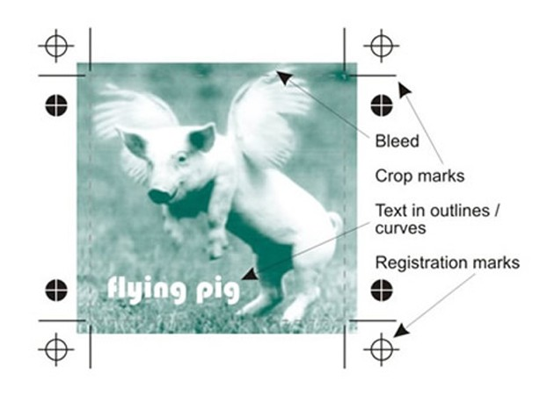
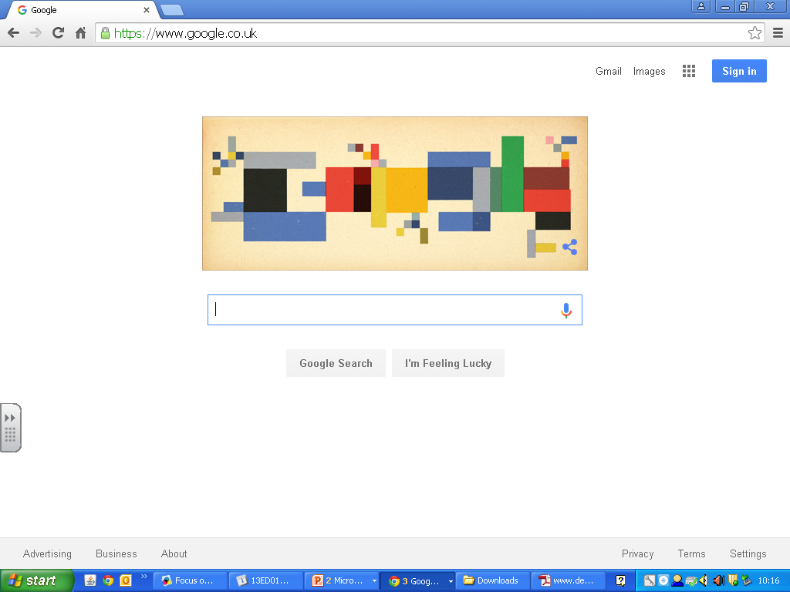
Ways to View Graphics
Hard Copy
On Screen

Slide 3
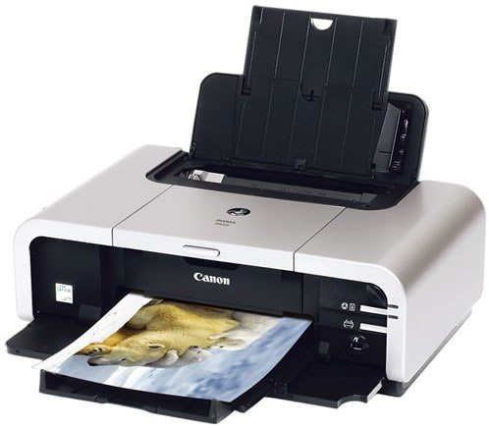
Producing a hardcopy
Inkjet – Most common printer found at home, schools and offices.
Pros and Cons
Inexpensive
Photographic quality
Print on different papers
Quick for short runs
Ink is expensive
Time to dry
Limited paper size

Slide 4
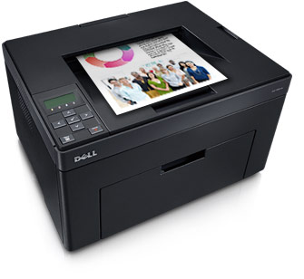
Producing a hardcopy
Colour Laser – work with toner and use a laser to fuse the toner dust to the paper.
Pros and Cons
Fairly Inexpensive
Good quality
but not photographic
Very quick for short
to medium runs
toner is expensive
Parts are expensive
Limited paper size

Slide 5
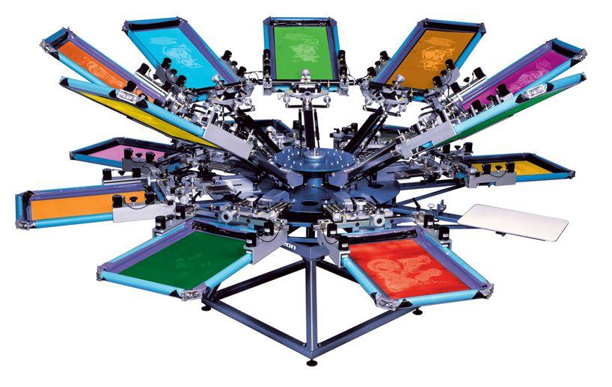
Producing a hardcopy
Screen Printing – Old fashioned but great for making t-shirts, posters or bags.
Pros and Cons
Low cost for mid volume
Bright vibrant colours
Can print on different
materials
Slow and messy
Expensive to set up
Cannot do high resolution
ink drying time

Slide 6
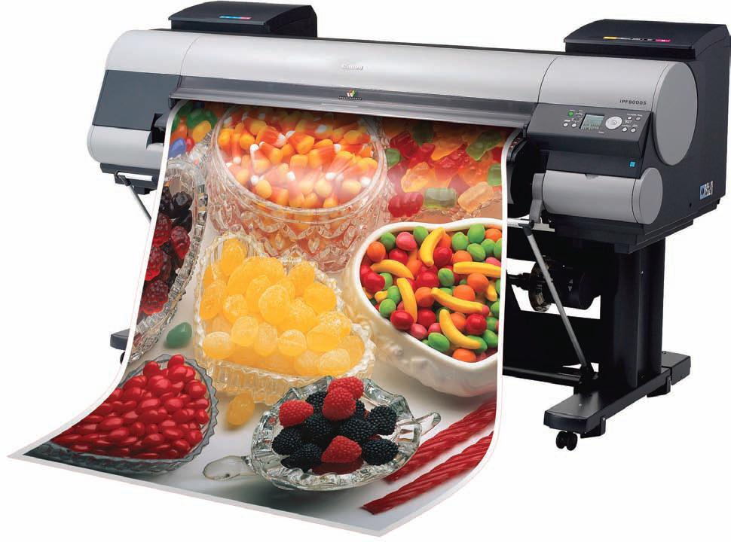
Producing a hardcopy
Wide Format Banner – Used for large banners or vehicles. Similar to an Ink Jet printer.
Pros and Cons
Can print in huge sizes
Photographic quality
Different papers
Quick for short runs of posters
Drying Time
Ink is extremely expensive
Bad for the environment

Slide 7
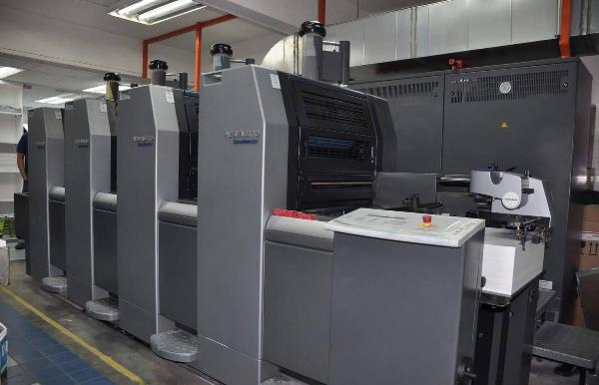
Producing a hardcopy
Offset Lithography– Great for high volume leaflets or brochures.
Pros and Cons
Cost efficient and quick
Photographic quality
Print on different paper sizes
Expensive set up
Time consuming set up
Specialist Training required

Slide 8
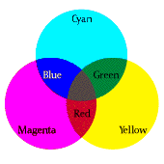
Hardcopies
All hardcopy prints require the page to be set up using CMYK.
C -
M -
Y -
K -
Cyan
Magenta
Yellow
Black Key colour
CMY overlapped in order to produce the other colours. This is called “subtractive colouring.”
When all 3 are overlapped they create a dark colour close to black but not it exactly this is why Black is still required.

Slide 9
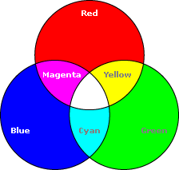
Electronic Displays
Electronic displays use RGB to produce colour.
R -
G -
B -
Red
Green
Blue
Electronic displays are normally made of extremely small LED’s. They are controlled suing an electric current. If all 3 LED’s are on then white is produces. This is called “additive colour.”

Slide 10
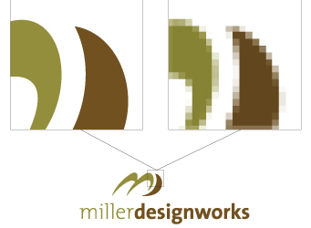
Vector V Bitmap
Vector
Easily Scalable
Good for shapes and curves
Uses maths equations
Small file size
Not good for photographs
Bitmap
High resolution = sharp image
Displays photographs to a high quality.
Large file size
Lose of quality when scaled

