Slide 1
3D CAD
The Tools, The Features, The Uses

Slide 2
Where you need 3D CAD knowledge…
In your Engineering work.
The objects you are required to make have to be created using a variety of different modelling techniques.
In the exam.
You will be given a part of a model and be expected to know what tools and process have been used to create it.

Slide 3
What Industries use CAD?
What do they use 3D CAD for?
What areas of the 3P’s is produced through the use of 3D CAD?

Slide 4
Who Uses 3D CAD?
3D CAD is one of the tools used by an engineer, designer or architect to create a range of work that help to produce material necessary for Manufacturing and Marketing.

Slide 5
What Industries use CAD?
Engineering, Designing, Architecture.
What do they use 3D CAD for?
Producing a 3D version of a model that will allow them to understand an object and help them to produce material for manufacturing and marketing.
What areas of the 3P’s is produced through the use of 3D CAD?
Production
Promotional

Slide 6
3D CAD Modelling Benefits
It is a times-saving process.
It can help us to produce a limitless amount of drawings from only one model.
It is accurate.
There is no human error when marking out.
Edits can be made quickly.
There are no rubber marks or incorrect line types.
Detailing can be done with the use of zoom
Extra features can be used to support you.
Back Up and Storage can keep files safe and secure.
No physical space is required for large drawings and they can be printed out if a hardcopy is required.

Slide 7
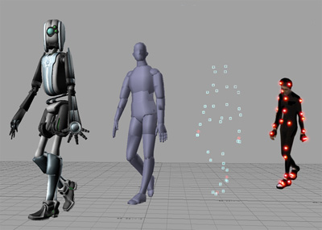
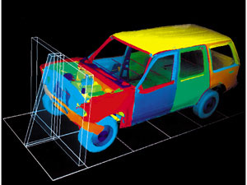
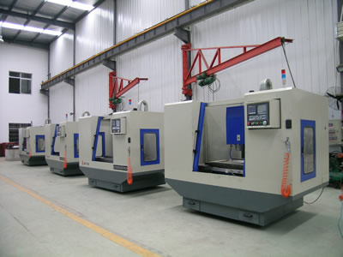
3D CAD Modelling How it is used…
Manufacturing
The software can be used with CNC Machines to produce accurate physical objects.
Testing
Simulation can take place on the computer to put the object through a range of tests such as temperature change, pressure applied.
Animation
Parts of the model can move to give it a more real-life context and provide greater understanding as to how the object works

Slide 8
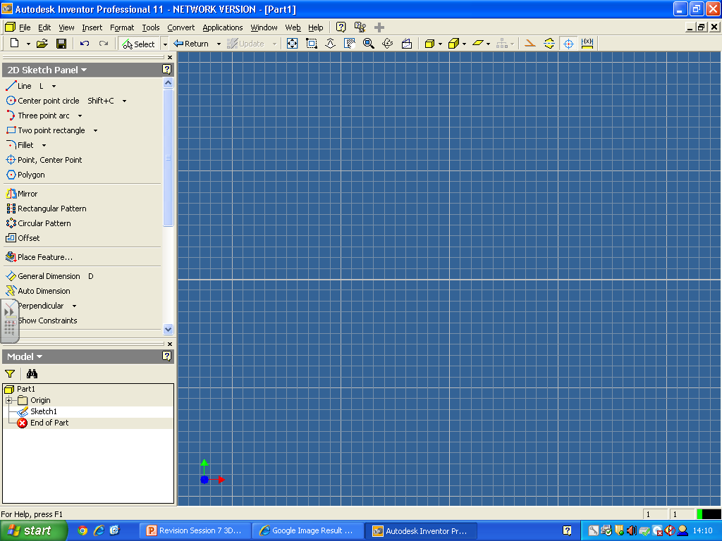
The 3D Modelling we use…
Inventor – Sketch Area

Slide 9
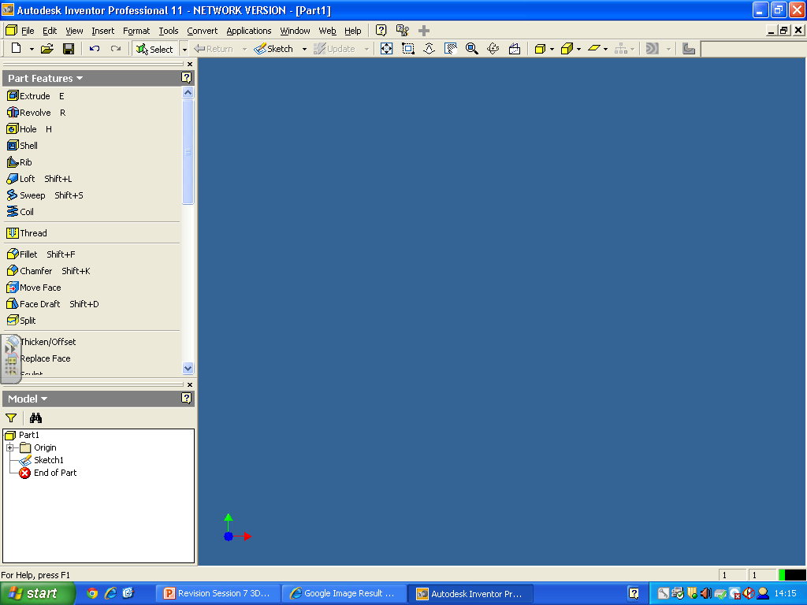
The 3D Modelling we use…
Inventor – Modelling Area

Slide 10
Sketch Panel

Slide 11
Features Panel

Slide 12
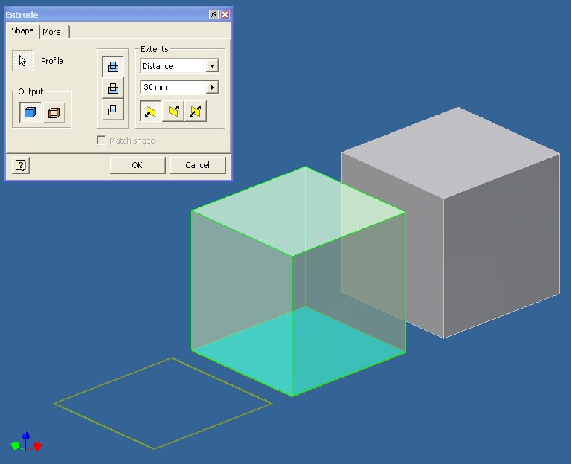
Extrusion
Takes a 2D sketch and pulls it into a 3D form.
Surface Sketch Extrusion goes 2 ways:
Union (ADD)
Subtraction (REMOVE)

Slide 13
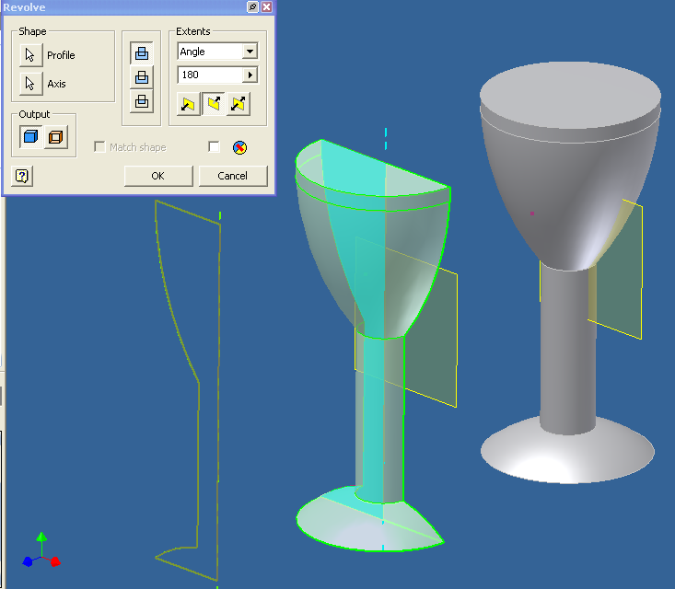
Revolve
Takes a 2D sketch and makes it into a 3D cylindrical shape.
What you need…
A profile
A centre line
An angle of degrees

Slide 14
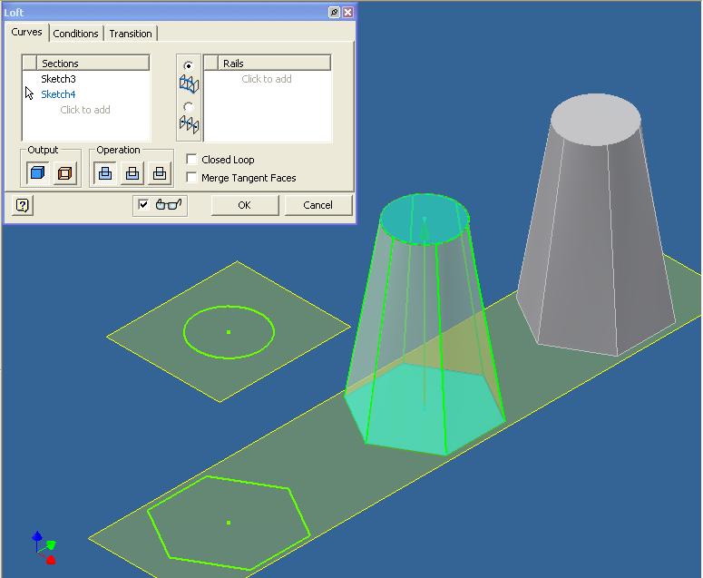
Loft
Takes 2D shapes and morphs them together to create a 3D form.
2 work planes
2 sketches

Slide 15
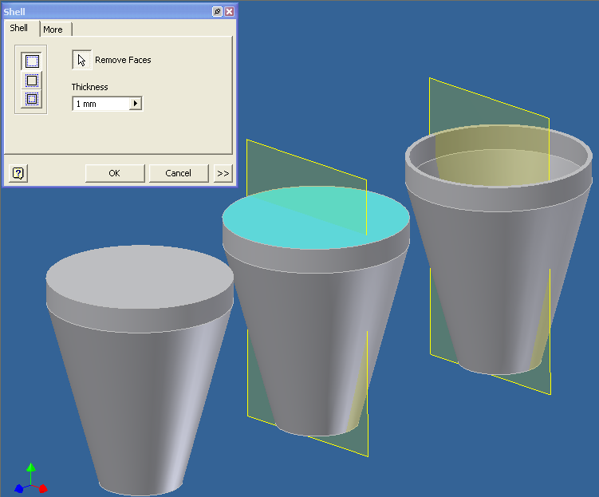
Shell
Takes a 3D form and makes it hollow. Can remove surfaces.
It can make the walls any thickness you require.

Slide 16
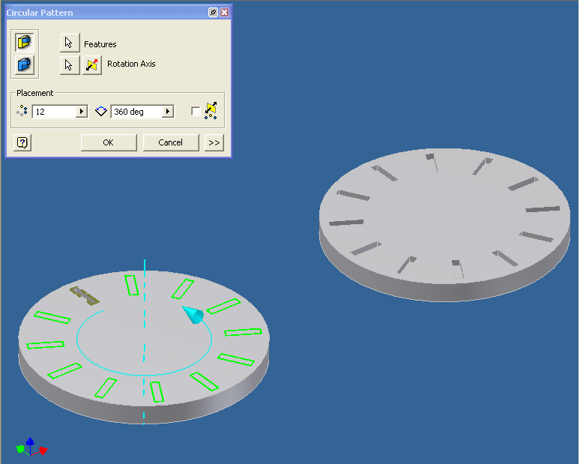
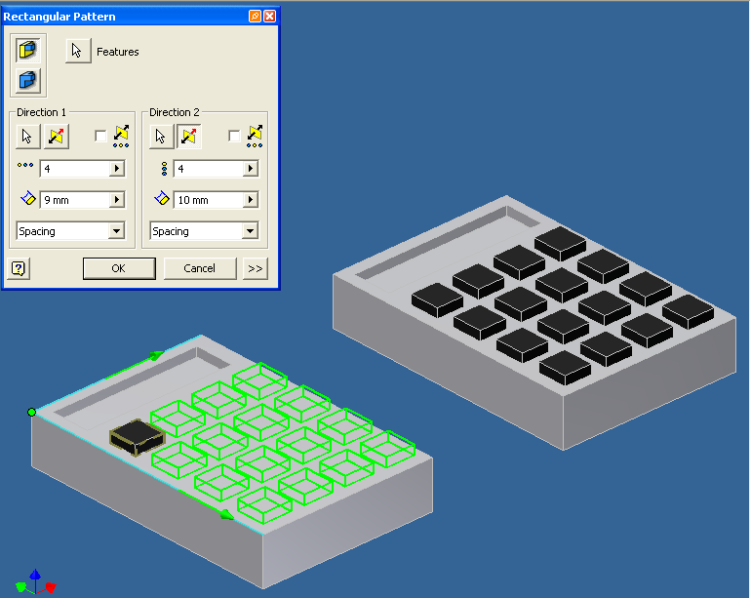
Array
Array makes multiple copies of a feature and then positions them in to possible ways:
Rectangular
Circular
Arrays can be unions or subtractions.

Slide 17
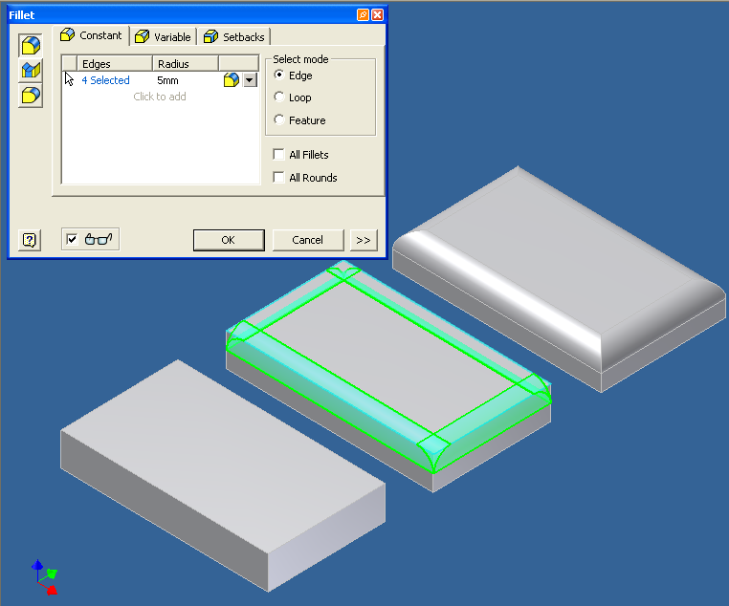
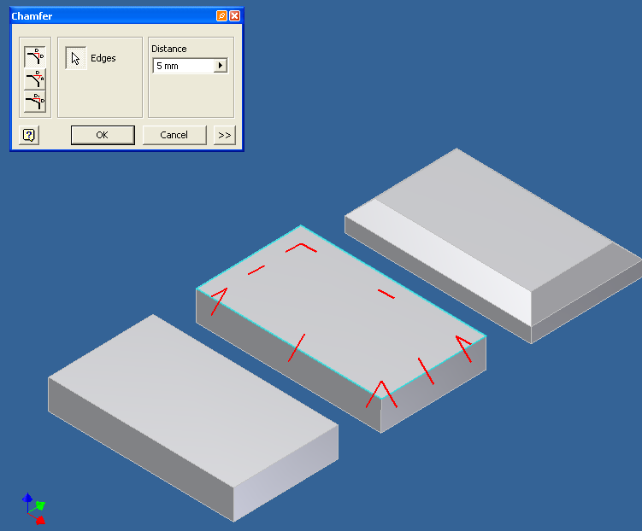
Fillet/Chamfer
Fillet/chamfer change the edge of a feature.
A fillet will round a corner.
A chamfer will angle a corner and is generally at 45˚.

Slide 18
Fillet/Chamfer
How to remember:
A Chicken Fillet is curved.

Slide 19
Exam Question
Explain how to create the following part…

