Slide 1
Design Elements
The Ingredients of Design

Slide 2
What are the Design Elements?
Design Elements are the small ingredients that can make up a page and allow it to be tidied together. These are the building blocks to creating a successful Graphical Layout.

Slide 3
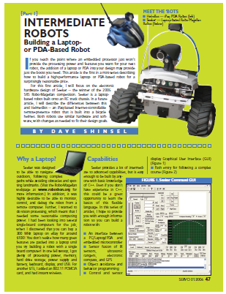
Line
Line is used to divide up the layout or connect various elements.

Slide 4
Shape
Shape is often used to keep the reader interested and can make a page much more dynamic. It can separate the page and allow for various items to stand out.

Slide 5
Texture
Physical Texture, the paper and its quality can portray a message. Visual texture that is revealed through the use of imagery, this can add to creating moods for the reader.

Slide 6
Size
The relationship between items. The larger the item the more dominant it will be on the page stressing its importance to the reader. This refers to text and imagery.

Slide 7
Colour
Colour is used to create moods and stimulate emotions. Colours that harmonise will help create a unified page where as contrasting colours will separate the page and create drama.

Slide 8
Mass
Mass refers to the amount of surface area an element takes up. The amount of mass used can reflect the mood or tone you want to convey.
i.e Thin lines convey class and elegance whereas a large heavy block of colour can represent fun.

Slide 9
Text
Not an element but equally as important.
Text is used in a variety of publications, and the different uses need different typographic treatments.

Slide 10
Text
Not an element but equally as important.
Text is used in a variety of publications, and the different uses need different typographic treatments.
Headings:
Sub Headings:
Captions:
Headers/Footers:
Pull-Quotes:

Slide 11
Font Types
Serif Sans Serif
T
T
Serif refers to the little flick added to a letter. This style of font is very formal and classic. It creates an official and serious tone.
Sans Serif fonts do not have the little flick. This style is more modern. It creates a relaxed tone.

Slide 12
Exam Question
On the following page identify where the following Design Elements have been used?
Line
Shape
Size
Colour

Slide 13
Exam Question

