Slide 1
Sections, Assemblies & Exploded
What are they used for?
What do they look like?

Slide 2
Sections
Sections are used to show internal details of an object. The can show how a product fits together which may me difficult to see from hidden detail.
Sectional drawings are generally found in instruction manuals and in workshops.

Slide 3
Sections
What is needed to create sectional drawing?
A Cutting Plane
Direction of the cut
A
A

Slide 4
How to identify a sectioned area
Hatching lines.
Lines at 45˚ approx 5mm apart
Hatching lines allow us to know where the object has been cut. They can highlight and internal holes.
What not to hatch:
Webs
Nuts, Bolts, screws
Washers
Shafts, axles

Slide 5
Assemblies
Assemblies are created when a drawings involves more than 1 part (component).
It reveals what the final object will look like when all the parts are placed together.
The abbreviation used in drawings for Assembly is ASSY.
Sections can be used in Assemblies to help gain understanding.

Slide 6
Exploded
An exploded drawing reveals all of the parts separated.
It lines of each part and reveals where it would fit into.
They are often used in instruction manuals when products need to be assembled at home.

Slide 7
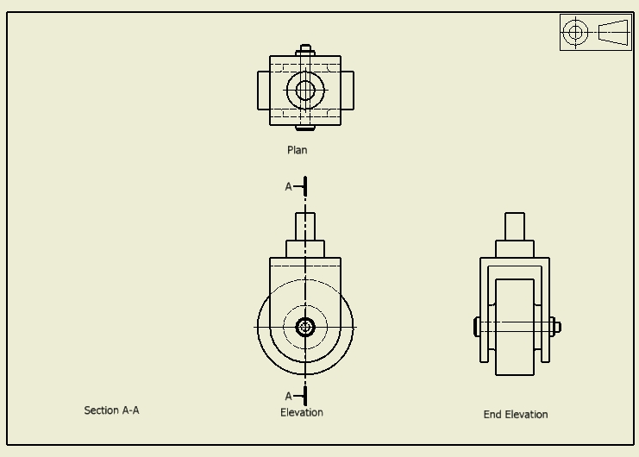
Exam Question

Slide 8
Identify which sectional view is section A-A
A
B
C

Slide 9
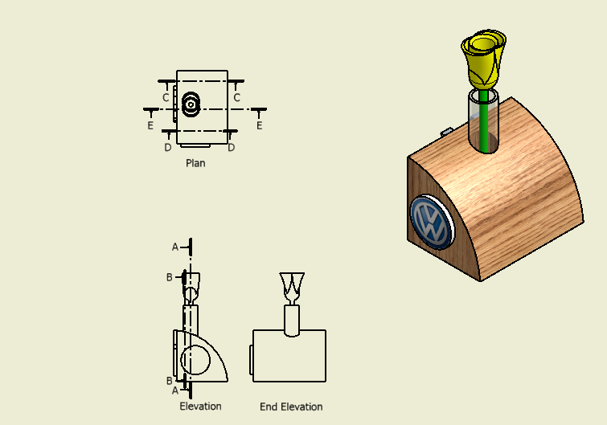
State which letter reveals the sectional view.
A
B
C
D
E
A-A___________ . B-B_________ . C-C___________. D-D_________. E-E__________

