Slide 1
Computer Aided Design/Modelling
Manual/Electronic Methods

Slide 2
Methods
There are currently two methods to produce graphics:
Manual
( Creating Graphics by hand)
Electronic/Digital
(Creating graphics using a computer)
Exam Knowledge requires you to be able to discuss the benefits of both and be able to argue for one rather than the other.

Slide 3
Manual - Advantages
What do you think are the benefits of drawing your work by hand?
Don’t have to use expensive equipment
Work will not get hacked.
No risk of a virus.
Freehand sketches are very quick to do by hand. Immediate way of producing and recording an idea.
If in front of a client you can do the work right there and then to convey ideas.
DTP preliminary and production work is much better when planned out.

Slide 4
Manual - Disadvantages
What do you think are the problems of drawing your work by hand?
Each element is drawn separately then cut out and layered up.
Modifying and fixing mistakes can often mean redo-ing a whole drawing.
Difficult to store the range of equipment.
Have to post them or scan them or take a photo.
Timing issues.
Accuracy can vary depending on the drawer/designer.
Environmental concerns over the amount of paper.
CNC control would be out of the option

Slide 5
Electronic - Advantages
What do you think the benefits of creating your work electronically are?
The correct drawings standards can always be achieved.
A CAD library can be used for commonly used parts.
CAD drawings can be modified easily, saving money and time.
Accuracy and Speed is improved because of the snap tool and the ability to zoom.
You change scales and the orientation very quickly.
You can transfer your files and then use CNC (Computer Numeric Control)
machines.
CAD files can be e-mailed to customers and colleagues for approval.
CAD Animations, Testing, Simulation
As you store on computer you can use less paper.

Slide 6
Electronic - Disadvantages
What do you think the problems of creating your work electronically are?
Initial investments are expensive for equipment and software.
Training is required with new software and new software updates.
Computers are often hacked and a target for industrial theft.
Virus can cause a loss of data.
Companies may need to do updates limiting timing.
A power cut could shutdown the system as you are working.
You must remember to make back ups.

Slide 7
Industry and the Environment
How can design companies be more environmentally friendly?
E-MAIL
Only print final copies.
Double sided printing.
Don’t write a memo on A4 use A6?
Don’t print magazines, leaflets, flyers on A3/A4, switch to a smaller size.

Slide 8
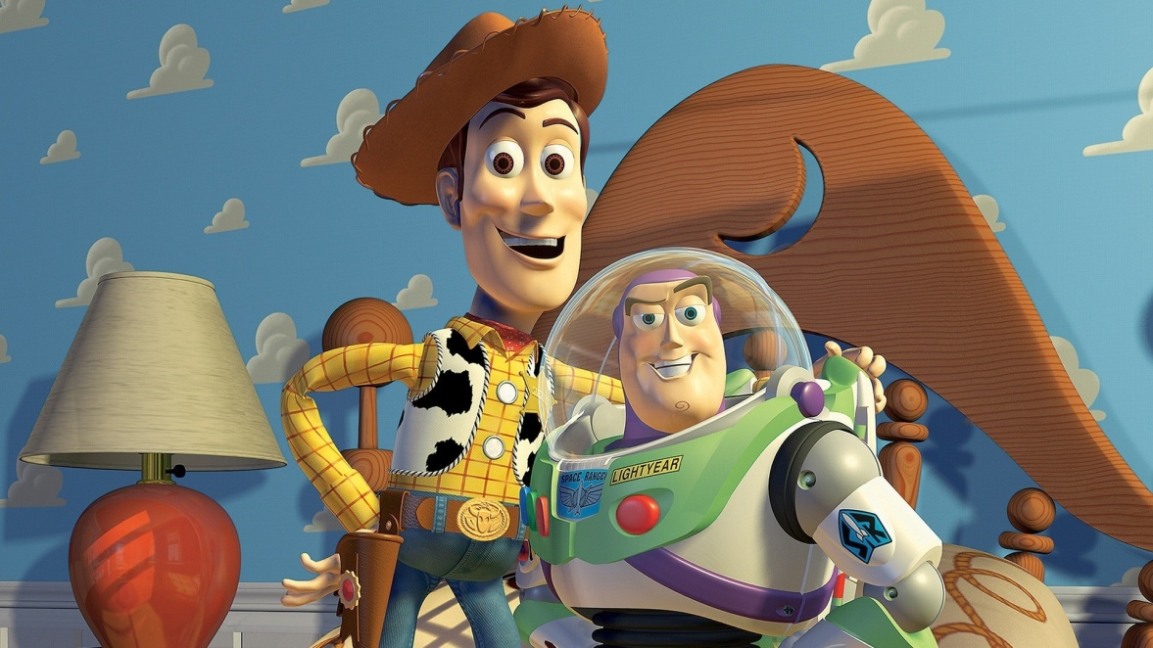
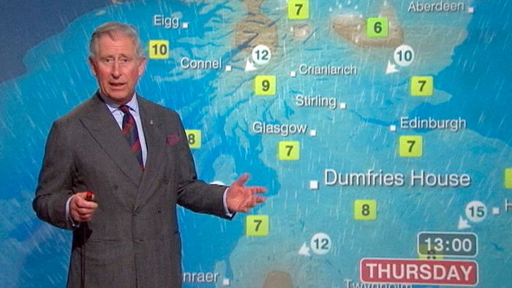
CAD- Animation
Where do you see animation being used?
Predicting
Films
Cartoon
Animations are 3D computer graphics that provide us with information, entertainment, education. They are not something that we can interact with.

Slide 9
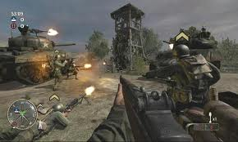
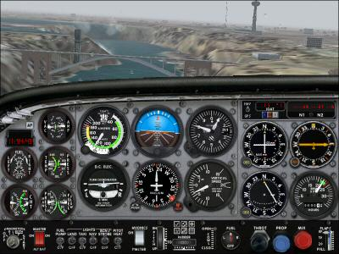
CAD - Simulation
Where do you see animation being used?
Training
Flight
Driving
Gaming
Simulations allow the user to have control. You are put in to a situation and have to interact with the computer to alter outcome. It is extremely beneficial for reducing training cost, being safe, providing accurate feedback.

Slide 10
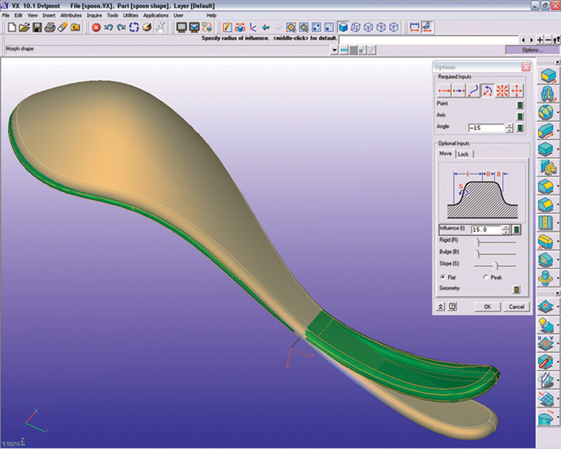
CAD - Testing
Cad Testing on products reduces production costs for the manufacturer and designer.
Apply stress
Alter thickness
Show flexibility.
Wind tunnel
Aerodynamic properties
After the computer calculates that results of the experiments it will output the results through an animation.

Slide 11
Exam Question
A company that designs conservatories has just changed from Manual to Electronic production methods for their production and promotional drawings.
Identify 3 advantages of using electronic methods.
Identify 3 disadvantages of using electronic methods.

Slide 12
Exam Question
State 3 ways in which a Graphic Design office can improve their use of paper and become more environmentally friendly.

