Slide 1
Higher Graphic Communication
Revision Session 2 - Engineering

Slide 2
What you needs to know about Engineering
The type of sketches and drawings that are involved in the Design Process for Engineering work. This includes understanding and applying British Standards 8888. protocols and conventions for each drawing.
Write down as many detailed views that should be included within Production drawings of Engineering Drawings.

Slide 3
Detailed Views within Engineering Production Drawings

Slide 4
Detailed Views within Engineering Production Drawings
True Lengths
True Shapes
Tangency Radii
Surface Development
Sectional Views – Full, Part, Stepped, Removed, Revolved
Assembly Drawings
Auxiliary Views
Exploded Views – Full, Sectional
Pictorials

Slide 5
Engineering – Types of Pictorial
3D drawings that show us an object in the different planes; the x, y and z axis and allows us to see information relating to the Length, Width and Height of an object.
Name as many pictorial drawings as you can.

Slide 6
Engineering – Types of Pictorial
3D drawings that show us an object in the different planes; the x, y and z axis and allows us to see information relating to the Length, Width and Height of an object.
Isometric - Objects
1pt and 2pt perspective - Scenes
Oblique - Objects
Planometric - Interiors
Sketch each of these out and identify angles of significant points.

Slide 7
Engineering – Types of Pictorial
B
A
C
E
E
E
D

Slide 8
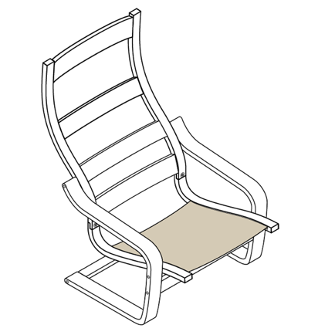
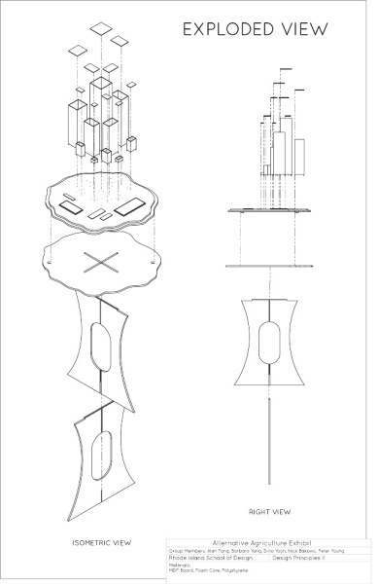
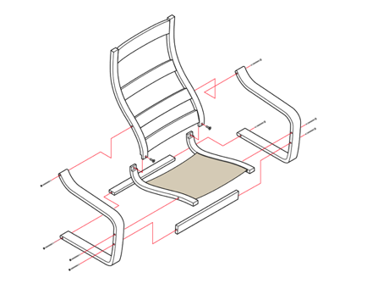
Engineering – Assembled and Exploded Views
These can be Orthographic or Pictorial and they have one purpose.
Assembled:
Exploded:

Slide 9
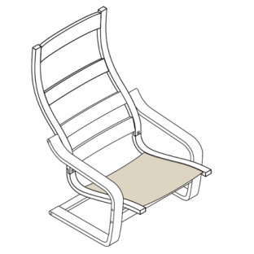
Engineering – Assembled and Exploded Views
These can be orthographic or Pictorial and they both have one purpose.
Assembled: To show what an object looks
like from a variety of different views both 2D
and 3D.
Exploded: To show how an object fits
together in a variety of different ways both
2D and 3D.

Slide 10
Engineering – True Shapes, Lengths, Auxiliary Views
All have one thing in Common…
90° Projection
True Shape True Length Auxiliary Views
Sketch out examples of the above.

Slide 11
Engineering – True Shapes, Lengths, Auxiliary Views
All have one thing in Common…
90° Projection
True Shape True Length Auxiliary Views

Slide 12
Engineering – Surface Development
Understanding how an object looks when laid out flat and determining where generators should be placed and how to use them correctly to produce a Surface Development.
Sketch Out the Surface Development for the given shapes.
Elevation
Elevation

Slide 13
Engineering – Surface Development
Understanding how an object looks when laid out flat and determining where generators should be placed and how to use them correctly to produce a Surface Development.

Slide 14
Engineering – Surface Development
Understanding how an object looks when laid out flat and determining where generators should be placed and how to use them correctly to produce a Surface Development.

Slide 15
Engineering – Sectional Views
To provide details of internal shapes and cuts to provide a greater understanding of the objects shape and form.
State the type of section provided by the given cutting planes.
Full Section
Part Section
Step Section

Slide 16
Engineering – Sectional Views
To provide details of internal shapes and cuts to provide a greater understanding of the objects shape and form.
State the type of section provided by the given cutting planes.
Removed Section
Revolved Section

Slide 17
Engineering – Sectional Views
Full Section – Shows all internal detail that would not have previously been visible.
Half Section - Shows internal detail particularly useful for symmetrical objects.
Stepped Section – Shows internal detail on more than one plane.
Removed – Used to give an understanding of shape. Is not in line with the object and can have it’s scale altered and generally dimensions are provided.
Revolved – Used to give an understanding of the shape and remains within the view.

