Slide 1
National Design and Manufacture
Session 1

Slide 2
Metal Types
Ferrous-
Contains Iron
Magnetic
Rusts
Non Ferrous-
Does not contain iron
Not magnetic
Does not rust

Slide 3
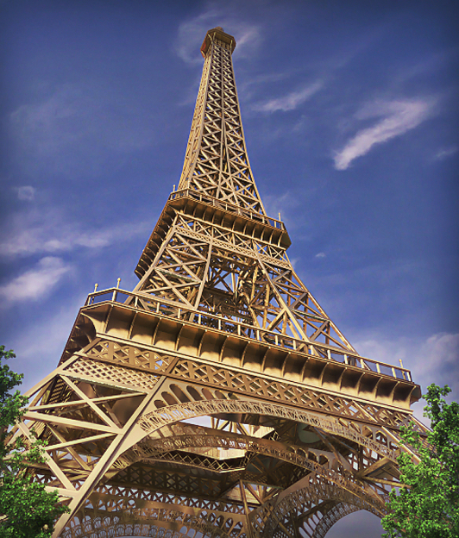
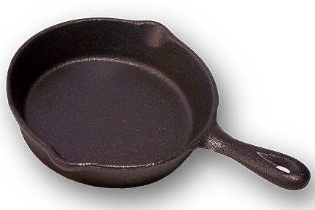
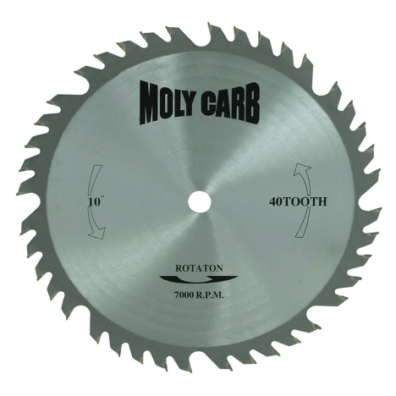
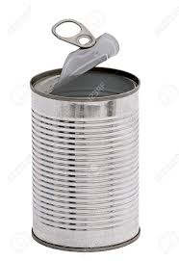
Ferrous
Cast Iron
Tin
High Carbon Steel
Mild Steel
Man Hole Covers, cooking pots
Tin Cans
Cutting tools
Structures, Bridges (eg Eiffel Tower/Forth Rail Bridge)

Slide 4
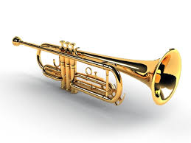
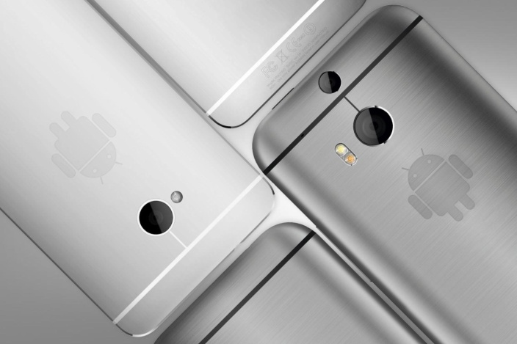
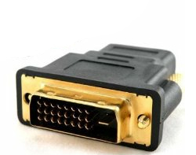
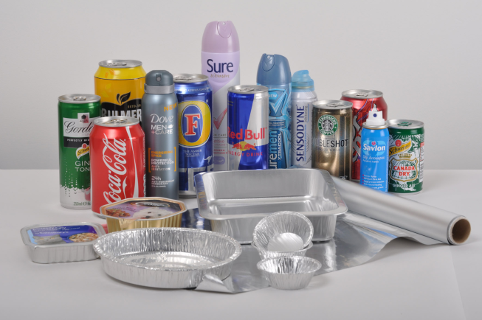
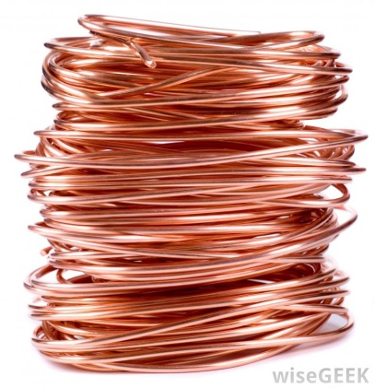
Non Ferrous
Drinks cans, Car bodies, bike frames
Instruments
Coins, wires
Jewellery, medals, electronics
Jewellery, electronics
Aluminium
Brass
Copper
Gold
Silver

Slide 5
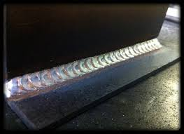
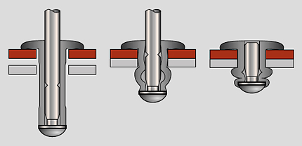
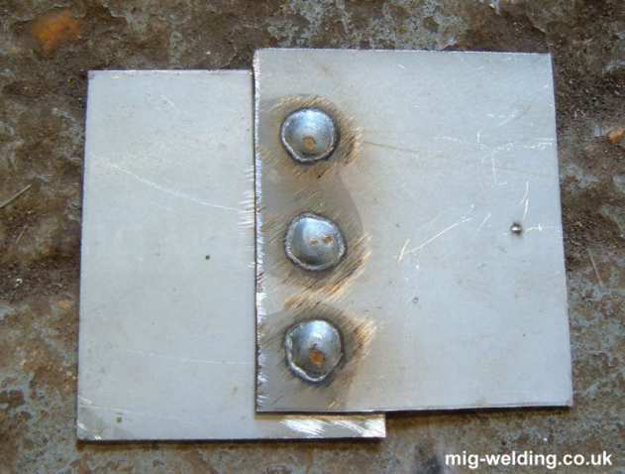
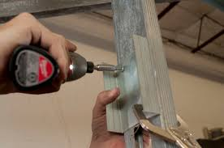
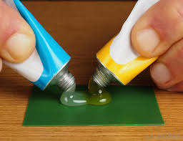
Metal Joining Methods

Slide 6
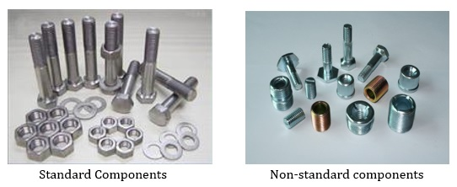
Standard Components

Slide 7
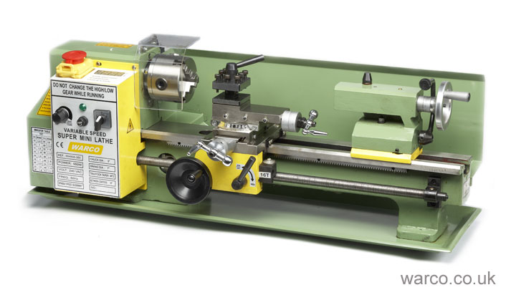
Metal Lathe

Slide 8
Plastics Types
Thermo Plastics
Thermosetting plastics

Slide 9
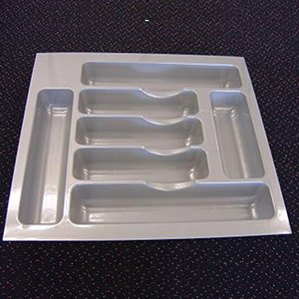
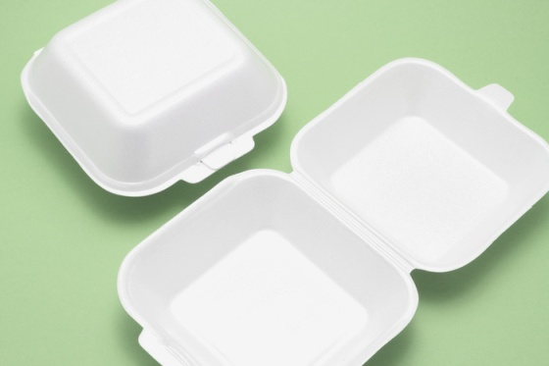
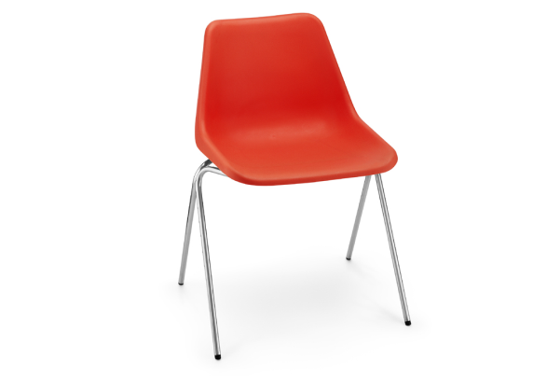
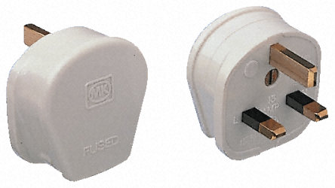
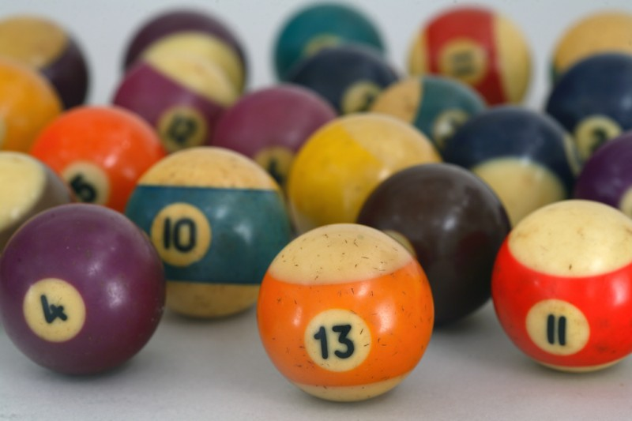
Names of Plastics
Thermo Plastics
ABS
HIPS
Acrylic
Polypropylene
Polyethane
Polystyrene
Thermosetting Plastics
Urea Formaldehyde
Bakelite
Melamine Formaldehyde

Slide 10
Plastic Processes
Using an oven
Strip Heater/Line Bending
Injection Moulding
Vacuum Forming
Rotational Moulding
Blow Moulding
Rapid Prototyping

