Slide 1
Des Man 1

Slide 2
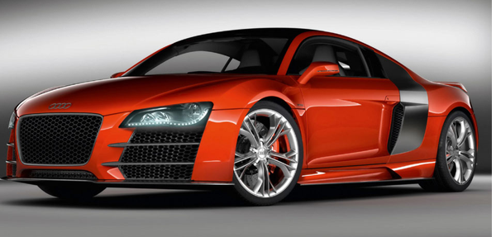
Question 1
In an advert, a car manufacturer describes their new sports car as “aesthetically pleasing”.
List four aesthetic factors which could affect thesales of a sports car.

Slide 3
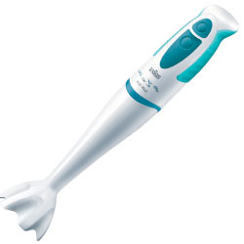
Question 2
A hand held food blender for use in the kitchen is shown below. The designer would have to consider three areas of ergonomics.
a) State two aspects of physiology which would have been considered. 2 marks
b) State two pieces of anthropometric data which would have been required 2 marks
c) State two aspects of psychology which would have been considered 2 marks

Slide 4
Question 3
. The ability to generate ideas is an important aspect of a designer’s work.
(a) State two idea generation techniques. (2)
(b) Describe one of these techniques. (3)

Slide 5
Question 4
For each type of model shown, state:
the stage in the design process when it would be used; (4)
and
(b) the advantages to be gained by modelling at that stage (4)

Slide 6
A Sketch model from card
B Block model made from styrofoam
C Rapid prototype
D CAD model

Slide 7
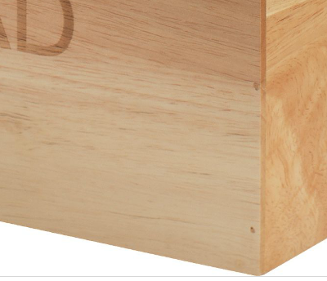
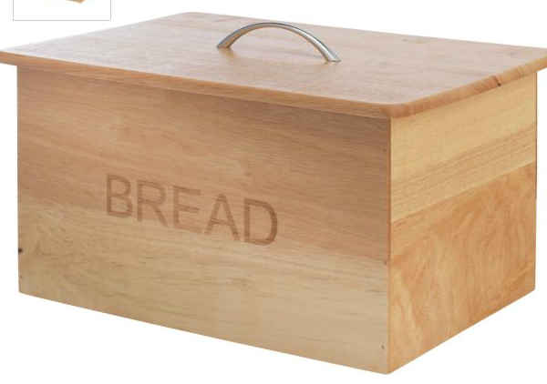
Question 5
The Kitchen bread bin shown below is mainly constructed from timber. A butt joint has been used at corner A
(a) St ate the name of another suitable joint that could be used at A.
Describe the stages of manufacture for your chosen joint at A.
(b) State why melamine faced MDF is a suitable material for the base of the bread bin.
(c) State why aluminium is a suitable material for the handle on the lid
(d) State the name of a suitable finish that could be applied to the bread bin.
State the name of a power tool which could have been used to produce
the rounded edges of the lid.
5
1
1
1
1
(9)
Corner A

