Slide 1
Mechanisms
Revision

Slide 2
Learning Intentions
To develop understanding of motions, forces and gear systems
To state the four motions
To state the seven forces
To state the gear ratio
To demonstrate how to use the gear ratio
Success Criteria

Slide 3
Types Of Motion
Rotary- Turning in a circle
Linear- Movement in a straight line
Reciprocating- Backwards and Forwards movement in a straight line
Oscillating- Swinging Backwards and forwards in an arc

Slide 4
Forces
Static
Dynamic
Bending
Tension
Compression
Shear
Torsion

Slide 5
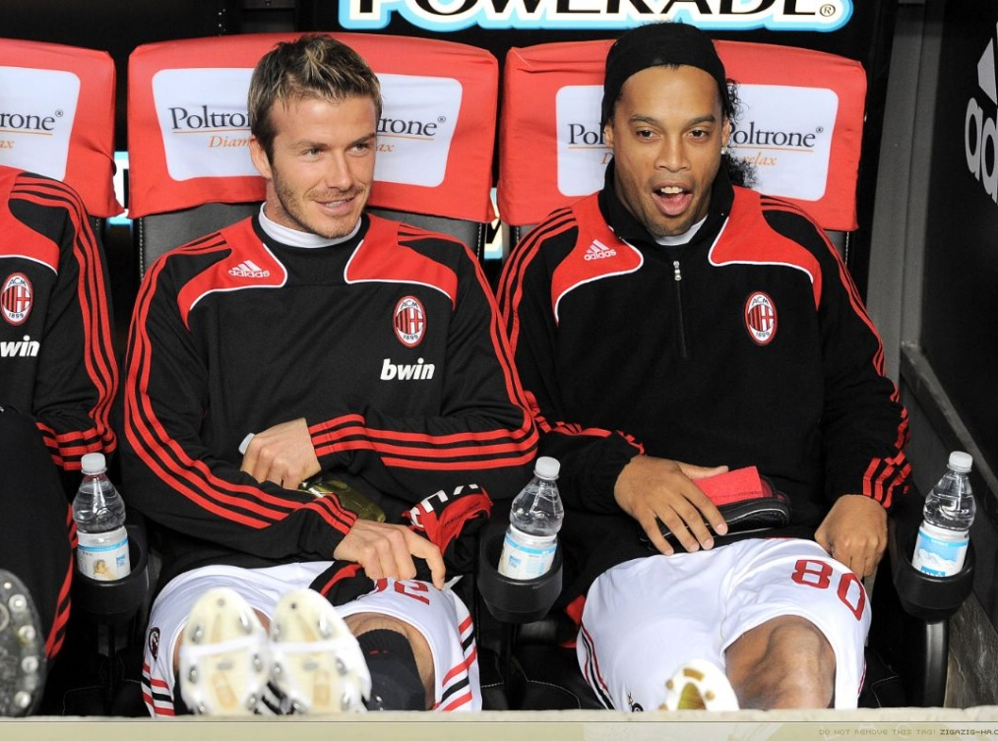
Forces
STATIC
DYNAMIC

Slide 6
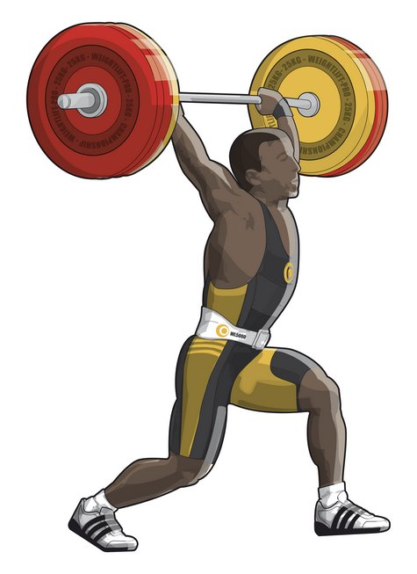
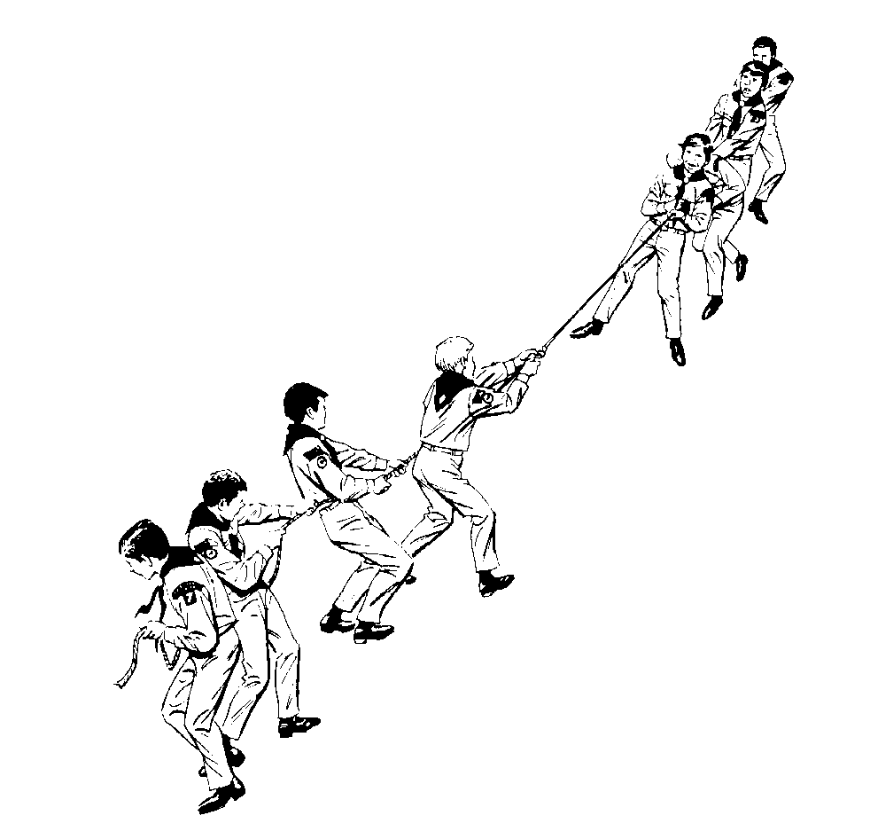
Forces
COMPRESSION
TENSION

Slide 7
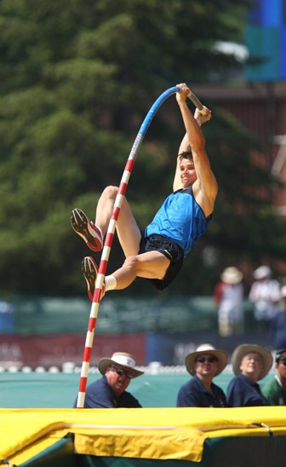
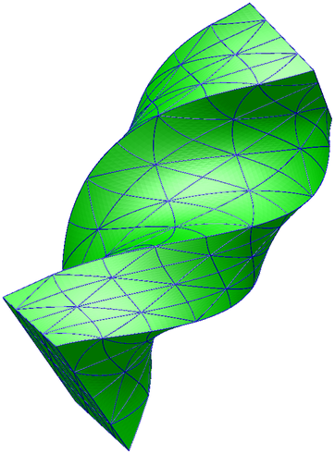
Forces
BENDING
SHEAR
TORSION

Slide 8
Write down an example of something that uses two motions
Rotary- Turning in a circle
Linear- Movement in a straight line
Reciprocating- Backwards and Forwards movement in a straight line
Oscillating- Swinging Backwards and forwards in an arc

Slide 9
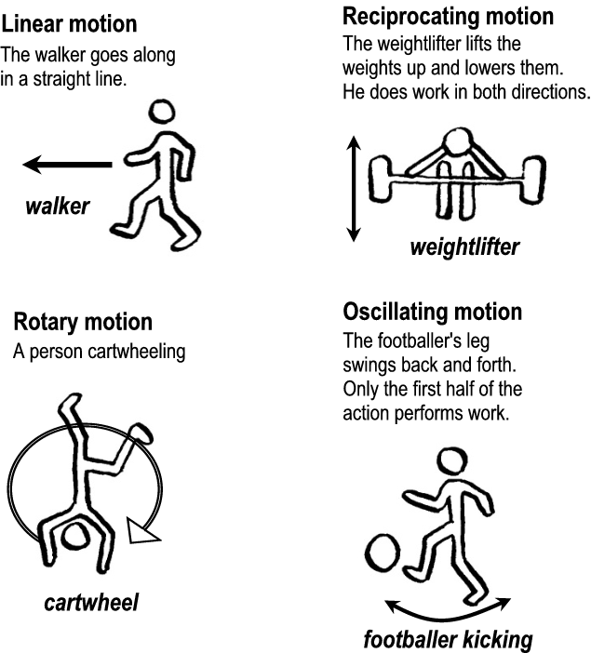

Slide 10
Gear Ratio
Gear ratio =
number or teeth on driven gear
number of teeth on the driver gear
Or
Driven
Driver

Slide 11
Complete the Gear Ratios in the simplest form
Number of teeth on Driven Gear | Number of Teeth on Driver Gear | Gear Ratio
80 | 60
80 | 10
40 | 80
20 | 60
60 | 20
20 | 40
Driven
Driver

Slide 12
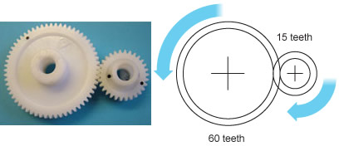
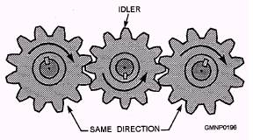
Gear Trains
Gears in a row are called Gear Trains

Slide 13
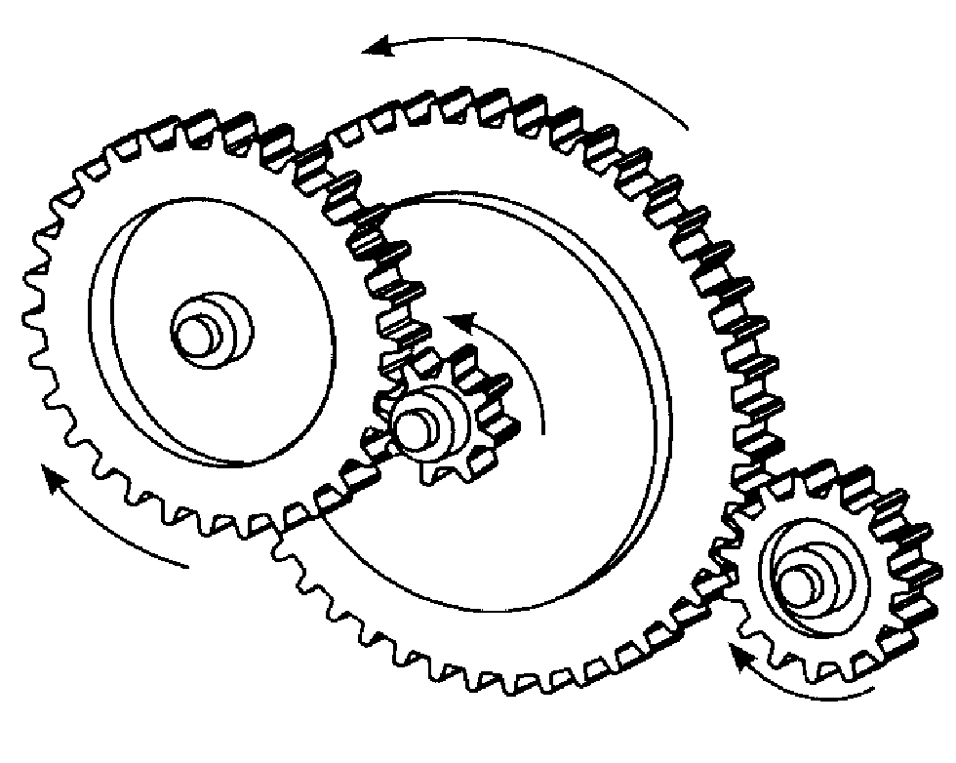
Compound Gear Trains
If a gear has two gears on it linking to another gear then its called a compound gear

Slide 15
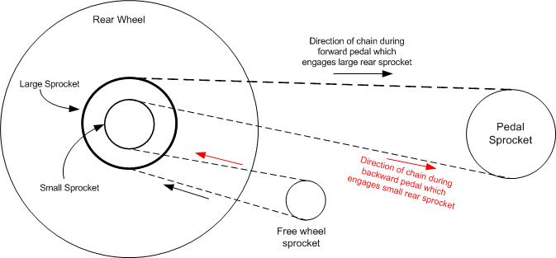
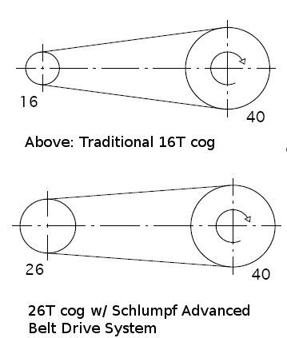
Belt and Chain Drives

Slide 16
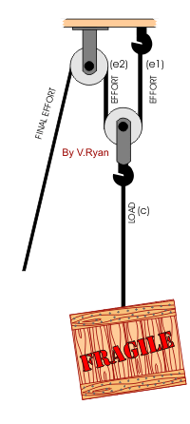
Pulley

