Slide 1
Design and Manufacture Revision
Marketing Techniques and Manufacturing Processes

Slide 2
Marketing Methods
Technology Push
Technology push is when products are re-designed because of changes in materials or manufacturing methods. This might mean that new materials have become available, with improved properties; or that improvements in manufacturing processes mean a manufacturer can make the product cheaper or more efficiently, which reduces manufacturing costs.
Technology/Market Pull
Market pull is when product ideas are produced in response to market forces. Examples of market influences include:
A demand from consumers for new or improved products.
A competing product is launched by another manufacturer. (Xbox v PlayStation)
A manufacturer wants to increase their share of the market.

Slide 3
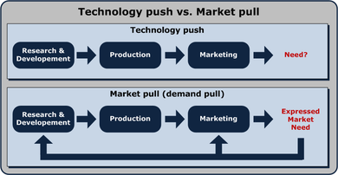

Slide 4
Some examples of Marketing Techniques
Planned Obsolescence
Mobile Marketing
Product Placement- http://www.bbc.co.uk/news/entertainment-arts-34727307
Viral Marketing
Mass Marketing, Brand Names
Seasonal Marketing

