Slide 1
Marketing
The Marketing Mix

Slide 2
Marketing Techniques
Planned Obsolescence
Mobile Marketing
Product Placement
Viral Marketing
Mass Marketing, Brand Names
Seasonal Marketing
Celebrity Endorsement

Slide 3
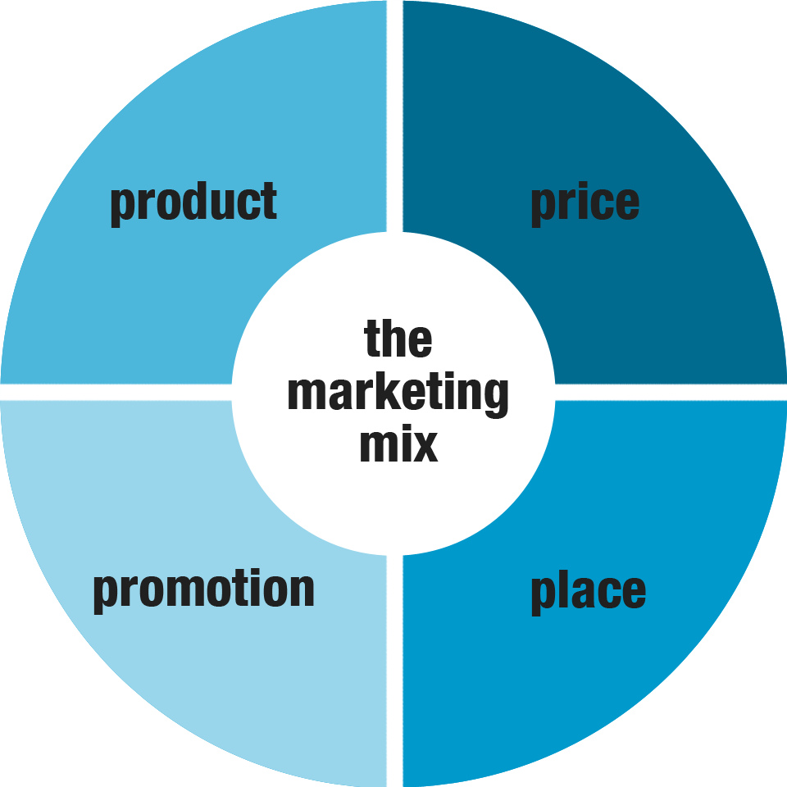
http://marketingmix.co.uk/

Slide 4
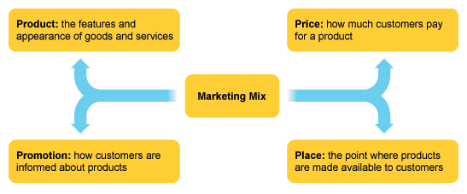
No one element of the marketing mix is more important than another – each element ideally supports the others. Firms modify each element in the marketing mix to establish an overall brand image and unique selling point that makes their products stand out from the competition

Slide 6
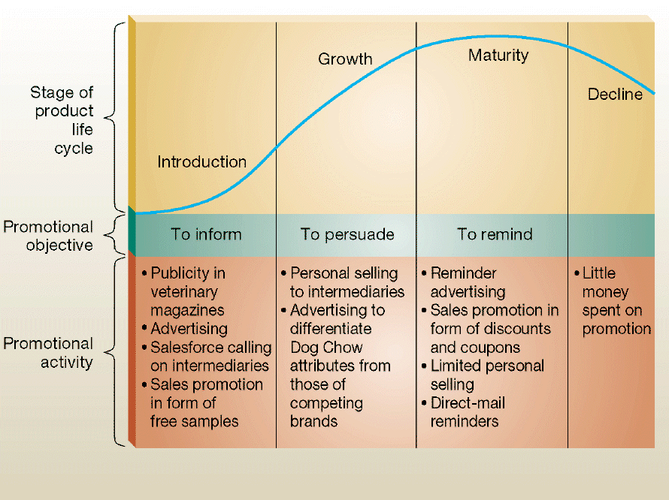
Product Life Cycle

Slide 7
