Slide 1
The Lego Man
Basic 3D Modelling

Slide 2
The Head
Use the Revolve Tool to get the sketch from 2D to 3D.

Slide 3
The Head
Sketch on the Highest surface and draw a circle of diameter 3.5.
Extrude and Cut the circle to a depth of 8mm

Slide 4
The Head
Repeat the process on the bottom surface.
Right Click and Finish the Edit and Save.

Slide 5
The Body
Look at the bottom of the Head and use project geometry to get the exact shape and location of the smallest circle.

Slide 6
The Body
Extrude the circle 7mm but ensure it is going in both directions.
Create a new sketch on the bottom surface

Slide 7
The Body
Draw a rectangle and apply the sizes shown.
Finish the sketch.

Slide 8
The Body
Select the Work Plane tool and then select the XY Plane in the Model Tool Box.

Slide 9
The Body
Click hold and drag the Blue XY plane out a reasonable distance and let go.
Now type
24 into the
Box and
Click okay.

Slide 10
The Body
Select the Blue Work plane and sketch on to it.
Look at it, Project the geometry of the
small circle, draw
a rectangle around
it and apply the dimensions shown
to the rectangle.

Slide 11
The Body
Using the Loft Tool merge the small rectangle to the large rectangle.
You may have to click on add sketch as you move from rectangle to rectangle.

Slide 12
The Body
Make the form hollow by using the Shell tool and giving it a thickness of 2mm.
It will look like nothing has happened after you press okay.

Slide 13
The Body
Sketch on to the side of the body and draw a circle Ø4 applying the dimensions shown.

Slide 14
The Body
Extrude the circle 2mm and select Cut.
You should now be able to see the hollowed out body that the Shell created earlier.

Slide 15
The Body
Rotate the model around and do the same at the opposite side.

Slide 16
The Body
Sketch on the base of the body.
Draw 2 circles Ø4 and apply the dimensions shown.
It’s worth noting that you can turn off the visibility of the yellow work plane by right clicking on it and clicking on visibility.

Slide 17
The Body
Extrude and Cut and the circles 2mm.

Slide 18
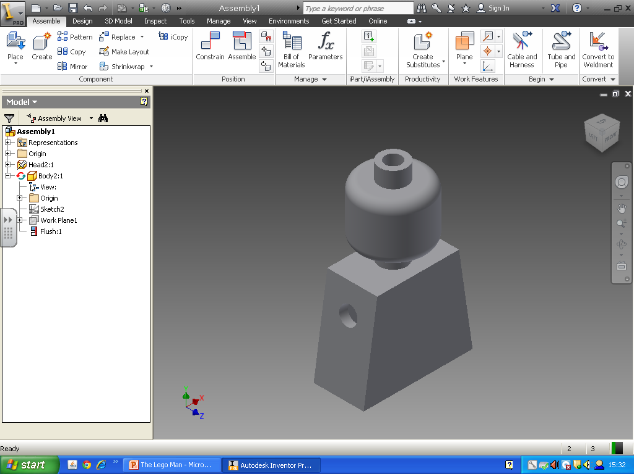
The Body
Finish the Edit
and Save.

Slide 19
The Hips
Look at the base of the body and project through the circular holes.
Extrude these up into the body by 5mm.

Slide 20
The Hips
Sketch on to the bottom of one of the cylinders you have just created.
Project through the shape of rectangle and Extrude it 2.5mm.
Remember to select
the circles also.

Slide 21
The Hips
Select work plane and select the side of the hips as shown.
Click drag and drop the work plane roughly in the middle of the hips and then type -12mm into the box.

Slide 22
The Hips
Sketch on to this work plane.
Look at the side at the plane and project through the rectangular shape of hip and draw a circle to the side in the sketch area.

Slide 23
The Hips
Apply the dimensions shown to the circle.

Slide 24
The Hips
Using the trim tool remove the top of the circle that intersects with the part of the hips you have already modelled.

Slide 25
The Hips
Extrude the remaining shape by 3mmensure it goes in both directions.

Slide 26
The Hips
Sketch on to the side of circular shape.
Draw a circle Ø2.5 selecting the centre of the circular shape as the centre of this circle too.
.

Slide 27
The Hips
Extrude the circle by 5mm.

Slide 28
The Hips
Select Mirror from the menu and select the cylinder you have just created as the feature.
Then select Mirror Plane in box and then select the yellow work plane.
Then select okay and a cylinder will be placed at the opposite side too.

Slide 29
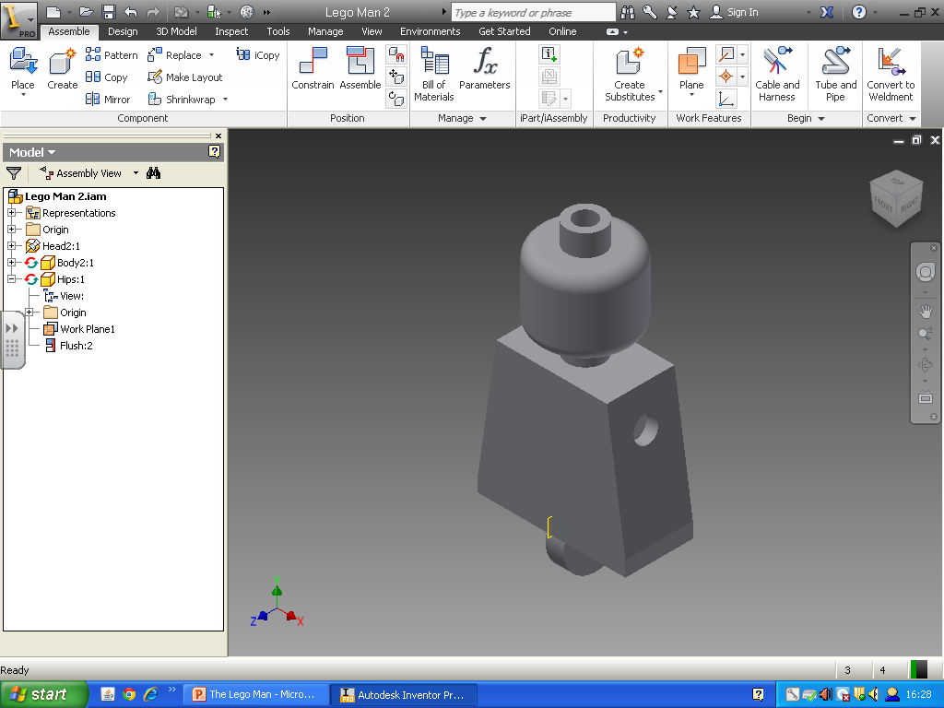
The Hips
Finish the Edit
and Save.

Slide 30
The Leg
Project through the geometry of the hips.
Draw the lines shown below and apply the dimensions shown.

Slide 31
The Leg
Complete the profile by drawing an arc that joins the straight of the leg to the straight of the hip.
Apply a radius of 6.5mm.

Slide 32
The Leg
Extrude the leg 10.5mm.

Slide 33
The Leg
Rotate the view round so you can see the other side of the leg and sketch on to this area.
Project through the small circle of the hip.

Slide 34
The Leg
Extrude the circle in 5mm to cut out a space for the hip to fit into.
Finish the Edit.

Slide 35
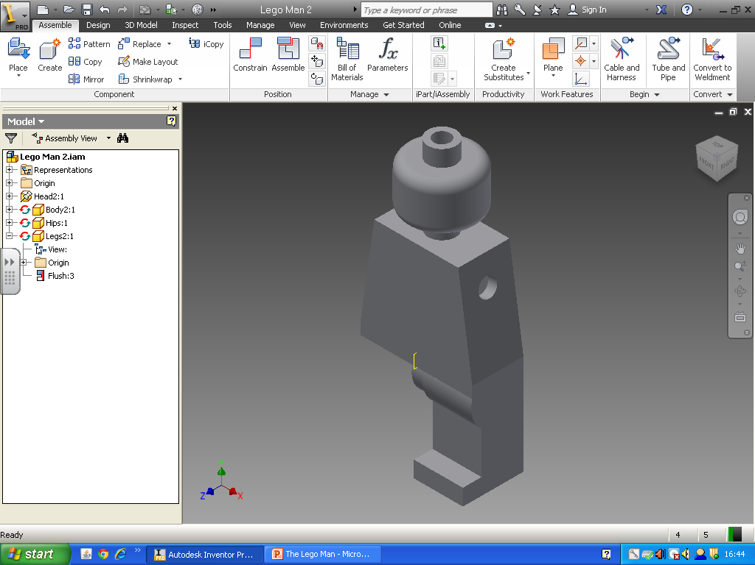
The Leg
Now we will mirror the leg to make the right leg.

Slide 36
The Legs
Select Mirror Component, Select the Leg. It will turn blue.
Select Mirror Plane and select the Yellow work plane in the Hips.
Select Next and
the Select Okay.

Slide 37
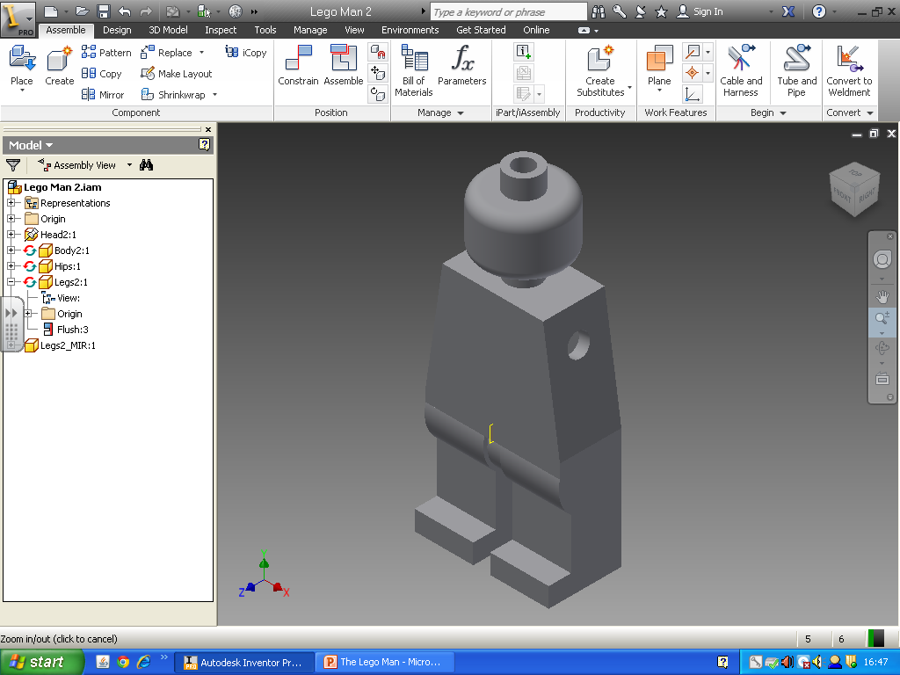
The Legs
Finish the Edit
and Save.

Slide 38
The Arm
Project through the Geometry of the circle.
Extrude the circle 5mm into the body.

Slide 39
The Arm
Sketch on to the cylinder. Project through the centre of the circle and the side of the body.
Draw the profile shown.

Slide 40
The Arm
Apply the dimensions shown.

Slide 41
The Arm
Trim away the extra of the circle to create the
shown.

Slide 42
The Arm
Extrude the profile by 6mm.

Slide 43
The Arm
Create a Work Plane 6.5mm away from the bottom of the arm.
Sketch on to the Work Plane

Slide 44
The Arm
Project through the geometry of the upper arm.
Draw a rectangle around it and apply the dimensions shown.

Slide 45
The Arm
Loft between the 2 rectangles.
Select the front
rectangle at the
Bottom.

Slide 46
The Arm
Add a fillet to the outside edge of the Arm with a Radius of 2mm.

Slide 47
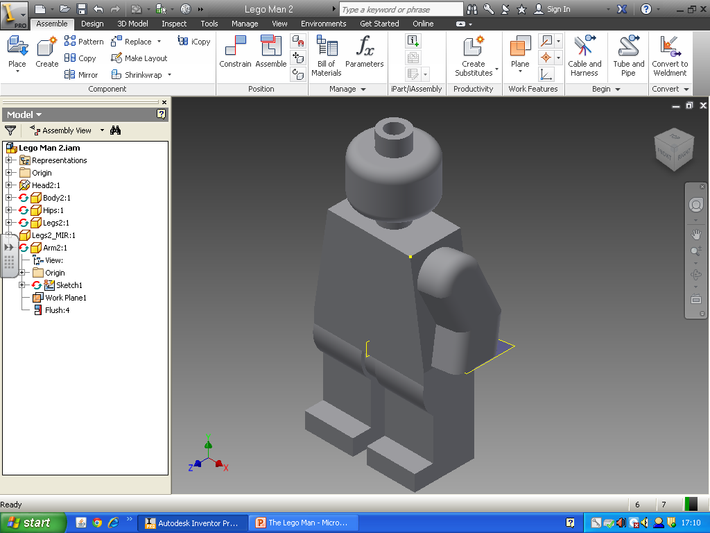
The Arm
Finish the Edit and Save.

Slide 48
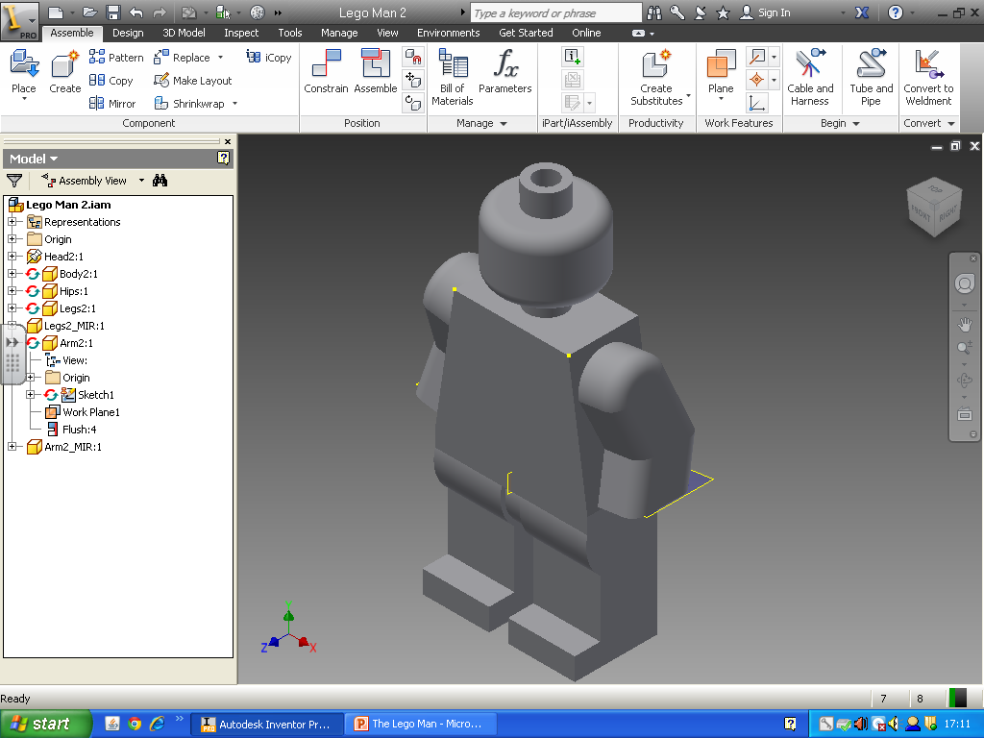
The Arm
Mirror the arm across using the same mirror plane as the leg.

Slide 49
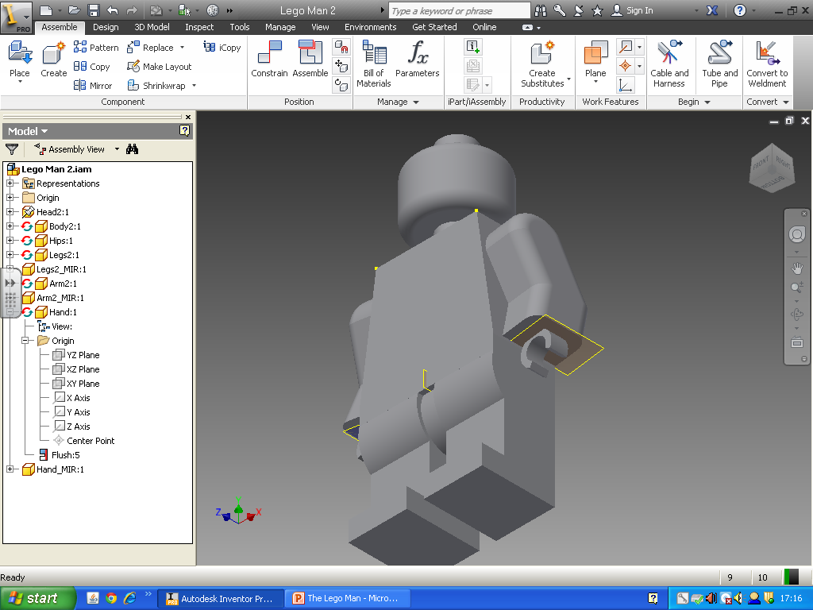
The Hand
Make your own Lego Persons Hand.
An edit may have to be made to the arm to allow this to happen…

