Slide 1
Graphic Ownership
Digital Rights Management
Intellectual Property Rights.

Slide 2
What intellectual property is…
Having the right type of intellectual property protection helps you to stop people stealing or copying:
the names of your products or brands
your inventions
the design or look of your products
things you write, make or produce
Copyright, patents, designs and trade marks are all types of intellectual property protection. You get some types of protection automatically, others you have to apply for.

Slide 3
What counts as intellectual property…
Intellectual property is something unique that you physically create. An idea alone is not intellectual property.
You own intellectual property if you:
created it (and it meets the requirements for copyright, a patent or a design)
You usually won’t own the intellectual property for something you created as part of your work while you were employed by someone else.

Slide 4
Who owns the intellectual Property…
Intellectual property can:
have more than one owner
belong to people or businesses
be sold or transferred
Protecting your intellectual property makes it easier to take legal action against anyone who steals or copies it.

Slide 5
Types of protection…
The type of protection you can get depends on what you’ve created. You get some types of protection automatically, others you have to apply for.
Automatic protection Protection you have to
apply for
Copyright
Design Right
Trademark
Patents
Registered Designs

Slide 6
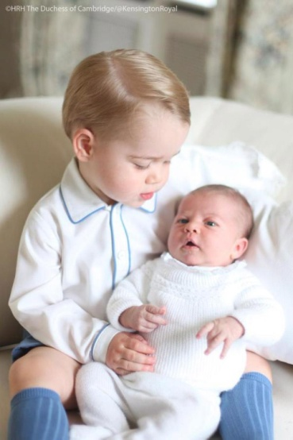
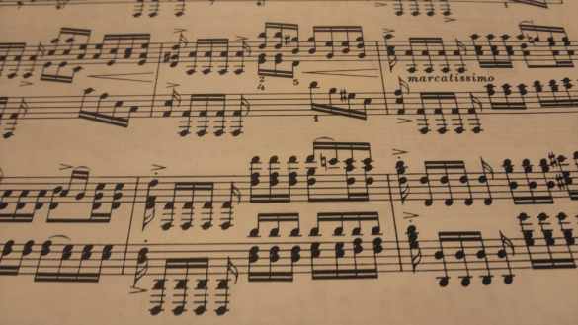
Copyright
WHAT IS PROTECTED?
Writing and literary works, art, photography, films, TV, music, web content, sound recording.

Slide 7
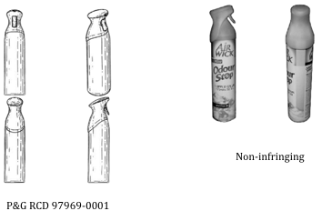
Design Rights
WHAT IS PROTECTED?
Shapes of objects

Slide 8
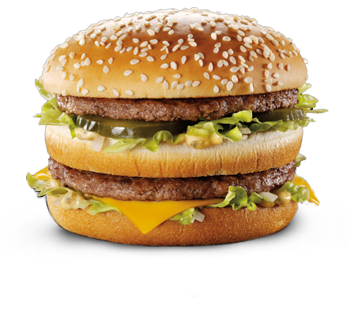
Trademarks
WHAT IS PROTECTED?
Product names, logos, jingles
TIME TO ALLOW FOR APPLICATION
4 months

Slide 9
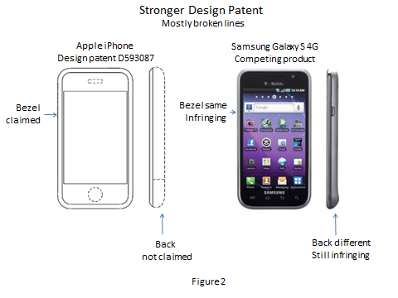
Registered Designs
WHAT IS PROTECTED?
Appearance of a product including, shape, packaging, patterns, colours, decoration
TIME TO ALLOW FOR APPLICATION
4 Months

Slide 10
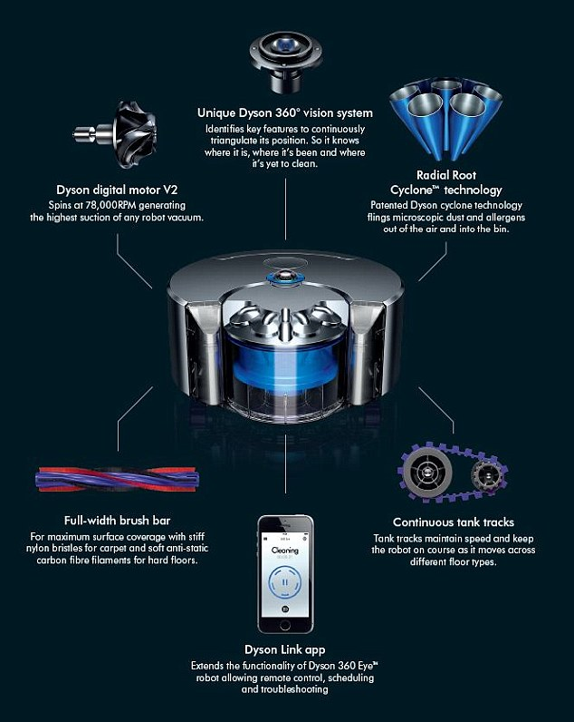
Patents
WHAT IS PROTECTED?
Inventions and products, eg machines and machine parts, tools, medicines.
TIME TO ALLOW FOR APPLICATION
5 Years

Slide 11
Using more than one type of protection…
More than one type of protection could be linked to a single product, eg you could:
register the name and logo as a trade mark
protect a product’s unique shape as a registered design
patent a completely new working part
use copyright to protect drawings of the product
Keep these types of intellectual property secret until they’re registered. If you need to discuss your idea with someone, use a non-disclosure agreement.

Slide 12
Types of Graphic Ownership a Graphic Designer uses…
Copyright
Photos
Images – Art Work
Logos
Trademark
Their brand/identity through a logo

Slide 13
Types of Graphic Ownership an Architect uses…
Copyright
Initial ideas of a building
Trademark
Their company logo
Registered Design
Plans for a building

Slide 14
Types of Graphic Ownership a Design Engineer uses…
Copyright
Initial concepts sketches
Design Rights
Early design shapes, idea working drawings
Trademark
The product to their company.
Registered Design
Protecting the 3D physical form of their product, working drawings
Patents
New Technology within their product

