Slide 1
Higher Design and Manufacture
Revision Session 2

Slide 2
Topics covered
Design Factors
Idea Generation
Production Planning Systems
Marketing
IPR

Slide 3
Design Factors
Aesthetics
Ergonomics
Economics
Environment
Safety
Function

Slide 4
Aesthetics
Shape
Form
Line
Pattern
Texture
Harmony
Balance

Slide 5
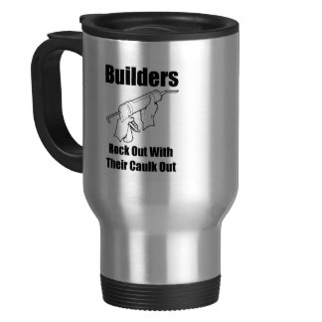
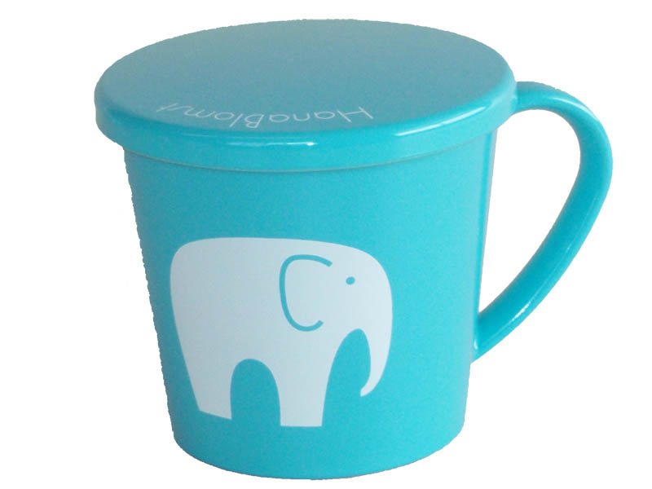
Compare the aesthetics of these two mugs

Slide 6
aesthetics
Fashion
Market Trends
Style

Slide 7
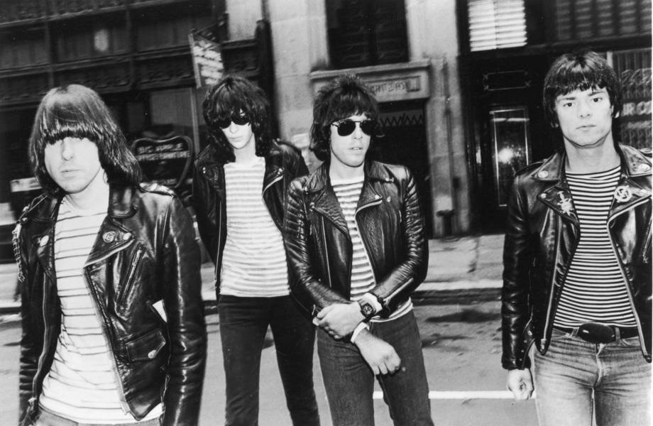
Describe the difference between fashion and style using these biker jackets

Slide 8
ergonomics
Anthropometrics
Finding the correct measurements for products using an anthropometric data table
Ensuring that the product fits the user

Slide 9
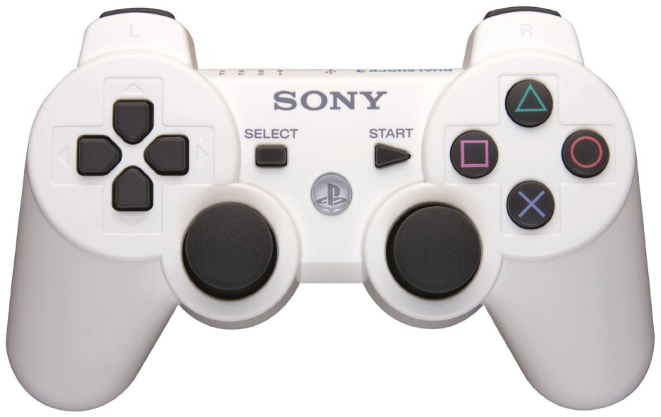
ergonomics
Psychology
How the user understand the product

Slide 11
ergonomics
Physiology
How the user uses the product and their Physical Strength
Can they press the button comfortably?
Can they lift up the product?
Can they change the batteries easily?

Slide 12
economics
Costs
How much a product costs or how much a business will have to spend.
Cost implications of businesses:
Introducing a new system/machinery
Training of staff
Updating software or equipment
Material costs
Maintenance costs

Slide 13
environment
Impact on Environment
Impact /suitability on surroundings

Slide 14
safety
Compliance to BSI standards
Ensure that the workplace is safe. (HSE)
Ensure that materials are safe to use (non toxic, non flammable)

Slide 15
function

Slide 16
Idea generation
SCAMPER
Six hat thinking
Lateral Thinking
Brainstorming
Brain writing
http://www.leckieandleckie.co.uk/page/9780007504831_Images/scamper
http://resources.leckieandleckie.co.uk/Design_Manufacture/978-0-00-750483-1/6057_Six_Hat_Thinking.pdf

Slide 17
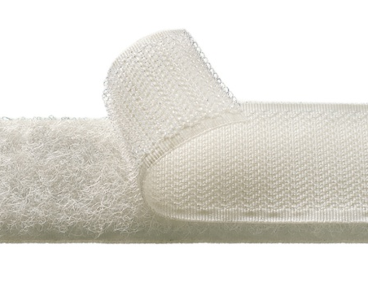
Idea generation
Analogy - Biomimicry
Mood boards
Lifestyle Boards
Morphological Analysis
Technology Transfer - Dyson Roller Ball

Slide 18
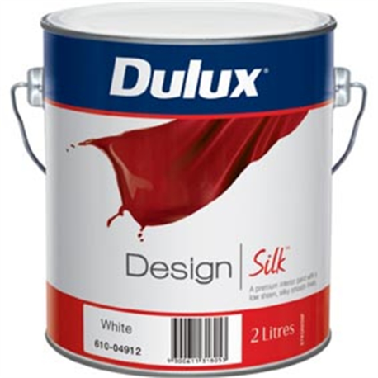
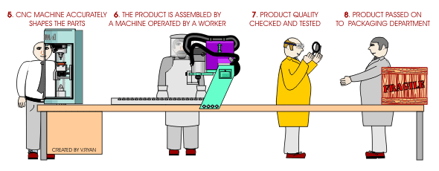
Production and planning systems
One off
Batch
Mass
Line
Flow

Slide 19
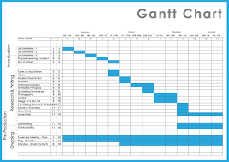
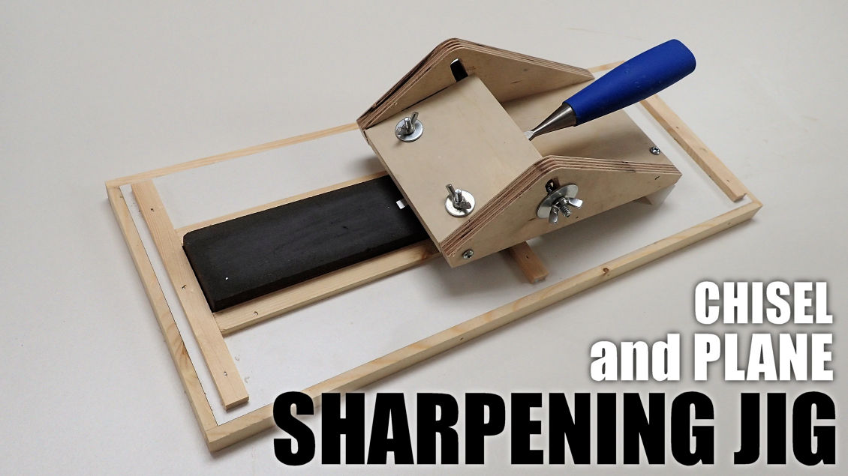
Production and planning systems
Gantt Charts
JIT
Jigs
CAD
CAM

Slide 20
Marketing
Push – Market forcing it on customers
Pull – Market demanding it

Slide 21
Marketing Mix
4P’s
Price
Product
Place
Promotion

Slide 22
Marketing Techniques
Planned Obsolescence
Mobile Marketing
Product Placement
Viral Marketing
Mass Marketing, Brand Names
Seasonal Marketing
Celebrity Endorsement

Slide 23
IPR
Trademark
Copyright/Design Right
Patent
Registered Design

