Slide 1
Graphic Types & Techniques
3DCAD, 3D Printing, CNC Applications,
Animation.

Slide 2
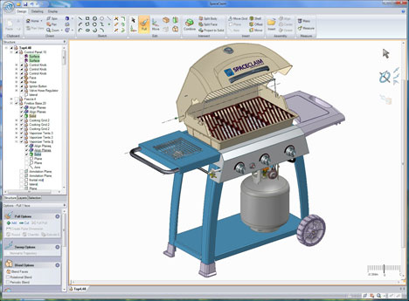
3D CAD
Audience:
Purpose:
Benefits:

Slide 3
3D CAD
Audience: Designers, Architects, Engineers, Bio-Medical, Games Industry, Clients.
Purpose:
Benefits:

Slide 4
3D CAD
Audience: Designers, Architects, Engineers, Bio-Medical, Games Industry, Clients.
Purpose: Engineers and designers can create a digital prototype to experience their 3D CAD designs virtually, before they’re built. It gives them an integrated way to explore a project’s key physical and functional characteristics digitally. FEA and CFD testing. Virtual walk-through. Creation of production drawings and files for CNC manufacture.
Benefits: Digital Prototyping solutions let teams test and optimise 3D CAD designs, helping to drive innovation, achieve higher quality, and speed time to market.

Slide 5
3D CAD
Key Issues:
Software
File Transfer
Cloud
File Types
Rendering
Materials
Security

Slide 6
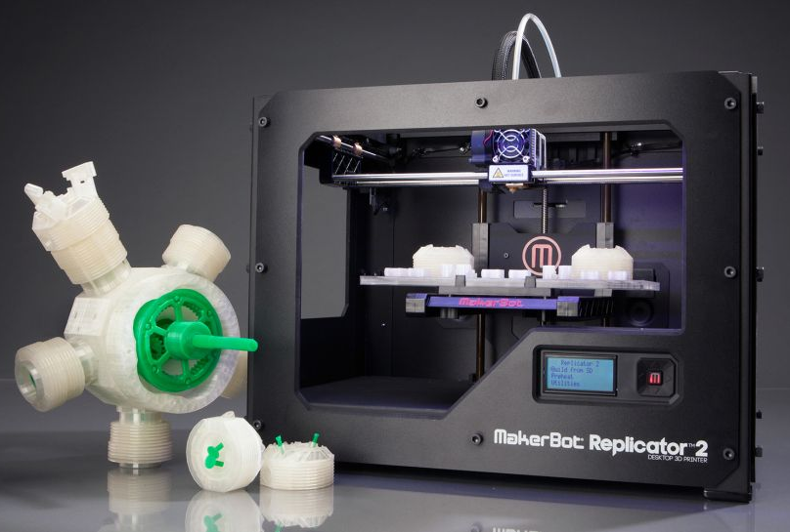
3D Printing
Audience:
Purpose:
Benefits:

Slide 7
3D Printing
Audience: Product Designers, Architects, Engineers, Biomedical Industry, Fashion Designers.
Purpose:
Benefits:

Slide 8
3D Printing
Audience: Product Designers, Architects, Engineers, Biomedical Industry, Fashion Designers.
Purpose: Allows designers and engineers to quickly create physical prototypes to test a project’s key physical and functional characteristics or component assembly. Used to manufacture bespoke (one off) products, eg medical/dental prosthetics. Used to mass produce components which are lighter and stronger than other methods, eg aerospace components.
Benefits: Ability to personalise products / levels of complexity that simply could not be produced physically in any other way / design faster and be more innovative / product development time reduced (no expensive tooling or moulds required) 3D scanning can replicate complex objects.

Slide 9
3D Printing
Key Issues:
Orientation
Scaffolding
Fillets & Chamfers
Quality of Finish
Rafting
Webs
Solid vs Hollow
File Types
STL
Notes:
http://support.3dverkstan.se/article/38-designing-for-3d-printing
https://i.materialise.com/blog/save-money-with-3d-printing
http://www.instructables.com/id/Quality-Finish-3D-Prints-with-Acetone/

Slide 10
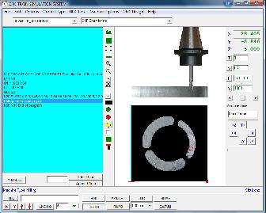
CNC Applications
Audience:
.
Purpose:
Benefits:

Slide 11
CNC Applications
Audience: Designers and Manufacturers who use subtractive methods to manufacture components.
Purpose:
Benefits:

Slide 12
CNC Applications (Simulation)
Audience: Designers and Manufacturers who use subtractive methods to manufacture components.
Purpose: To simulate/test in a digital environment the set-up and cutting of a component before production commences.
Benefits:Allows you to see the toolpaths.
Visualise the resulting component.
Collision detection prevents
catastrophes. Speeds up product
development time.

Slide 13
CNC Applications (Simulation)
Key Issues:
Orientations
Datums
Billet
Tool Selection
Material Selection
Clearances
Tool Paths
Surface Finish

Slide 14
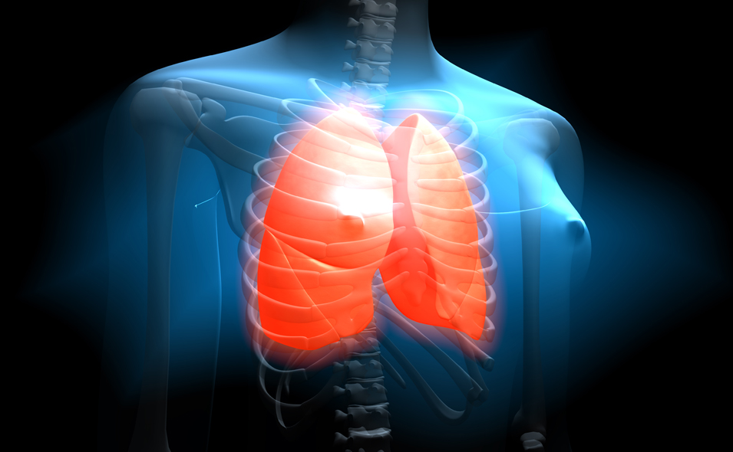
Animation
Audience:
Purpose:
Benefits:
Notes:
http://voicecription.com/blog/importance-of-3d-animation-in-medical-industry/

Slide 15
Animation
Audience: Gen pop, medical professionals & their patients, forensic scientists, architecture clients, teachers & learners, product designers, engineers.
Purpose:
Benefits:
Notes:
http://voicecription.com/blog/importance-of-3d-animation-in-medical-industry/

Slide 16
Animation
Audience: Gen pop, medical professionals & their patients, forensic scientists, architecture clients, teachers & learners, product designers, engineers.
Purpose: Medical animation as an instructional tool. Forensics in which animated recreation of incidents are created to aid investigators & help solve cases. Used to explain theory and concepts to students in a more convincing manner.
Benefits: Cutting down on development costs. Working in a virtual world can let developers eliminate problems that would normally require extensive physical test
models & experimentation. Training packages
can eliminate language barriers.
Notes:
http://voicecription.com/blog/importance-of-3d-animation-in-medical-industry/

Slide 17
Animation
Key Issues:
Types
Mo Cap
Tweening
Stop Frame
File Types
Wmv
Avi
.mov
.mpeg
Effects
Transitions
Overlays
Morphing
Notes:
http://voicecription.com/blog/importance-of-3d-animation-in-medical-industry/

