Slide 1
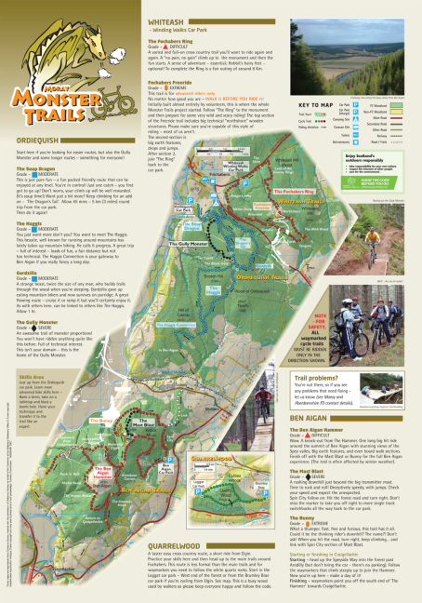
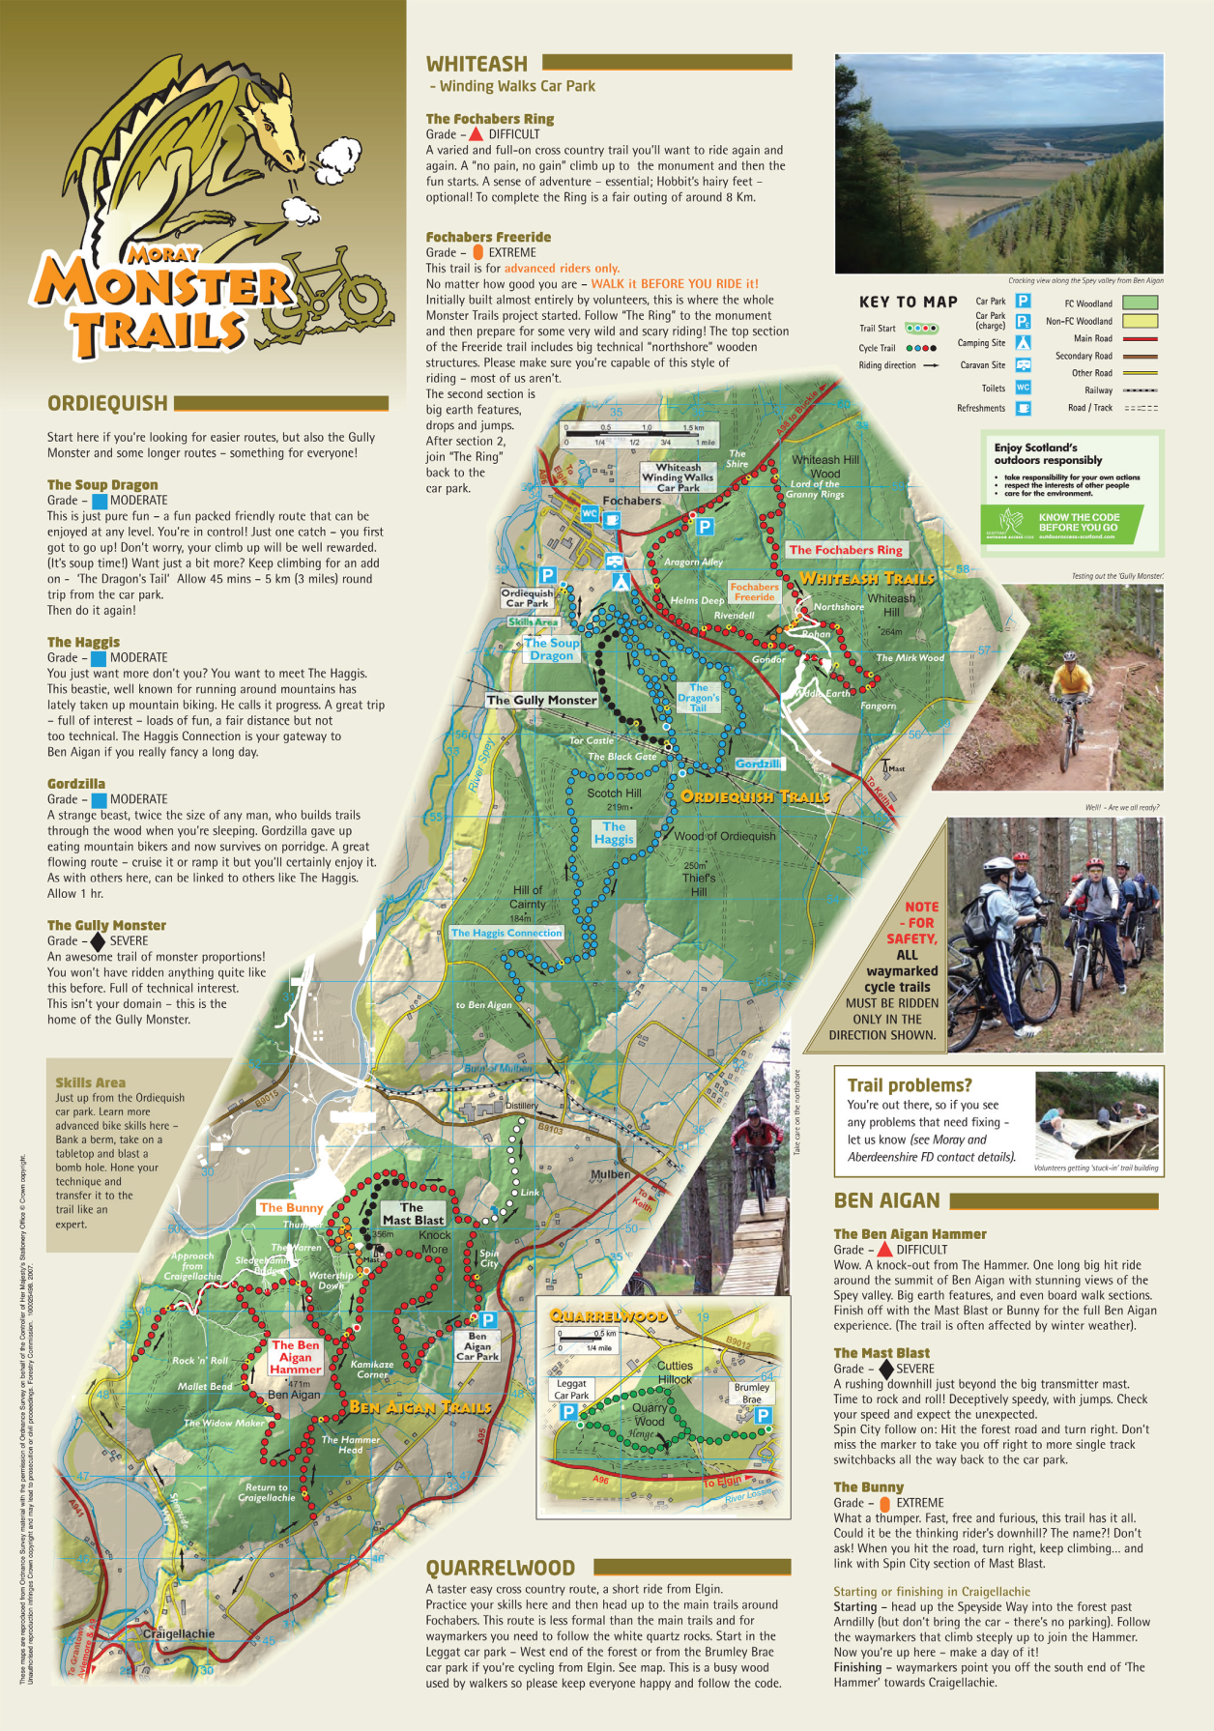

Slide 2
Question 1
Design Elements/Principles have been given below. Please refer to “Moray Monster Trails” leaflet.
1. Identify whether the term is a Design Element or Design Principle.
2. Describe with direct reference to the leaflet, how the design element or design principle has been used in the leaflet.
White Space Balance Shape
Colour Contrast Value
12 marks

Slide 3
Question 2
Identify 2 Design Elements and 2 Design Principles and discuss their impact on the page.
8 marks

Slide 4
Question 3
Label, on the sample text, the typographical features given below.
(a) Typographical features:
• X-height
• Baseline
• Descender
• Meanline
(b) Explain, with the aid of annotated sketches, the difference between a serif and a sans serif typeface.
Design Principles

Slide 5
Question 4
Identify the most effective way in which to model the following 3 components of a Lego Man. Sketches should support your answer.
3 marks for each

Slide 6
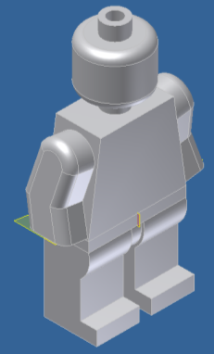
Question 5
When producing this model the designer decided to build each part individually and then assembly these in 1 file. State the name of this type of modelling and explain the difficulties the designer may face when using this style of modelling. 2marks

