Slide 1
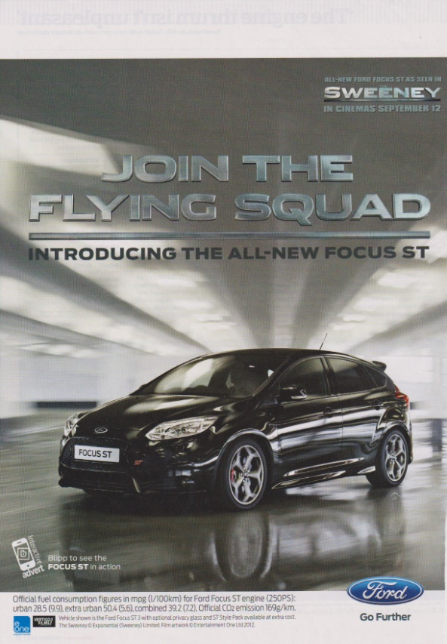
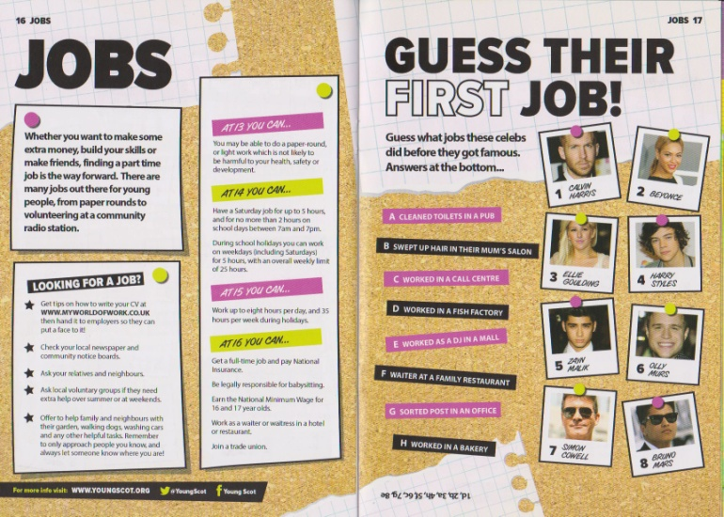
Question 1
For each of the following DTP promotional graphics identify the target audience and justify how design principles have been used to make them suitable for that market.
4 marks for each

Slide 2
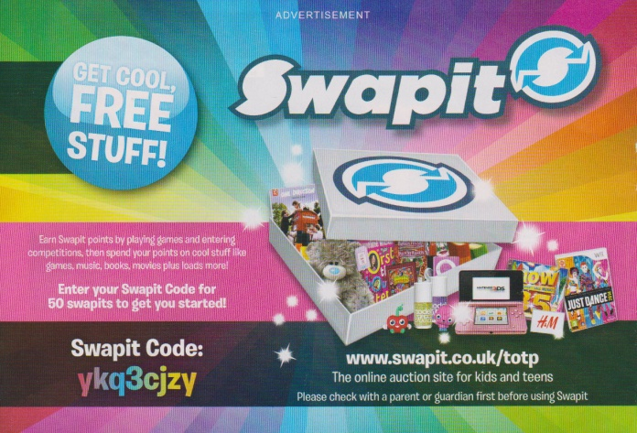
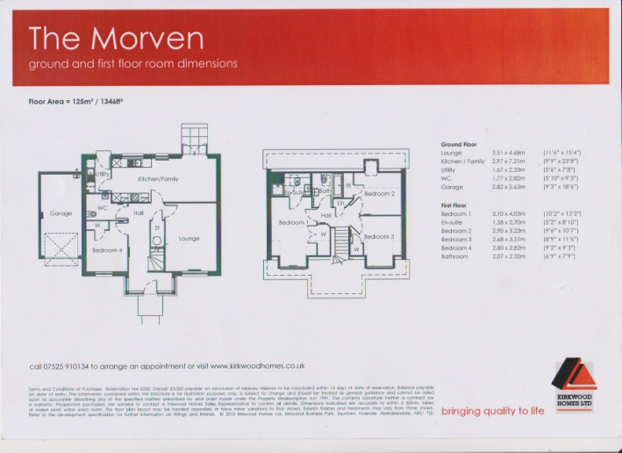
Question 2
For each of the following DTP promotional graphics identify the target audience and explain how imagery, typeface and colours support in ensuring they reach this audience.
4 marks for each

