Slide 1
Question 1
Graphic design is often used to provoke an emotional response. “Save the Children” ran a campaign in 2006 using the graphic below.
Explain how the various elements of the graphic have
been used to achieve maximum impact. (4 marks)

Slide 2
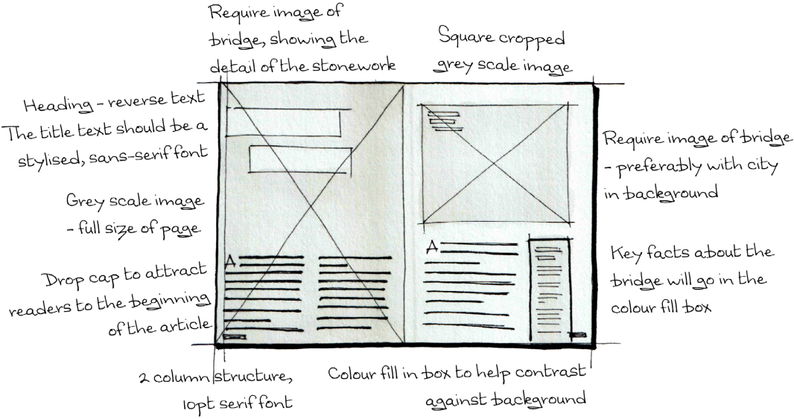
Question 2
Thumbnails are used extensively by
graphic designers to explore and
develop ideas.
1. State two reasons why thumbnails
are not appropriate to
communicate ideas with a client. (2)
The graphic designer decided to make use of stock photographs, such as that
shown above, for the publication. These were purchased online.
2. Describe one advantage and one disadvantage of using stock
photographs. (2)

Slide 3
Stock Imagery
Advantages:
• access to high quality images
• an extensive range of images
• broad range of subjects/topics
• constantly refreshing the stock/content
• image size can be selected
• easy to browse
Disadvantages:
• financial/monetary/cost implications
• image may not be exactly what is needed/preferred/desired
• potentially large file sizes — therefore potential to slow
• productivitiy where larger numbers of images are required

Slide 4
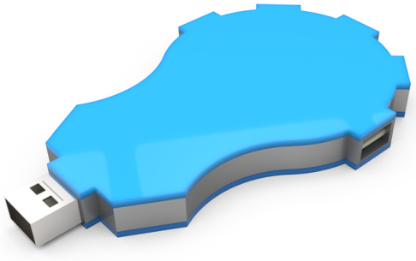
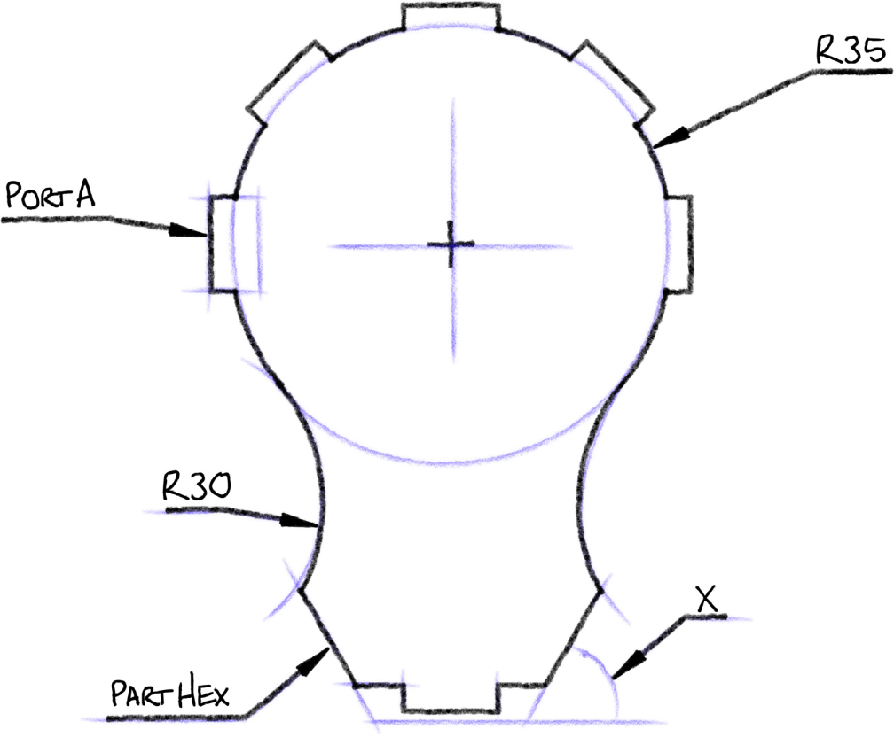
Question 4
A 3D CAD model of the USB hub and its preliminary sketch are shown.
1. Describe, with reference to 2D drawing techniques, how you would create a tangent between the R30 and the R35 arcs. (5)
You may write your answer and/or sketch in the preliminary sketch on the previous page to support your answer if you prefer.
2. The USB hub is symmetrical about the vertical centre axis.
State angle X. (1)

Slide 5
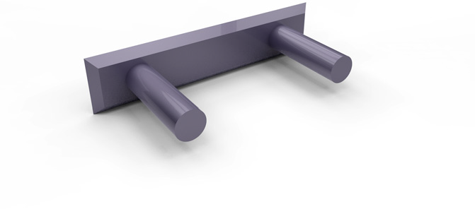
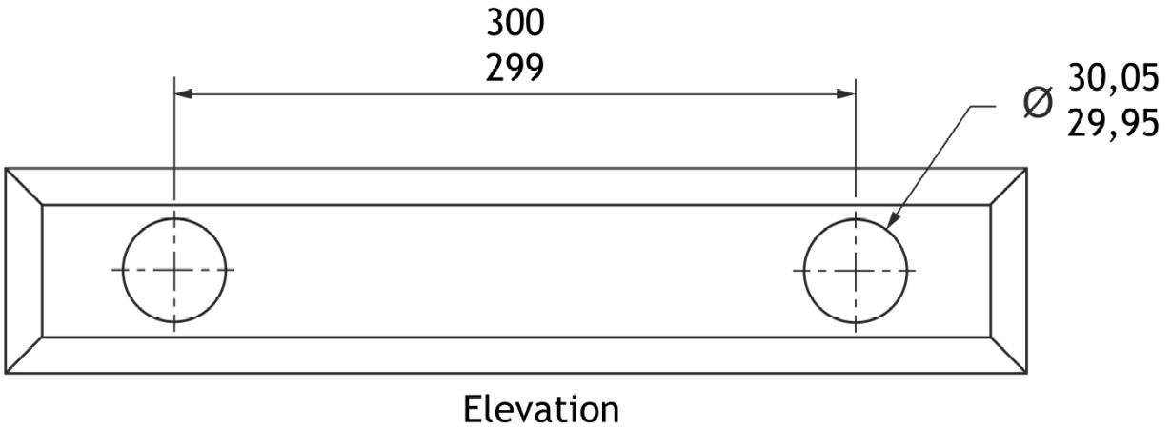
Question 3
A 3D CAD model and elevation of a bracket are shown above. The location pins, each Ø30 mm, are set apart at 300 mm nominal centres.
There are tolerances on both the sizes and location of the pins.
Calculate the maximum and minimum gap between the pins. (2)
2. Explain why tolerances are an important feature in production drawings
for manufacturing. (2)

Slide 6
Tolerances
• Cost — the more accurate an item needs to be, the higher the
cost.
• Time to produce — the more accurate an item, the longer it
will take.
• Affects the function of the product.
• Affects the inter-changeability of the product.

Slide 7
Identify 5 Design Principles explain how they impact on the article. 5 marks
White space
Alignment
Balance
Unity
Contrast

Slide 8
White space
Alignment
Avoids cluttering the layout – makes poster easier to follow.
Text is centre aligned. This helps the flow of the poster as the general layout is very symmetrical.
Headline/title is aligned with the head.
Balance
Symmetrical layout. Image and text are all centred. This makes the poster easy to follow.
Unity
Title and background are same colour
Subtext and image are same colour
Contrast
Text colour– white and pink against black.
Text size- Heading is much larger than bottom text. This shows order of importance

