Slide 1
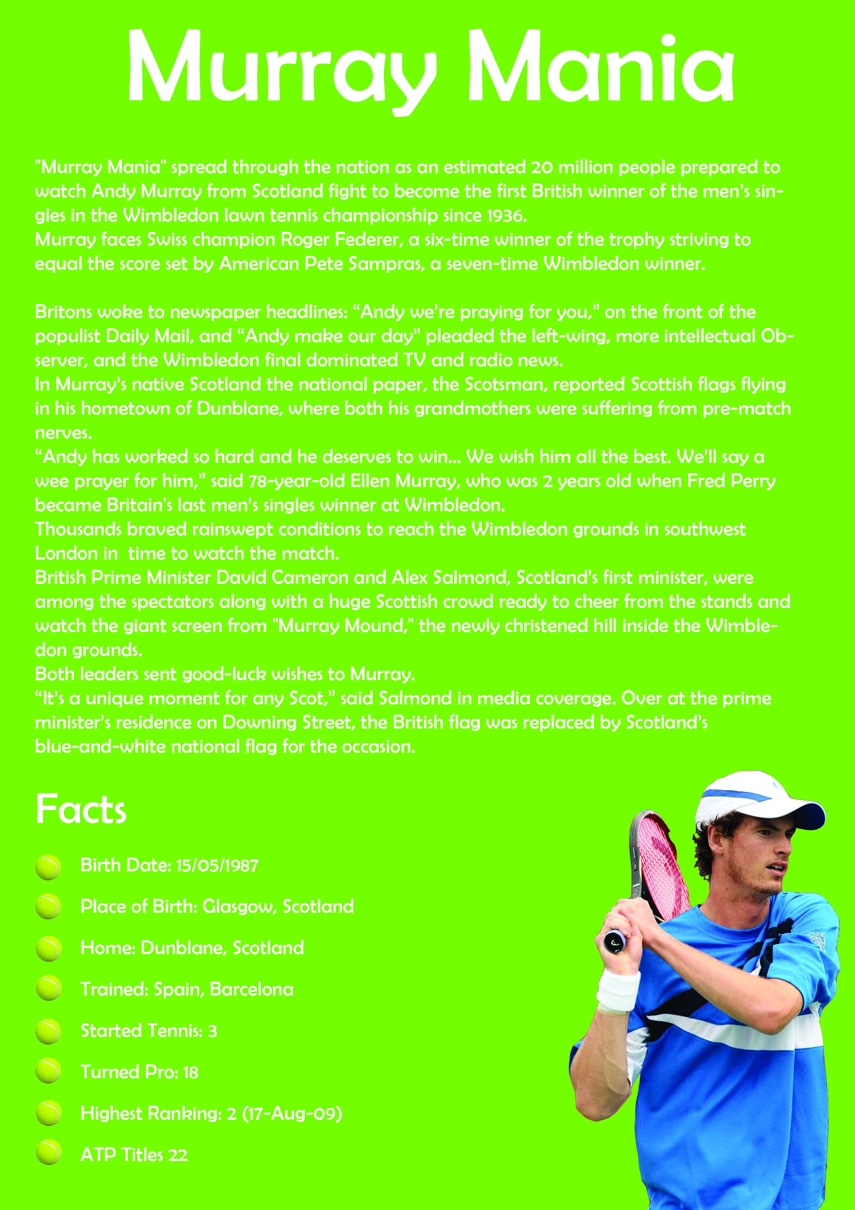
Question 1
The first image below was an early working rough; the second is a final copy.
Identify 5 new DTP features that have been made between the first and the second and explain the impact they have on the page.
10 marks

Slide 2
Question 1

Slide 3
Question2
Sketch out the elevation for the exploded isometric shown. Show all hidden detail and identify the web.
4 marks

Slide 4
Question 3
Apply hatching to Stage 2 and Stage 3 above taking account of British Standards and conventions
Explain the term “blind hole”
1 mark
What does the “M” stand for on the M10 bolt?
1 mark
State the type of section shown at Stages 1 to 3.
1 mark

Slide 5
Identify 4 Design Principles and 1 Design Element and explain how they impact on the article. 5 marks
Balance
Repetition
Contrast
Alignment
Colour

