Slide 1
Question 1
The silhouette of the child at the top of the infographic was electronically captured and inserted into the DTP document.
Describe how a hard copy image could be captured and inserted into a DTP document, making reference to file type.
2 marks
The graphic designer decided to make digital copies rather than hard copies of the infographic
(b) Describe the advantages of this decision.
1 mark

Slide 2
Question 2
A public building that was constructed in the 1950s is to be modernised. The original drawings were produced manually in paper format. The architect has requested that the manual drawings be converted to a digital format and sent electronically.
The conversion methods being considered are: scanning the original drawings or reproducing the drawings using CAD software.
Compare the two methods in terms of their suitability for this task.
4 marks

Slide 3
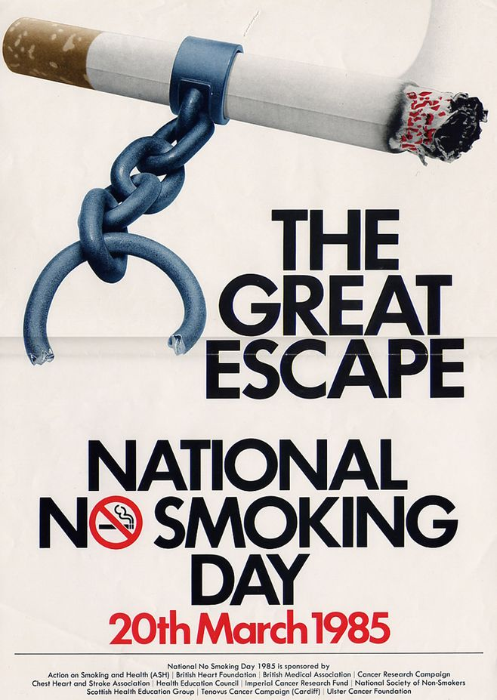
Contrast
Identify 4 Design Principles and 1 Design Element
discuss the impact they are having. 4 marks
Dominance
Alignment
Line
Unity

Slide 4
Contrast
Bold black text against the white background – contrasting colours.
Contrast can also be seen in the difference in text size between the title and additional info at the bottom
Identify 4 Design Principles and 1 Design Element
discuss the impact they are having. 4 marks
Dominance
is the largest item on the page. This captures your attention first.
Alignment
Text – centre aligned
Line
Is used to separate the main poster from additional information
Unity
repeated colour this can also be seen in the cigarette

