Slide 1
Materials and Processes
Casting Metals

Slide 2
Casting
Casting is a manufacturing process in which a liquid material is usually poured into a mold, which contains a hollow cavity of the desired shape, and then allowed to solidify
Sand Casting
Die Casting

Slide 3
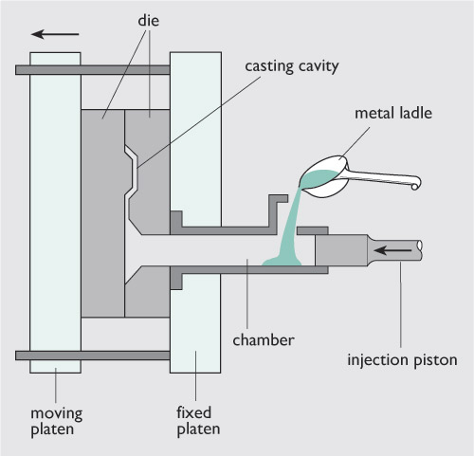
Die Casting-The process
Works similar to injection moulding for plastic.
The metal is poured into a chamber
Its then heated up.
An injection piston pushes the metal into the mould
The metal is then allowed to cool in the mould
Once cool the metal is removed then any additional parts are removed.

Slide 4
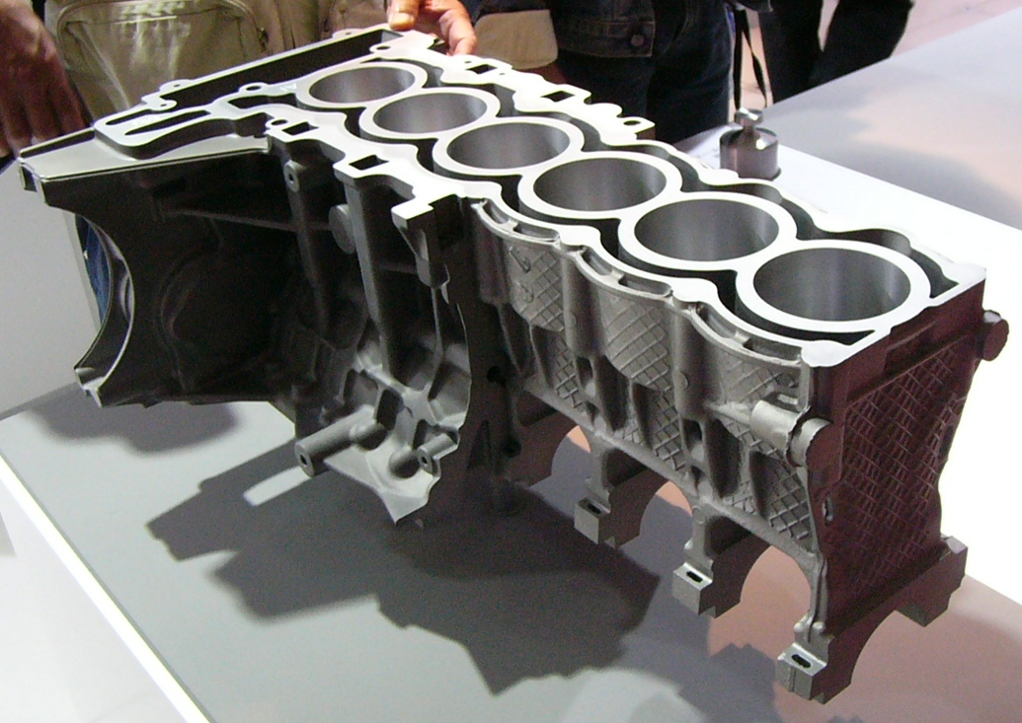
Die Casting
Why is Die Casting used?
Die casting mostly feature non-ferrous metals such as zinc, copper, aluminum, magnesium, lead, tin, etc.
Die casting would be used to create lots of parts that are the same, such as parts for a car engine.

Slide 5
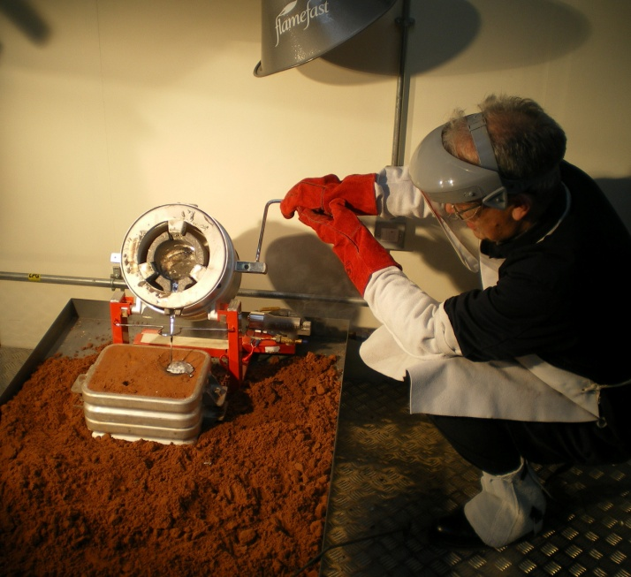
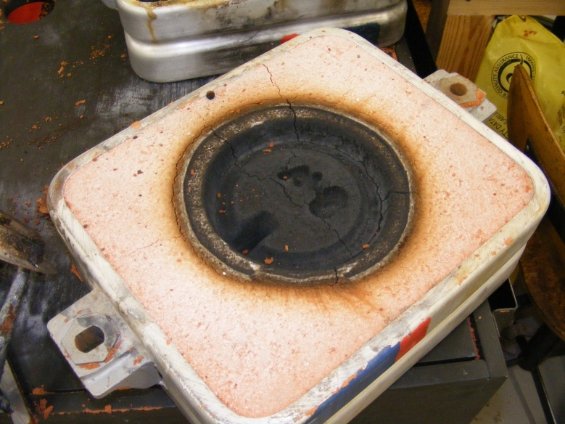
Sand Casting
Sand casting is used when a small volume is required or one off models.
This is because the sand moving and burning with the molten metal.
Burnt sand

Slide 6
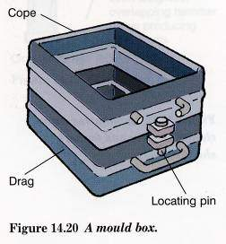
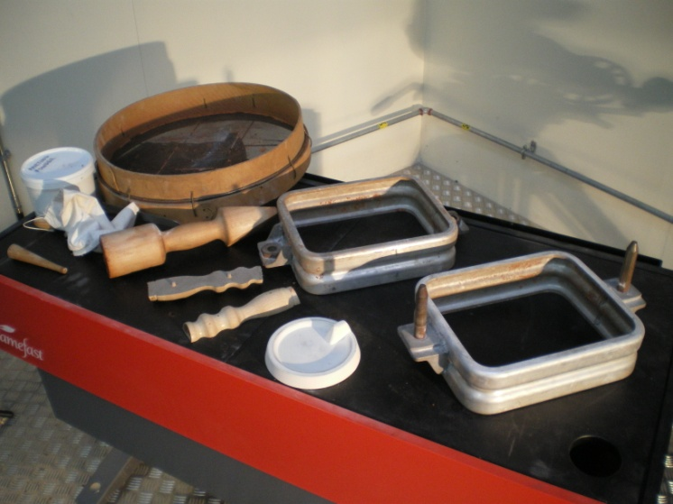
Sand Casting
Sand castings can be produced from a variety of metals, but the most popular metals are aluminum, grey iron, ductile iron, steel, and magnesium.

Slide 7
Task
Use the internet to find out more on the casting of materials.
Open a new Word document and title it “Casting”
Put a subheading of “Die Casting”
Underneath the sub heading write at least two advantages and two disadvantages of die casting.
After this write a subheading of “Sand Casting”
Underneath the title write at least two advantages and two disadvantages of sand casting.
If you complete this then look for example products made from each process.

