Slide 1
CFD
Computational Fluid Dynamics

Slide 2
What is CFD?
CFD is a form of digitally testing the airflow through the internals of a building.
Computational fluid dynamics, usually abbreviated as CFD, is a branch of fluid mechanics that uses numerical analysis and algorithms to solve and analyze problems that involve fluid flows.
Computational fluid dynamics (CFD) is the use of applied mathematics, physics and computational software to visualize how a gas or liquid flows -- as well as how the gas or liquid affects objects as it flows past. Computational fluid dynamics is based on the Navier-Stokes equations. These equations describe how the velocity, pressure, temperature, and density of a moving fluid are related.

Slide 3
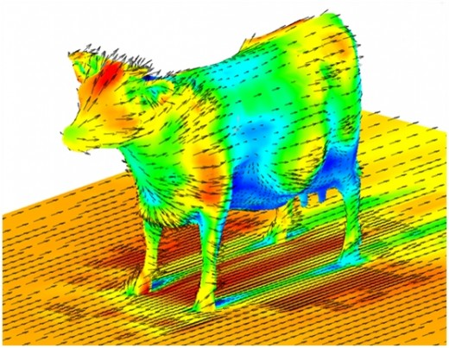
What is CFD?
CFD is a form of digitally testing the airflow through the internals of a building.
It is a cost effective way of improving internal/external building design. The use of CFD can increase building design performance by establishing how the air flow through rooms is going to
affect the people
working/living in that area.
It could be used to establish
where to locate various
furniture, heating systems,
height of ceilings, etc.

Slide 4
CFD In Action

Slide 5
How does it work?
It shows Architects how the airflow through a design of say an office could be detrimental to the workers, i.e. warm/cold areas thus allowing fact based decisions to be made, e.g. where to place duct venting, positions of internal walls and furniture, height of ceilings, etc.
As with FEA it uses complex mathematical formula to analyse and establish volumes and flow rates through confined areas.

Slide 6
What benefits does it provide?
It instantaneously yields volume data which is useful to the overall design.
It allows Architects to visualise and manipulate new building designs, determine heat flow and heat control and loss and the environmental efficiency of the build at an early stage.

Slide 7
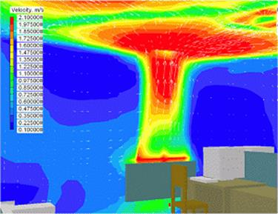
A Professional’s View
If pre-construction, CFD (Computation Fluid Dynamics) software could be used to model airflows based on different surfaces/dimensions within the room, windows, heat sources, ventilation grilles etc. This would be beneficial as a pre-assessment and to gain an understanding of airflow paths within the space which could inform optimum layouts i.e. positioning occupants out with airflow paths to avoid complains of draughts. Conversely, warm equipment such as photocopiers could benefit from being located within natural airstreams to assist heat rejection. These pre-construction digital assessment methods are fundamental in the design of natural ventilation strategies by maximising the use of and optimising the location of natural (controllable) openings which will in turn minimise the use of mechanical ventilation and therefore energy use.

Slide 9
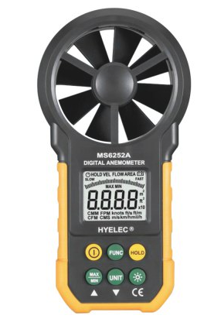
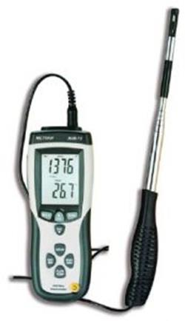
A Professional’s View
If post-construction, a digital anemometer could be used to measure airflows within the space. These physically measure air velocity either by a set of rotating “propeller” blades or by measuring the cooling effect on a hot bulb/wire. Both instruments enable velocity to be measured accurately in metres/second (m/s). This can also be useful in measuring the total airflow volume if the velocity is established across a known surface area, for example, m/s x m² = m³/s (volume flowrate). These methods are commonly used to establish airflow currents and volumes within a room as part of a “comfort” analysis and during testing, commissioning and validation of heating and ventilation systems.

