Slide 1
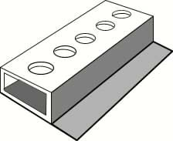
5: Jigs
There is a big difference between making a one-off product and a number of identical products. The latter items may need to have holes drilled in exactly the same places. They may need to have identical shaped folds or forms. In order for us to guarantee that a number of products are exactly the same we need to make tools (jigs) which are used throughout the manufacturing process. These jigs may possibly be:
Drilling jigs
Folding or shaping jigs
Cutting jigs
Drilling jigs
The diagram below is of a simple drilling jig. This jig allows the user to drill holes onto a square section piece of wood. The jig may be made from mild steel. The holes are accurately marked out and drilled along the centre of the top surface. The wood is placed into the jig and clamped to the surface plate of the pillar drill. Once again the pillar drill bit is passed through the jig and into the wood. The holes will be accurately placed along a centre line.

Slide 2
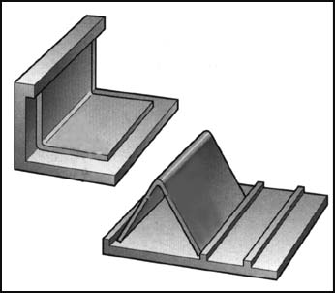
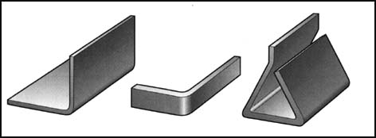
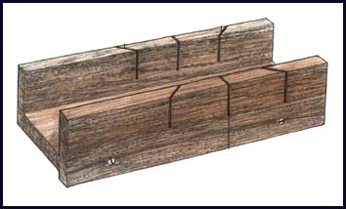
5: Jigs
Folding jigs The two mild-steel folding jigs below are used in conjunction with the strip heater. The acrylic is heated on the strip heater. Whilst in a malleable state the acrylic is placed into the jigs. When the plastic is cooled, it will retain its new shape and the marking-out lines (in felt-tipped pens) can be cleaned off.
Cutting jigs The image below is of a mitre box. This jig allows the user to cut angles of 90 and 45 degrees in wood. This common jig may be bought from most tool shops. The 45-degree cuts are called mitre cuts.

Slide 3
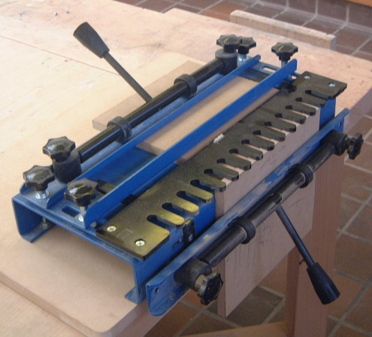
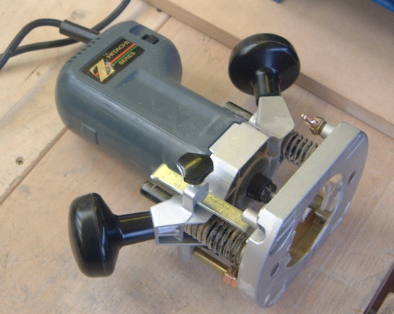
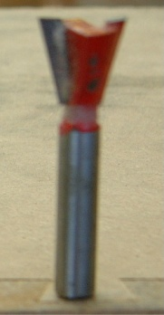
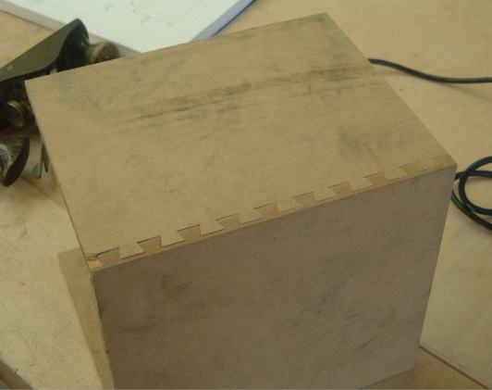
5: Jigs
Ready-made jigs
There are also lots of other ready-made jigs available to use. They could be as simple as the fence on the band saw which you would set a specific distance from the saw blade to guarantee the same size of cut every time.
Below is an example of a router jig. This is a ‘dovetail’ jig for a router; it helps to produce accurate dovetail joints in wood and man-made board, a job that would take a very long time and a lot of skill to do by hand.
Dovetail jig
Router
Dovetail cutter
The material is held vertically and horizontally in the jig and the pieces are offset by the thickness of the material. The router is fitted with a collar and a dovetail cutter and is simply guided through the comb-like fence of the jig. The box below shows the finished dovetail joint.

Slide 4
5: Jigs, Formers and Templates
Use this page to draw as many other examples of jigs, formers and templates as you can find in the workshop. Add your own too.

Slide 5
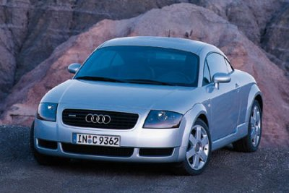
6: Mass Production
This is high …………….. production of products including personal computers, cars and televisions, and standardised sub-assemblies of these products like transformers and cathode-ray tubes. As with ‘flow production’ (continuous production), mass production requires specialised equipment but in this case a large ………….. workforce particularly in assembly areas. Mass-production processes are often broken down into small simple and easy-to-learn operations in order to provide the flexibility to move around an unskilled workforce.
This car is an example of a product that is mass produced. Use the spaces below to add some more examples:
1. ……………………………
2. ……………………………
3. ……………………………
4. ……………………………
5. ……………………………
Audi TT roadster
Injection moulding is a mass-production plastic-forming process. Using sketches to support your answers, list six other mass-production manufacturing techniques:
1. ………………………………..
2. ………………………………..
3. ……………………………….
4. ……………………………….
5. ……………………………….
6. ……………………………….

Slide 6
7: Continuous/Flow Production
Some processes such as steel manufacture are only economic if they are always kept running. Continuous production refers to the type of manufacture that is normally associated with primary processes such as refining, chemical manufacture and oil production. This type of production requires ……… investment in capital equipment.
This type of production also refers to the production of high-volume products that are constantly being used and are in demand, simple things such as tomato ketchup and baked beans. As these are continuously being produced 24 hours a day by automated machinery this keeps the unit costs down.
Tomato ketchup is given as an example of a product that is continuously produced. Using sketches to support your answers find some more:
1. ……………………………
2. ……………………………
3. ……………………………
4. ……………………………

Slide 7
8: Sequential Production
When a company undertakes to design a new product, there are many stages it has to go through before the product reaches the market-place. Many companies organise this in an orderly sequence, with each stage having to be completed before the new product is passed along to the next stage.
Some of the stages in product development are shown in the diagram below.
Design
Quality control
Sales
Research
Manufacture
Distribution
Over the wall engineering
Some companies still work on a departmental basis, each one working very much in isolation and preparing information only relevant to the next stage in the process. No department ever has an overview of the whole process. This can be compared to passing the information over a brick wall to the next department and not being able to see it again. As a result, there is little communication between departments and often a lack of interest and concern among employees on issues such as quality control and product management.
This orderly step-by-step process will bring control to complex projects but it is very slow. In today’s highly competitive marketplace this can lead to product failures and lost sales.
The barriers to information transfer need to be broken down in the interests of efficiency, quality control and speed. Reorganising departments in such a way as to encourage teamwork and communication between workers can radically improve the transfer of information between workers. Integrated Information Transfer systems and updated computer design packages mean that all departments have access to the contributions made by everyone in the organisation.

Slide 8
8: Concurrent Production
The problems associated with sequential production can be overcome by companies using a concurrent production approach. This is a method of developing and manufacturing products using a team-based approach. Members from every department are brought together at the beginning of the project to form the product design team. Each member is a specialist in their area but more than likely will have a knowledge of the other departments’ inputs as well. They are able to interact and contribute to the project from an early stage and can begin to plan, organise and develop their own specialist inputs without having to wait for another department to finish.
SALES
DISTRIBUTION
QUALITY CONTROL
MANUFACTURE
DESIGN
RESEARCH
Product planning
Survey research
Idea development
Planning for manufacture
Testing
Advertising & promotions
Consumer trials
time
Concurrent engineering requires departments to work closely together, overlapping the steps in the product development and manufacturing process, thus saving time and increasing effectiveness.

Slide 9
8: Just-In-Time Production (JIT)
Just-in-time (JIT) production is a concept initiated by the Japanese in order to reduce stock levels within factories, thus reducing costs. It is a method of manufacturing products more quickly and in the exact quantities needed to meet customer demand. Production materials arrive ready for use exactly when they are needed. This means that manufacturing firms have less capital tied up in raw materials, carry less stock and therefore require less storage space. There are no stockpiles of finished goods waiting to be dispatched.
JIT requires good relationships between manufacturers and suppliers. Suppliers have to be flexible and able to respond to the manufacturer’s demands. Any delay will be costly and may halt production. This means that manufacturers must plan carefully, have accurate estimates for each stage of production and have efficient stock control systems in place.
The goal of JIT is to achieve the five zeros. These are:
Zero stock
Zero lead times (time taken between order being placed and the product delivery)
Zero defects
Zero breakdowns
Zero paperwork
It is almost impossible to achieve all of these goals but they are targets to aim at.
When will JIT not work? Write down some suggestions as to when this system may fail.

Slide 10
9: Quality Control/Assurance and TQM
Quality control (QC) is a technique used in all areas of manufacturing. It is used to check quality against a set standard or specification. It may be used to check the dimensions of a product or component. We say that the component has been checked to ensure that it is within accepted tolerances (acceptable variations of sizes which stray from the optimum size). Quality control requires constant inspection throughout the manufacturing process in order to detect products which are not up to the required standard. These inspections are also carried out on the completion of a product by trained inspectors.
In the space below, state three other aspects of a product that would have to undergo quality control:
1. …………………………………
2. …………………………………
3. …………………………………
Quality assurance (QA) is a company’s guarantee that the product or service it offers meets the accepted quality standards. The planned checking procedures take place 'before, during and after' and the aim is to get it 'right first time, every time'. QA must be the responsibility of everybody involved in the creation of a product or service. QA must be built into every stage of product development and every stage of the manufacturing process.
Total quality management (TQM) takes quality control even further. Its aim is to create a Quality Culture. A company that embraces TQA is a company that is continually attempting to improve its products and its performance. Customers tend to be loyal to this type of organisation.

Slide 11
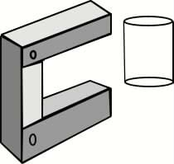
9: Tolerances/Quality-Control Gauges
Tolerances When we use the word tolerance we are really defining how much variation from a precise size specification is allowable. It would be ideal for there to be no variation at all; this is called zero tolerance but, in reality, that is very difficult to achieve. To achieve zero tolerance costs a lot of money. Some products (for example, computer chips) and some engineering components have to be accurate to +/– 10 microns (10 microns above or below the optimum size). Other products (for example, a garden shed) may be accurate to +/– 50mm. Quality-control gauge We have already looked at the use of quality-control checks throughout the manufacture of a product or component.
As a machine operator produces a number of products (a batch) it is important to find out if the parts or components are all the same size or are within acceptable tolerances. In order for the person to do this a GO/NO GO gauge is needed. This simple device may check the diameter, length or width of a product.
The drawing on the left shows a GO/NO GO gauge. It is made from three pieces of steel strip which are riveted together. The space between the two ends has been measured. For example, it may be used to check that each piece of hollow perspex has been cut to the correct length.

Slide 12
9: Quality control gauge design
Use the space on this page to design a GO/NO GO test gauge for a product component. Clearly state what it is designed to test and explain how it works.

Slide 13
Vocabulary
Use this page to make any notes on the vocabulary used in this booklet and add any new words.
CAD – Computer-Aided Design
CAM – Computer-Aided Manufacture
CNC – Computer Numerically Controlled
Workforce
Rapid prototyping
Manufacture
Components
Library
2D – Two Dimensional
3D – Three Dimensional
Architect

Slide 14
Vocabulary
Use this page to make any notes on the vocabulary used in this booklet and add any new words.
Engineer
Orthographic projection
Rendering
Laser sintering
Stereolithography
One-off production
Batch production
Jig
Template
Former
Mass production
Continuous production

Slide 15
Wordsearch
ARCHITECT
BATCH PRODUCTION
COMPONENTS
COMPUTER AIDED DESIGN
COMPUTER AIDED MANUFACTURE COMPUTER NUMERICALLY CONTROLLED CONTINUOUS PRODUCTION
ENGINEER
FORMER
JIG
LASER SINTERING
LIBRARY
MANUFACTURE
MASS PRODUCTION
ONE OFF PRODUCTION ORTHOGRAPHIC PROJECTION RAPID PROTOTYPING STEREOLITHOGRAPHY
TEMPLATE
THREE DIMENSIONAL
TWO DIMENSIONAL
WORKFORCE

