Slide 1
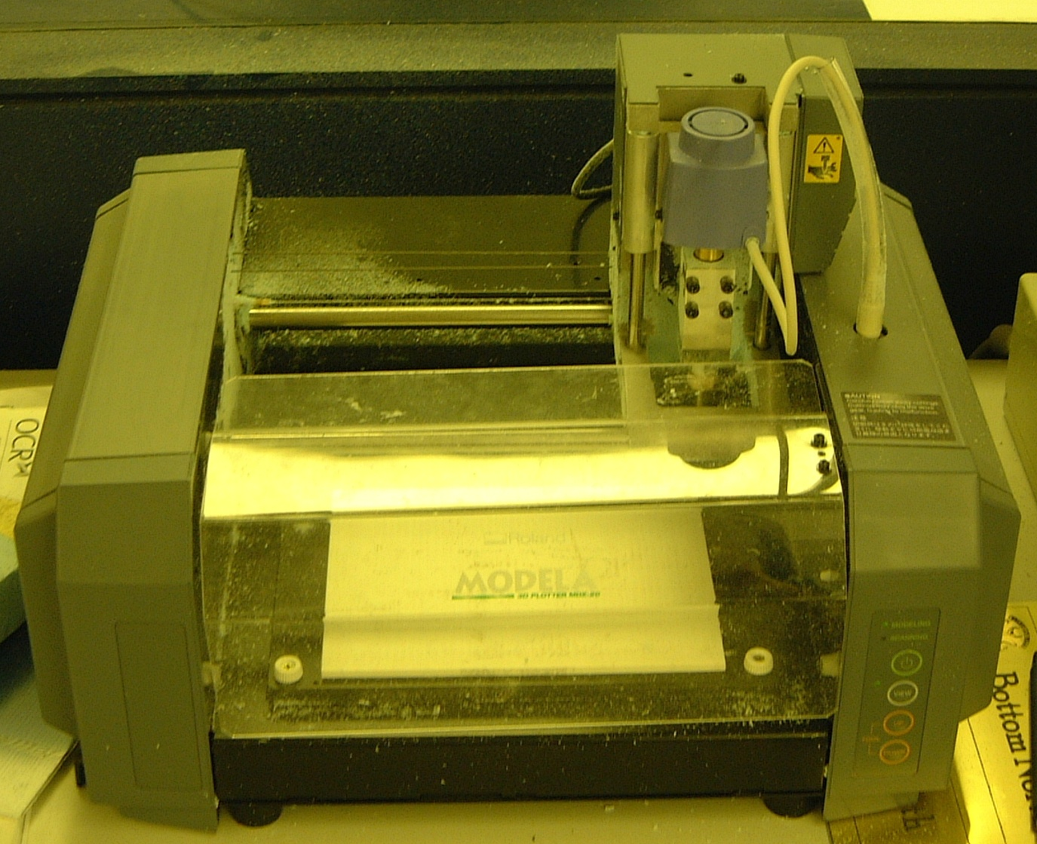
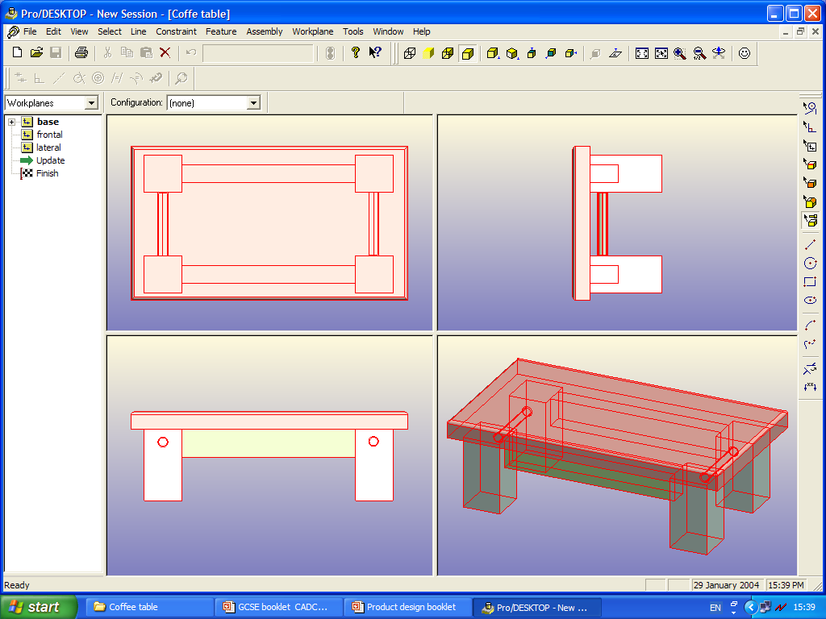
Higher
Product Design
CAD/CAM
and
Production Methods

Slide 2
Introduction
CAD/CAM techniques (Computer-Aided Design/Computer-Aided Manufacture) have been increasingly used in industry as technology has advanced. Traditionally, designing would be done by hand and a workforce would be required for manufacture.
Products can now be designed and manufactured much quicker through CAD/CAM and models and prototypes can be made quite easily by rapid prototyping techniques.
Also, the number of products that are required affects the way they are manufactured. For example, if a single component is required it is unlikely that a company will invest in hi-tech machinery; conversely, if 200,000 components are required they will not be hand made, because this would drive the costs up.
Throughout this booklet we will look at the following:
1. CAD
2. CAM
3. Rapid prototyping
4. One-off production
5. Batch production
6. Mass production
7. Continuous/flow production
8. Sequential/Concurrent/JIT production
9. Quality Control/Assurance/TQM
We will need to have a good understanding of these terms if we are to be able to answer Higher Product Design exam questions with confidence.

Slide 3
1: CAD (Computer-Aided Design)
A CAD system may be regarded as a tool that allows designers to input design criteria such as sizes and shapes of components. The designer can produce drawings from a ‘blank canvas’ or insert standard component parts from libraries into designs. (The latter may be the case for an interior designer who has a library of components such as light fittings, tables, chairs, doorways, etc.).
Once produced the designs can be viewed 2-dimensionally (as flat shapes) or 3-dimensionally (as solid forms) from many angles; changes can also be made to the designs quite easily, such as changing the dimensions or the surface texture.
Professionals such as designers, architects and engineers, whose work involves draughting skills have improved their productivity by using Computer-Aided Design.
Advantages and disadvantages of CAD
Advantages Disadvantages
…………………………………… …………………………………...
…………………………………… …………………………………...
…………………………………… …………………………………...
…………………………………… …………………………………...
…………………………………… …………………………………...
…………………………………… …………………………………...

Slide 4
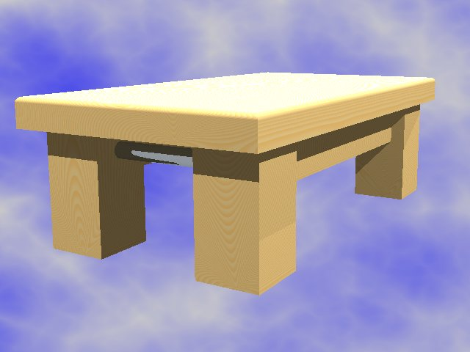
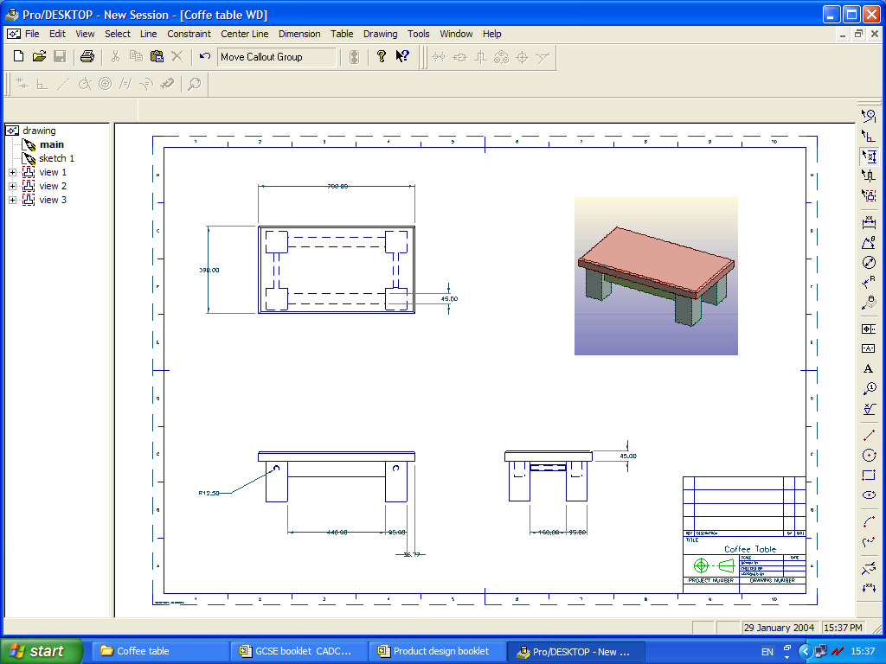
1: CAD (Computer-Aided Design)
There are many different CAD packages available on the market and all have good points and bad points. Some packages may be more suitable for some people and tasks than others, but a lot of the time it just comes down to what you are familiar with and what you prefer.
A common and popular CAD package is Pro-Desktop; this is very useful because you can produce your design in it, produce an orthographic projection from it, and also render it within the same package. With some packages it is required that you export the design file into a separate rendering package.
The design is produced from scratch
A presentation drawing is produced to show the client what their product will look like
An orthographic projection is produced with dimensions on it that can be taken into the workshop or factory

Slide 5
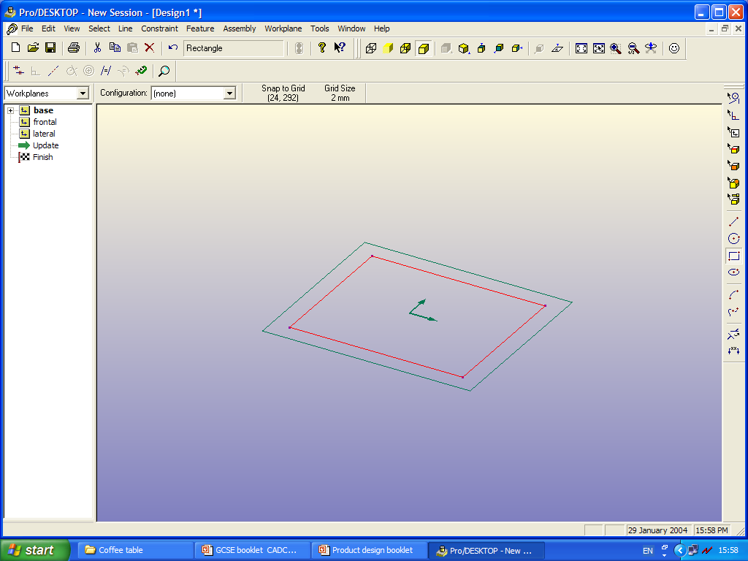
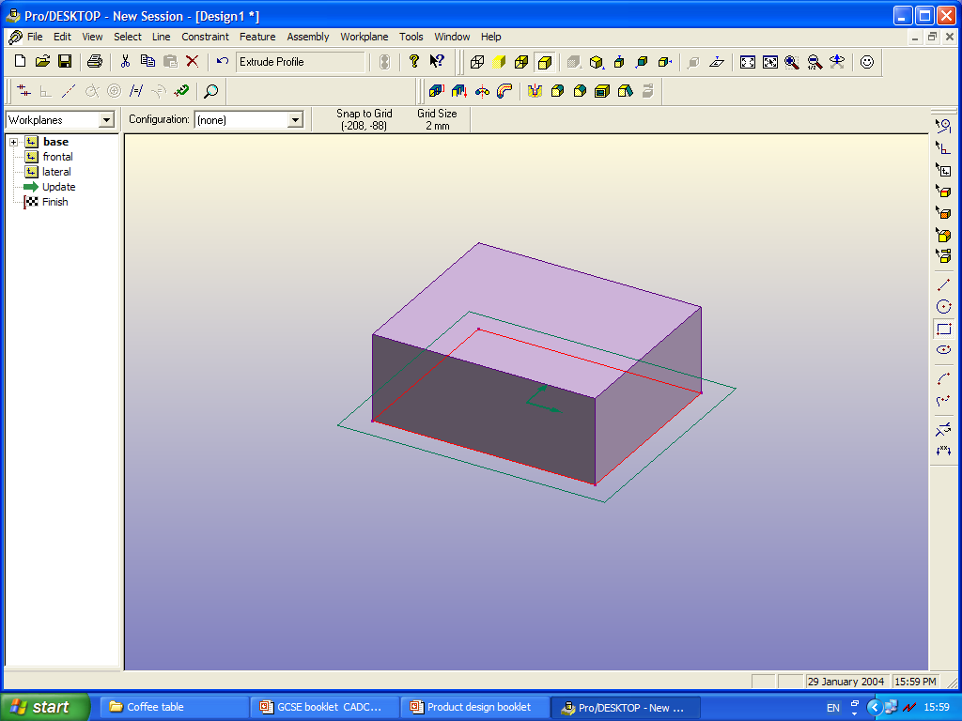
1: CAD (Computer-Aided Design)
You do not need to have a specific CAD package to produce Computer-Aided Designs.
List at least 6 different packages that could help you produce CAD:
1. …………………………………
2. …………………………………
3. …………………………………
4. …………………………………
5. …………………………………
6. …………………………………
Q. What function would you have to execute to make this rectangle shape (above) into the cuboid form (below)?
A. …………………………………….
2D rectangle
3D cuboid

Slide 6
2: CAM (Computer-Aided Manufacture)
CAM is a term used to describe production processes where machine tools and equipment are controlled by a computer.
CNC machines or ………………………………… machines were developed in the 1960s but due to the cost of the computers only large corporations could afford to invest in them.
Nowadays, with the computer revolution well under way it is possible to power all of the machine tools at a relatively low cost. Electronic storage means that instructions for the machines can be downloaded very quickly and any changes to the instructions can be made quite easily.
Machine
program input
Detailed working drawings
CAD system
Computer
(controller)
Machine tools
The computer has the ability to accept information from different sources and to control more than one machine at the same time.
Production output
Advantages and disadvantages of CAM
Advantages Disadvantages
…………………………………… …………………………………...
…………………………………… …………………………………...
…………………………………… …………………………………...
…………………………………… …………………………………...
…………………………………… …………………………………...
…………………………………… …………………………………...

Slide 7
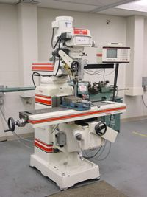
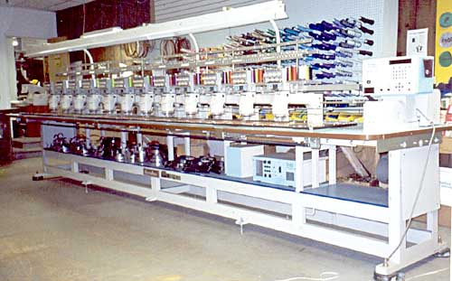
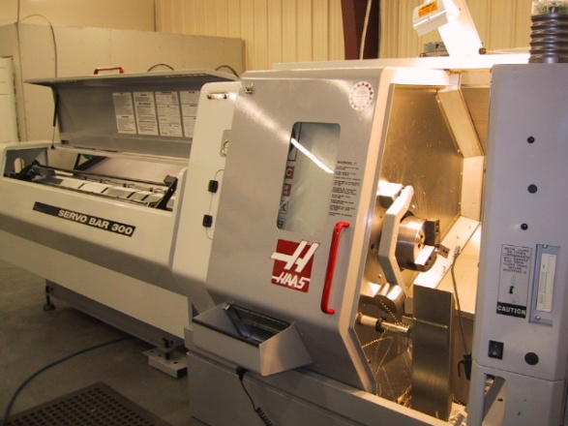
2: CAM (Computer-Aided Manufacture)
There are many different types of CAM machine in industry, from a CNC lathe to an embroidery machine that would sew the design of a club or school badge onto a sports shirt.
Use arrows to correctly join each machine name with its picture.
CNC embroidery machine
CNC lathe
CNC milling machine
Using research techniques, find at least 4 more CNC machines:
1. …………………………………………
2. …………………………………………
3. …………………………………………
4. ………………………………………...

Slide 8
2: CAM (Computer-Aided Manufacture)
Some schools are lucky enough to have CAM machines in their D&T departments. Here is a Roland STIKA machine and a Roland MODELA.
This is the STIKA machine. It etches out shapes and words accurately onto a roll of plastic sticker. This is a very useful tool to have in a department. It is also known as a vinyl cutter.
STIKA in action
The Roland MODELA is a more expensive machine but it too is a very useful design tool to have. It can produce detailed and intricate engravings such as the ones below or even produce complex 3D models out of materials such as styrofoam.
Door name-plates
Air hockey mallet model

Slide 9
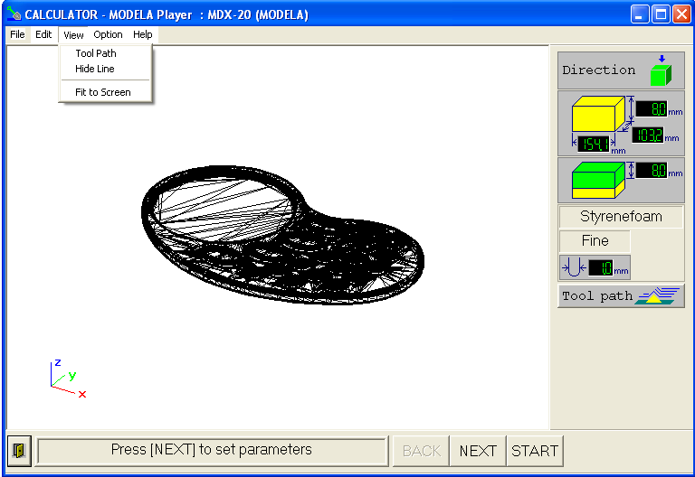
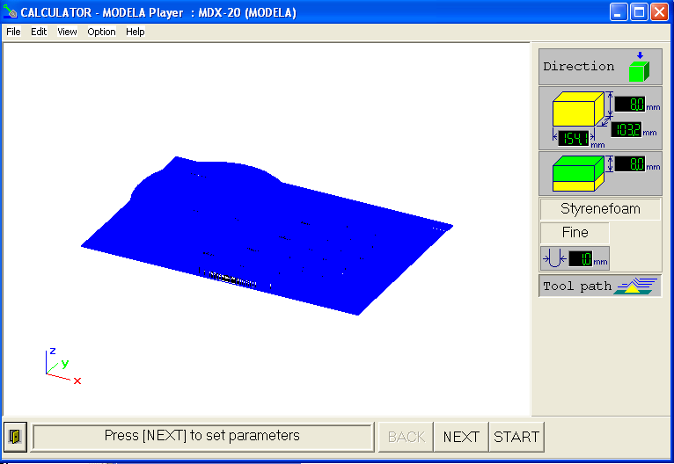
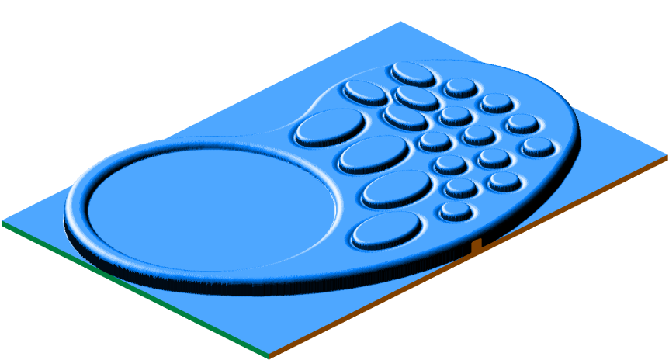
2: CAM (Computer-Aided Manufacture)
A styrofoam model can be produced quite quickly and very accurately using the Roland Modela. Once you have designed your product on Pro-Desktop or another CAD package you must save it as a Stereo Lithography File or a .stl
Save your ProDesktop drawing as a stereo lithography file by using the FILE menu and EXPORT option.
Open VIRTUAL MODELA PLAYER and then open the .stl file that you saved from ProDesktop.
It will create an image similar to the one on the left.
Spur Gear Drive
Generate a tool path after having set the resolution to fine. It will take a minute for the computer to calculate the path and draw it on the screen.
Go to FILE – OUTPUT PREVIEW, and VIRTUAL MODELA will automatically start, and produce a graphic image of what the MODELA-MDX20 will produce.

Slide 10
2: CAM (Computer-Aided Manufacture)
Before you can produce the ‘hard’ model there are several steps you must follow to set the machine up; these are the same for most machines like the Modela.
You must fill in information so that the machine knows how deep to cut, how many cuts it will have to make, the diameter of the tool used to make the cuts and how fast it cuts – this is known as the ………….. rate.
Use arrows to show whereabouts on the picture you would set up each of the points below.
How deep to cut
How many cuts it will make
Tool diameter
Feed rate
Also in setting up the machine, you must set the ‘Z’ axis. This is important because the machine must know where to start from.
The tip of the cutter must sit directly on the …………….. of the material.
‘Z’ axis to position the cutter at the start point

Slide 11
3: Rapid Prototyping
Model-making has always played a key role in product design and development – whether through making 2D sketched models that allow us to explore the visual form, or producing card, plasticine or other more solid models that enable us to test more functional qualities, or even to producing a fully working prototype model.
Time is money! This is why designers must try to develop their products and have them on the market as soon as possible.
‘Rapid Prototyping’ is a quick method of producing 3D models direct from a CAD drawing. It is very accurate and can be used to create intricate and complex forms.
Unlike the methods shown on the previous page (the Roland STIKA machine and the Roland MODELA), Rapid Prototyping is not a subtractive process, i.e. material is not cut away from a block but models are constructed by building up layers.
This reduces waste and often the material not used on the final model can be used again. There are several types of RP machine on the market and they each fall into one of these four main method categories:
Model formation method | Machine type
Liquid to solid | Stereo-lithography apparatus
Bonding powders | Laser sintering 3D printing
Extrusion | Fused deposition modelling Laser engineered net shaping
Stacking of layers | Thermojet Laminated object modelling
In this section we shall be looking at:
3.1 Selective laser sintering (SLS)
3.2 Stereo-lithography apparatus (SLA)
3.3 3D printing (3DP)

Slide 12
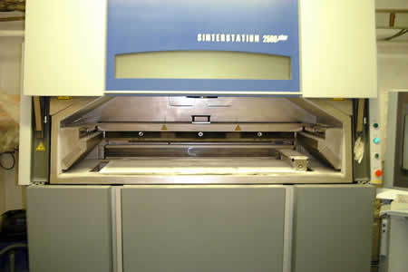
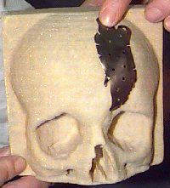
3.1: Selective Laser Sintering
This is a picture of a laser-sintering machine. Visit these two websites and describe in general terms how this rapid prototyping process works, what materials are used and examples of components made using this technique.
www.acucast.com/rapid_prototyping_sls.htm & www.3d-cam.com/services/sls.asp
Description:………………………………………………………………………………………………………………………………………………………………………………………………………………………………………………………………………………………………………………………………………………………………………………………………………………………………………………………………………………………………………………………………………………………………….
Materials: …………………………………………………………………………………
Example products: ………………………………………………………………………
The medical world has benefited greatly from rapid prototyping techniques such as this one. Here is a model of a skull that has been made from information taken from a head scan of a patient, and fed into an SLS machine. This will show the doctors quite clearly what the problems are and where exactly they are, thus minimising the risk of further illness during operation.

Slide 13
3.2 Stereo-lithography Apparatus
Visit these websites and describe in general terms how this rapid prototyping process works, what materials are used and examples of components made using this technique.
www.acucast.com/rapid_prototyping.htm
www.3d-cam.com/services/sla.asp
www.what-is-injection-moulding.com/stereo-lithography.aspx
Description:…………………………………………………………………………………………………………………………………………………………………………………………………………………………………………………………………………………………………………………………………………………………………………………………………………………………………………………………………………………………………………………………………………………
Materials: ………………………………………………………………………………
Example products: ……………………………………………………………………...
State the main differences between this process and that of Selective Laser Sintering and give the advantages and disadvantages of this one.
Differences……………………………………………………………………………………………………………………………………………………………………………………………………………………………………………………………………………………………………………………………………………………………
Advantages Disadvantage

Slide 14
3.3: 3D Printing
Visit this website and describe in general terms how this rapid prototyping process works, what materials are used and examples of components made using this technique.
www.imcuk.org/rapid/3dp.html
Description:………………………………………………………………………………………………………………………………………………………………………………………………………………………………………………………………………………………………………………………………………………………………………………………………………………………………………………………………………………………………………………………………………………….
Materials:……………………………………………………………………………….
Example products:………………………………………………………………………
Use sketches and notes to explain how it is possible to manufacture a fully functional plastic whistle, with a pea inside, using this process:

Slide 15
4: Production Methods
In this section we shall look into different methods of production.
The production method selected depends on how many products are to be manufactured.
One-off/job production
Batch production
Mass production
Continuous/flow production
Each of these different methods is explained on the following pages.
In addition to these four production methods we shall be looking at different ways in which the design and manufacturing teams liaise to come up with the finished product.
There are two main ways that this is done:
Sequential engineering
Concurrent engineering
We shall also look at a very efficient and cost-saving method of production called
‘Just-in-time’ (JIT) production
Finally we shall be looking into Quality Control and Quality Assurance issues.

Slide 16
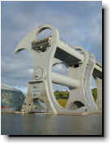
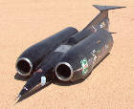
4: One-off Production
This method is used to produce individual items to a customer’s specification, but at a high unit cost.
These ‘jobs’ are normally produced by ………………………in a workshop environment. This is time consuming, very expensive and labour intensive. However, it offers total flexibility and the opportunity to custom-make products.
Here are some examples of products that were a ‘one-off’:
The Falkirk wheel was a one-off project.
This is Thrust SSC, a supersonic car powered by jet engines. It was test driven in the Nevada Desert in the USA and was driven by a fighter jet pilot because of the immense forces involved.
List some other products that are examples of one-offs. Use sketches to support your answers.
1. ……………………………………..
2. ……………………………………..
3. ……………………………………..
4. ……………………………………..

Slide 17
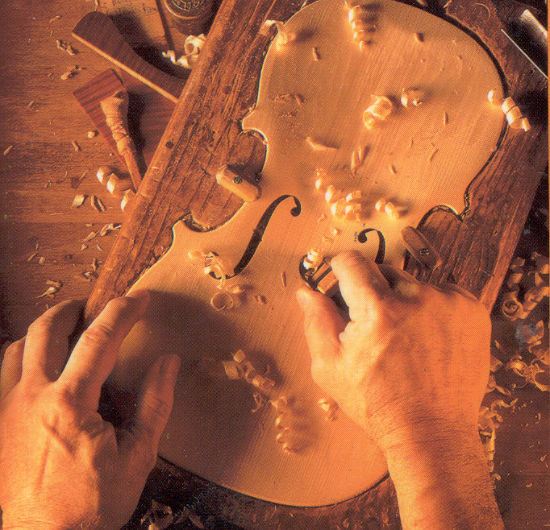
5: Batch Production
Larger quantities of identical products can be produced using this method. Each operation is completed for the whole batch of items before the next operation is carried out. Batch production can use ‘mass production’ manufacturing methods and the quantity produced can be increased or reduced easily, according to demand. Different types of jig are usually used in the manufacture of batch-produced items.
Violins are usually made in batches of about four.
Ensuring repeatability in the production of a model can be achieved in several ways. List them:
1. …………………………………….
2. …………………………………….
3. …………………………………….
4. …………………………………….
List some other products that you know are batch produced:
…………………………………….
…………………………………….
…………………………………….
…………………………………….

