Slide 1
CAD CAM
Computer Aided Design
Computer Aided Manufacture

Slide 2
The Basics
What do the letters stand for?
The Pro’s and Cons
Different Machines involved in CADCAM
File Types

Slide 3
CAD CAM
Pros
Streamline CNC Programming Workflow
Increase CNC Partmaking Potential
Customisable
Eliminates Waste & Costly Errors
Stay Competitive
Cons
Expensive to install
High maintenance cost
Loss of skilled work force
Notes:
PROS
How can manufacturing companies stay competitive and lean in the current manufacturing and economical climates. CAD/CAM is used to make things and technology has everything to do with how consumer products are being designed and made faster, smarter and more affordable than ever before. CONS

Slide 4
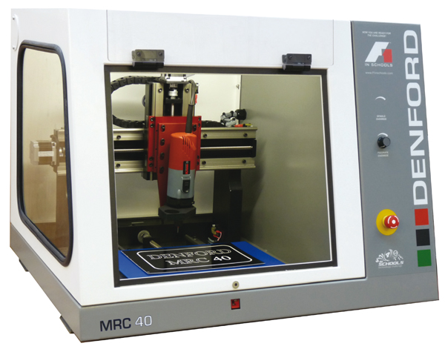
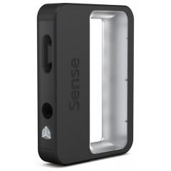
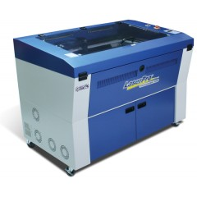
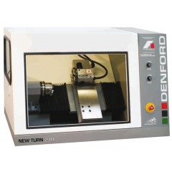
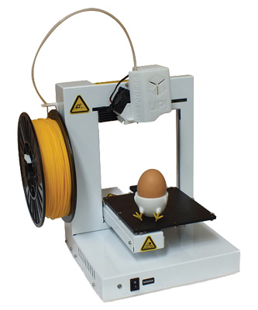
The Machines
3D Printer
3D Scanner
Laser Cutter
CNC Lathe
CNC Router

Slide 5
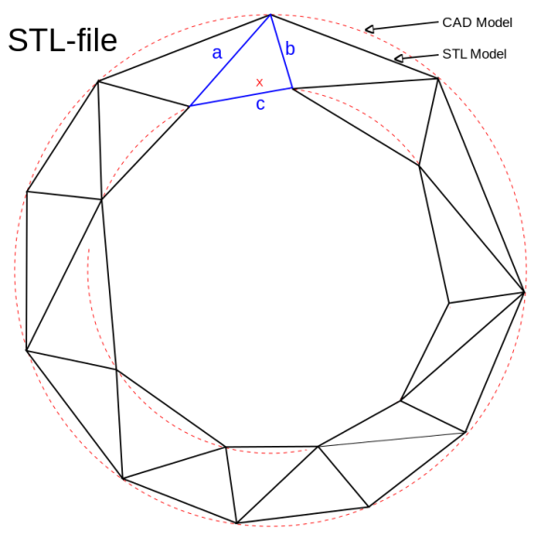
File Types
The best option is a neutral file type that can be read by a variety of different software:
STL is the standard file type used by most additive manufacturing systems.
DXF are commonly used to in 2D manufacture such as plasma cutting and laser cutting.

Slide 6
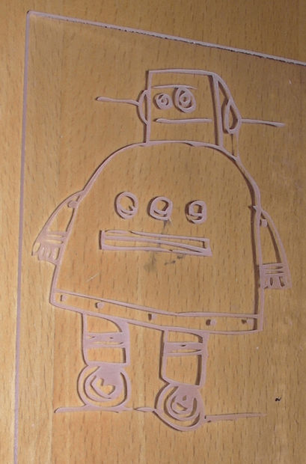
File Types
For laser cutting a vector or raster image can be used.
If using a VECTOR, The laser can cut all the way through the material. With RASTER it can only etch on to the materials surface.
Vector file requires the laser to always be on and will cut out where as a Raster wil work like an inkjet printer stopping and starting. This is why it is used for etching.
Notes:
http://www.instructables.com/id/How-to-Use-a-Laser-Cutter/step7/Vector-vs-Raster/

Slide 7
Advanced Knowledge
Preparing for CAM
Surface Finish and Datums
Volume, Mass

Slide 8
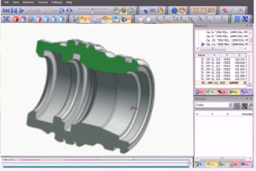
Prepare for CAM production
What is it?
During the manufacturing process, production engineers will use the models and CAD drawings that have been produced by the draughtperson.
For this to work correctly, the CAD technician will be required to follow strict protocols when producing the models so that all the data required is set to the same layer.
3D CAD models must also be drawn to mid tolerance; once again, there must be a clean shape without additional features such as text or borders. This model will be used by the production engineer to convert the model into the required tool paths for the specific machine that will be used.

Slide 9
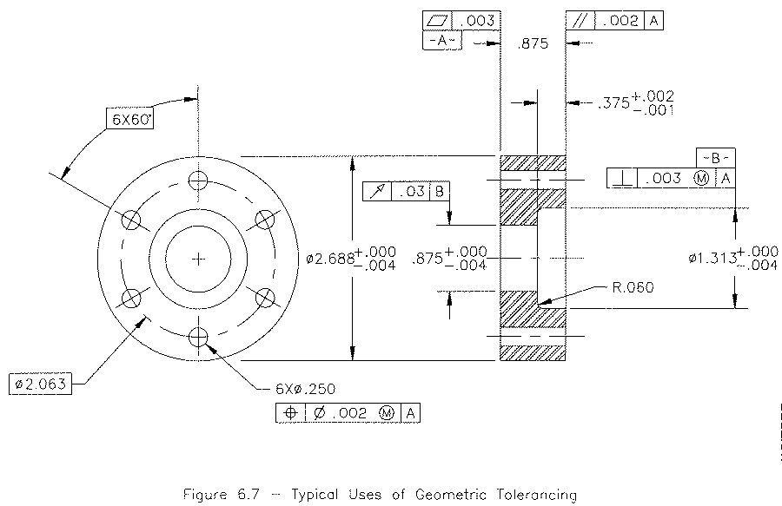
Prepare for CAM production
How does it work?
The model that is produced during the design process is used for the purpose of producing the CNC program to save on time and the reproduction of work. By producing the original model to mid tolerance, the production department can ensure that the finished model will be produced at the desired size.

Slide 10
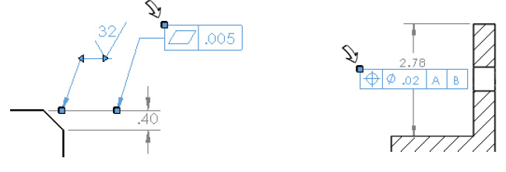
Surface Finish & Datums
What is it?
During the production process it is necessary to ensure that the tolerance between features remains within prescribed limits. To ensure this happens, a working drawing will have additional features added along with the original dimensions. These are datum features and control boxes as well as surface finish symbols.
Notes:
Qualification of Datum Features
Two Holes as Datum Features

Slide 11
Surface Finish & Datums
How does it work?
The Datum feature such as concentricity, parallel, flatness and perpendicularity can be added to a dimensioned surface then the corresponding surface has a control box that has the values and tolerance connected to that face.

Slide 12
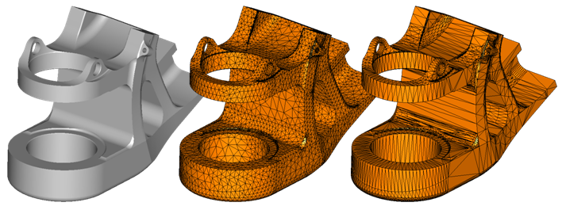
Gathering model information on volume, centre of mass and mass of the model.
What is it?
Within the engineering industry, there will be occasions when the mass of a finished assembly or volume of a casting is required. This will allow the weight of this object to be determined. If the assembly is a large piece of equipment, the manufacturer may require the total mass for shipping purposes or handling.

Slide 13
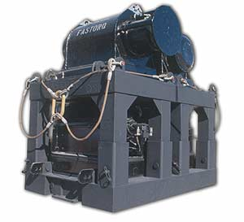
Gathering model information on volume, centre of mass and mass of the model.
How does it work?
CAD software allows us to quickly establish the total mass of irregular shapes once the specific material has been established. The software will also determine the centre of gravity for an irregular shape which will allow the fixing of lifting eyes and also informs engineers if a particular assembly requires a counter balance weight.
Notes:
http://www.lcm-wci.com/product/triple-crown-bop-xsport/

