Slide 1
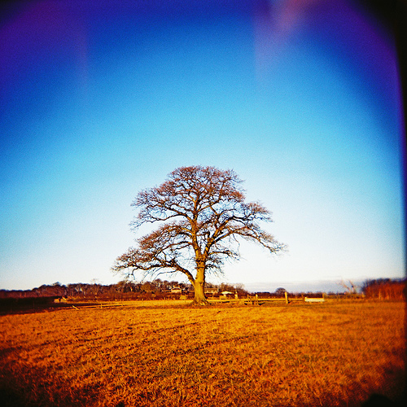

Slide 2
Learning Intentions
To identify different types of wood and their properties

Slide 3
Success Criteria
I can state a type of softwood/hardwood/manufactured board
I can describe the properties of a type of wood
I can name different woods based on appearance
I can describe how a manufactured board is constructed

Slide 4
Why do we need to know about types of wood?
Hardwoods and softwoods have different properties, this means that they can be used in different ways and for different products.

Slide 5
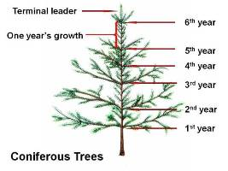
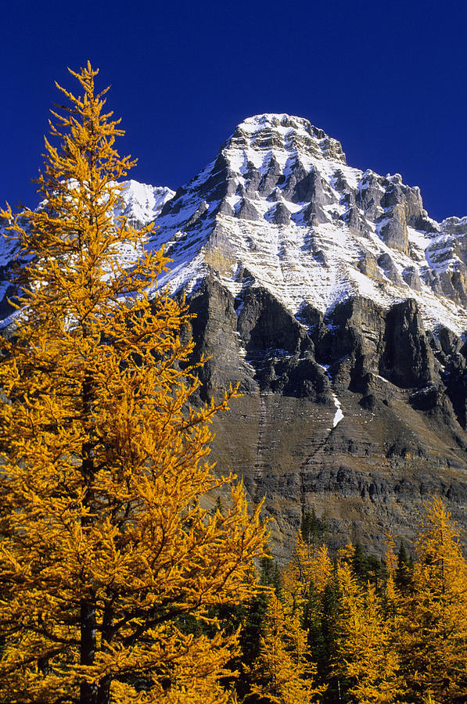
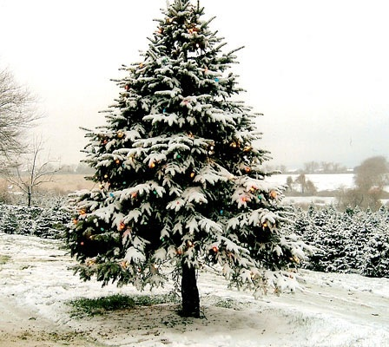
How do I know the difference?
Most softwood trees have spiky leaves and are coniferous (Larch is an exception it’s deciduous) with branches forming in whorls (rings) of two or more at the same level.
Larch Tree

Slide 6
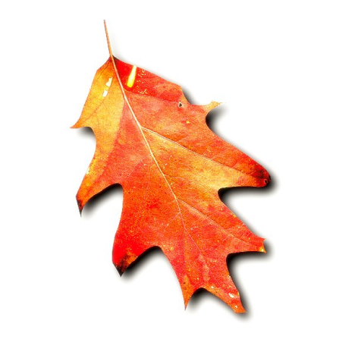
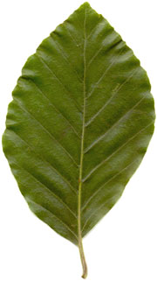
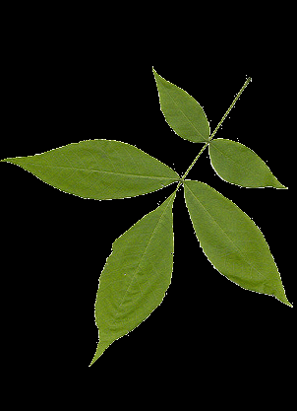
How do I know the difference?
Hardwood Trees have broad, flat leaves and are deciduous (Yew and Holly being exceptions).
Branches usually grow at different levels and never more than two at the same level. Unlike softwoods which are specifically grown and forested most hardwoods, especially tropical ones, occur at random and are naturally growing.

Slide 7
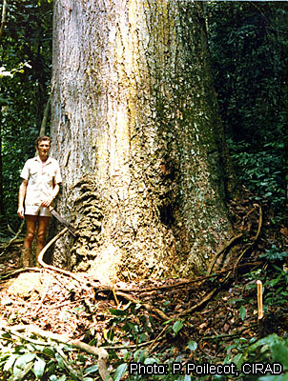
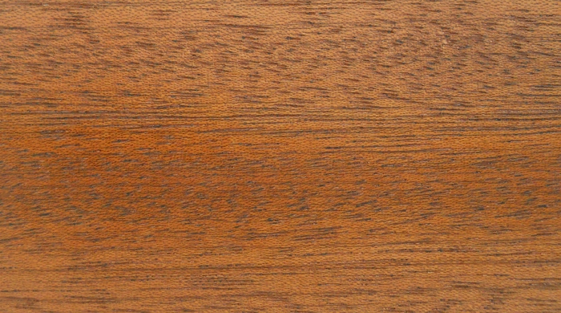
Utile Tree
In central Africa
This makes felling and collection difficult raising the prices considerably against softwood. This fact, and of course diminishing stocks, have led to greater interest in lesser known hardwoods such as Utile

Slide 8
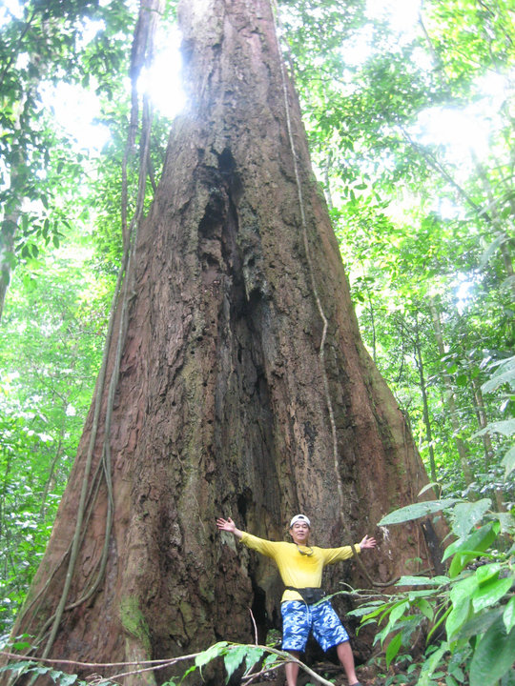
Meranti
Grown in the Philippines
Sometimes known as the Philippine’s Mahogany

Slide 9
How do I know the difference?
Manufactured boards are made up of the scraps of trees and are compacted together by manmade processes.
The wood does not stick together on its own and needs an adhesive to chemically attach them together.
Formaldehyde is the commonly used compound to do this, however this is not safe to be exposed to over a length of time.

Slide 10
Softwoods
 | Type Of Wood | Appearance | Properties | Uses
Softwoods | RED PINE | Light colour with reddish grain and knots | Long straight trunk, strong inexpensive, fast growing | Building, joinery
 | WHITE PINE | Light colour with light brown grain and small dark brown knots | Long straight trunk, strong inexpensive, fast growing | Building, joinery
 | CEDAR | Knot free, straight grain | Light, strong, resists rot | Weather boarding

Slide 11
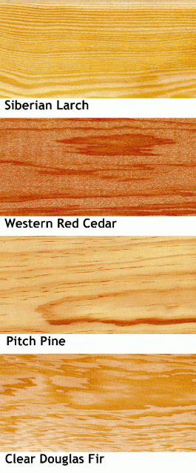
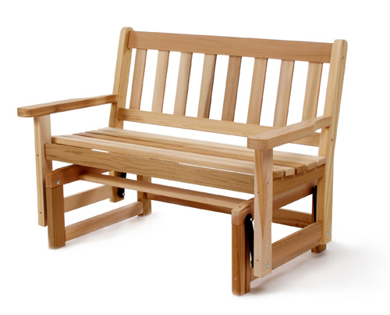
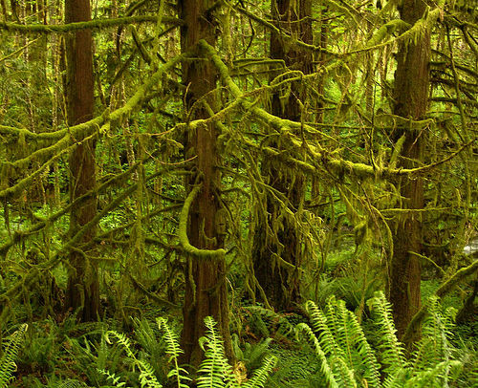
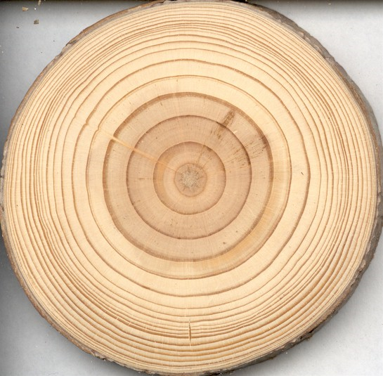
Softwoods

Slide 12
Hardwoods
Hardwoods | OAK | Golden brown | Strong, durable | Gates, posts, boats, furniture
 | WALNUT | Brown with a fine grain | Works well, high quality finish | Furniture veneers
 | BEECH | Flecks on a light pinkish wood | Doesn’t split, hard and can be laminated into curves | Toys, furniture
 | MERANTI | Reddy Brown colour with specks | Easy to cut, strong gives a good finish | Toys, storage
 | ASH | Brown colour with darker brown grain | Robust, hardwearing | Joinery, furniture

Slide 13
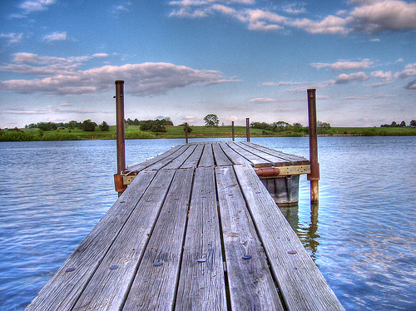
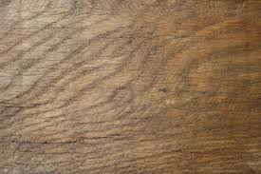
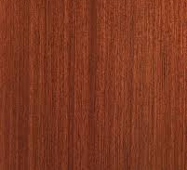
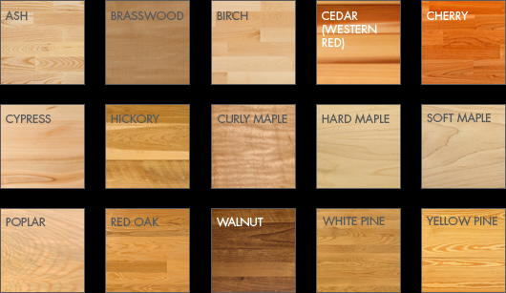
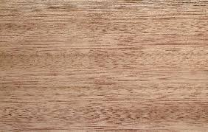
Hardwoods
Oak
Mahogany
Meranti

Slide 14
Manufactured Boards
BLOCKBOARD | Blocks glued between veneers | Flat, stable, won’t warp or split, supplied in large sheets | Furniture, table tops, drawing boards, can be laminated with thermo-setting plastic to make worktops
PLYWOOD | Layers of thin wood
MDF | Smooth surface, no grain
CHIPBOARD | Smooth surface
HARDBOARD | Coarse texture, smooth one side, textured other

Slide 15
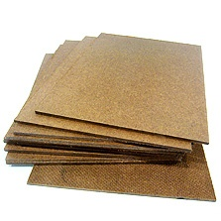
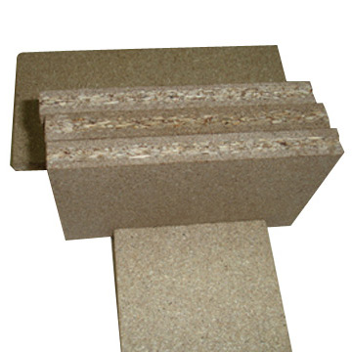
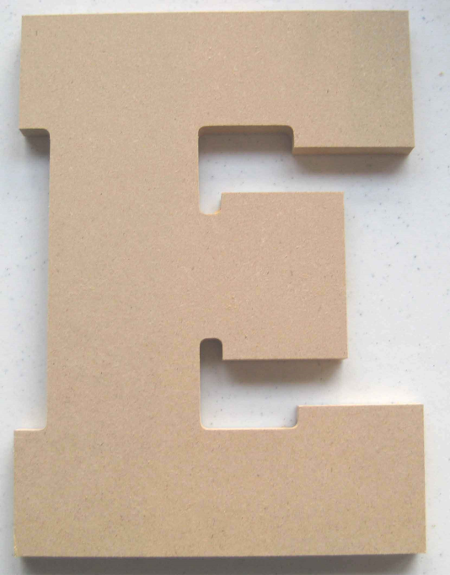
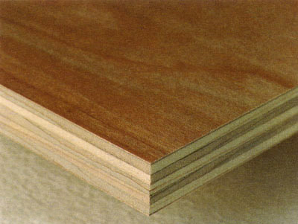
Manufactured Boards

Slide 16
Your Task
Write down:
How many softwoods you know.
How many hardwoods you know.
How many manufactured boards you know.

Slide 17
Your Task
What are the properties of Red Pine?
What are the properties of Oak?
What are the properties of Plywood?

Slide 18
Your Task
Write down:
Products are made of softwoods
Products are made of hardwoods
Products are made of manufactured boards

