Slide 1
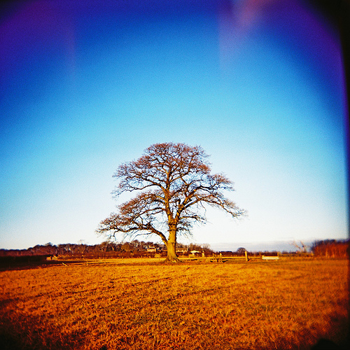
Wood Types

Slide 2
Softwoods

Slide 3
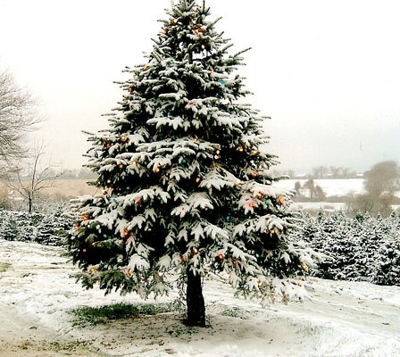
Larch
Most softwood trees have spiky leaves and are coniferous (Larch is an exception, and deciduous) with branches forming in whorls (rings) of two or more at the same level.
Larch (Larix decidua) is the only deciduous conifer native to central Europe. It was introduced to Britain in the 17th century.

Slide 4
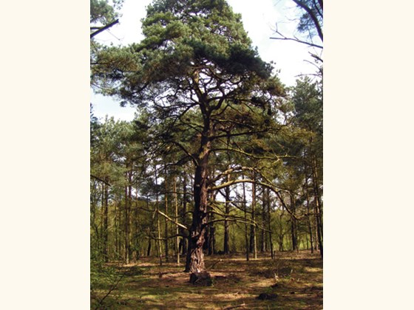
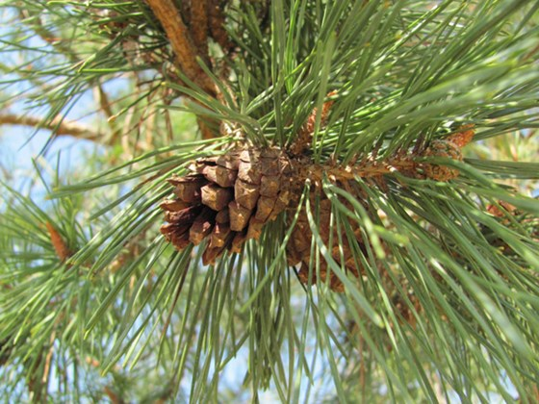
Scots Pine
Scots pine (Pinus sylvestris) is an evergreen conifer native to northern Europe, and is one of just three conifers native to the UK.

Slide 5
Hardwoods

Slide 6
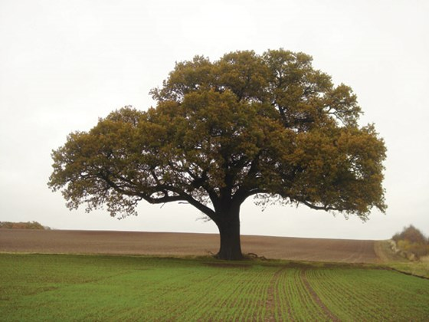
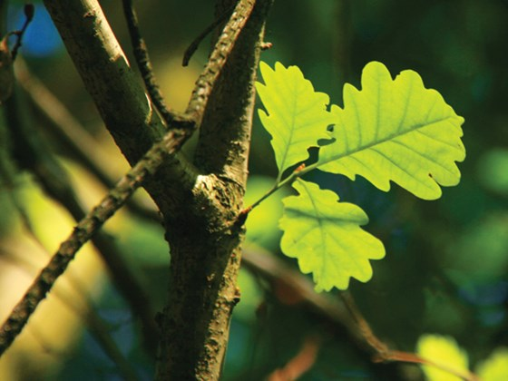
Oak
English oak (Quercus robur) is arguably the best known and loved of British native trees. It is the most common tree species in the UK, especially in southern and central British deciduous woods.

Slide 7
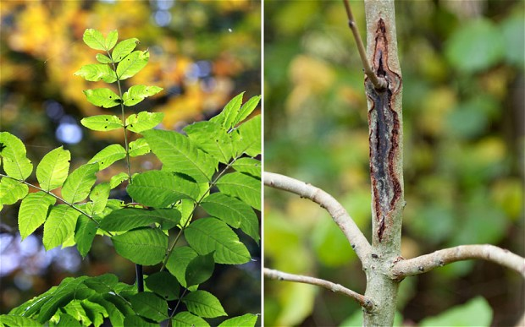
Ash
Tough and flexible - Ash is one of our toughest native timbers and because of its flexibility it can withstand pressure, shock and splintering. Traditionally ash was used for weapons and the word ash comes from the Anglo Saxon word for spear 'Aesc'. In modern times it is used wherever toughness is important as in sports equipment, tool handles, boat fittings, chair making, cabinet making and turnery.
Bending ­ Ash can be readily steam bent into curved outlines without breaking or loosing strength.
The tree disease “ash dieback” has now appeared in 115 sites across Scotland

Slide 8
Manufactured Boards
Medium Density Fibreboard (MDF)
Plywood
Chipboard
Sterlingboard
Hardboard
Blockboard

