Slide 1
The 3P’s
The P’s we use to design

Slide 2
What are the 3P’s?
Production
Promotional
Preliminary

Slide 3
What order do they come?
Production
Promotional
Preliminary
Preliminary
Production
Promotional

Slide 4
Preliminary - Orthographics
Sketches
Freehand
Good proportion
Visual quality
Range of detail
Dimensioned
Line types
Annotation
Purpose: Quick sketches to provide dimensions and understanding before making a 3D model or Production Drawings.

Slide 5
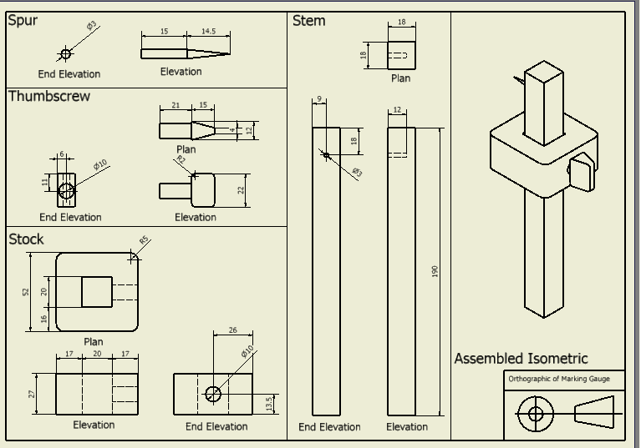
Production: CAD
An Orthographic
A Pictorial
Dimensions
Technical Detail
Parts List
Purpose: Detailed drawings that provide the manufacturer information on how to create each part and how to assemble the product.

Slide 6
Promotional: CAG
Background
Lighting
Shadow
Reflection
Gradient
Assembled
Texture
Purpose: An item that is used to promote the company/product. Can be a range of items form Posters to Business Cards.

Slide 7
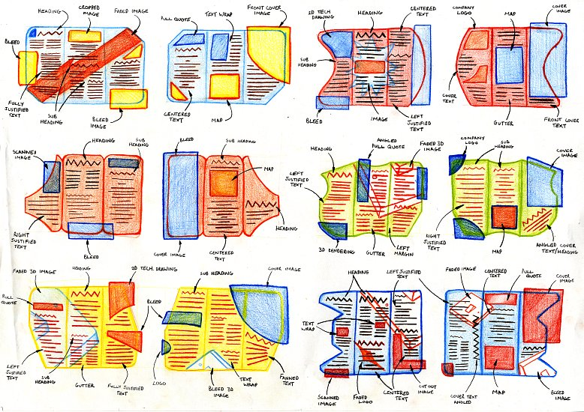
Preliminary - DTP
Thumbnail sketches
Graphic symbols
Size
Shape
Annotations
Design Principles
Design Elements
DTP Features
Purpose: Quick sketches to provide key information relating to layout, colour and shape.

Slide 8
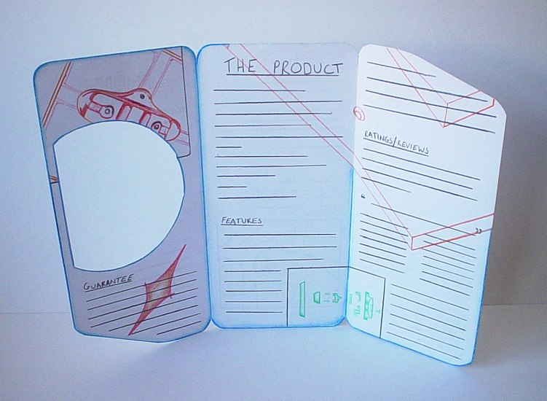
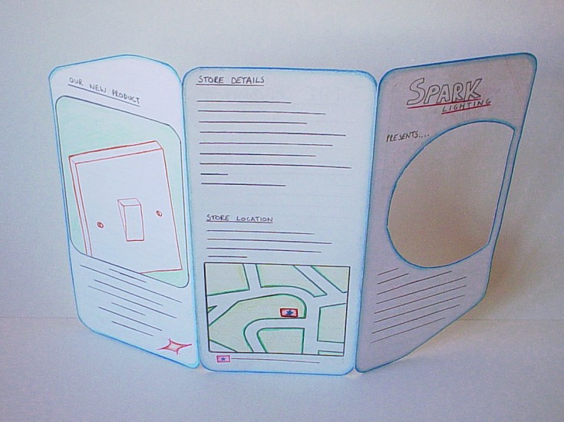
Production: Visual
Full Size
Structure
Annotation
Dimension
Font style and size
Colours
Rendered image
Purpose: A dimensioned drawings to provide essential information regarding dimensions, font type, type size and graphical images.

Slide 9
Promotional: CAG
Use your visuals
Same font throughout
Colour scheme
Consistency
Purpose: A promotional item that blends imagery and text to engage viewers.

Slide 10
Exam Question
An engineer’s office uses a range of Preliminary and Production graphics.
Explain the purpose of each type of graphic and give one example of each.
Preliminary Purpose ...................................................................................................
................................................................................................................
Example ..................................................................................................
Production Purpose ...................................................................................................
................................................................................................................
Example ..................................................................................................

Slide 11
Exam Question
A range of drawing types are used in industry within the categories Preliminary, Production and Promotional.
State the category that an orthographic drawing, showing dimensions and tolerances would be in.
Category……………………………………………..
State the purpose of this type of drawing
Purpose……………………………………………….
State a type of Promotional graphic commonly used in marketing.
Graphic………………………………………………..

