Slide 1
Viewing Graphics

Slide 2
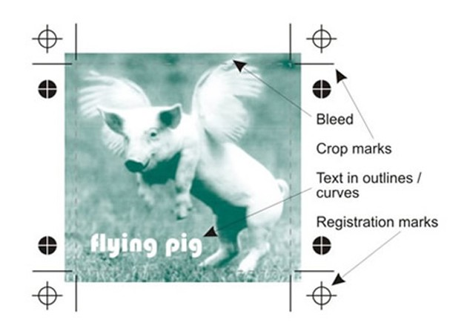
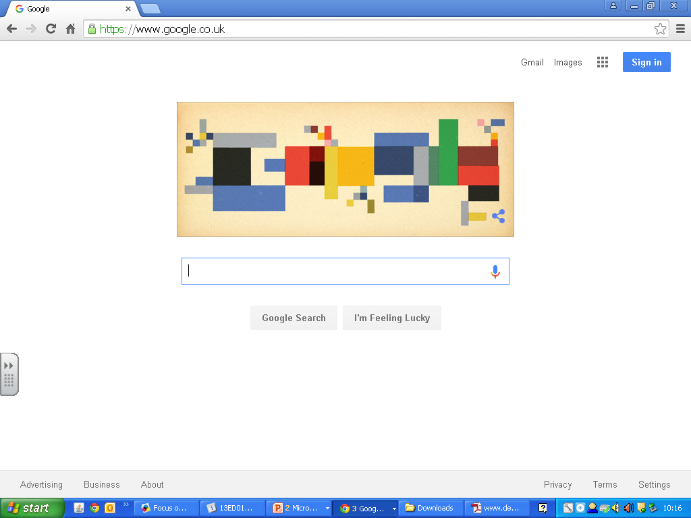
Ways to View Graphics
On Screen
Hard Copy

Slide 3
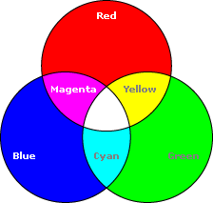
Electronic Displays
Electronic displays use RGB to produce colour.
R -
G -
B -
Red
Green
Blue
Electronic displays are normally made of extremely small LED’s. They are controlled suing an electric current. If all 3 LED’s are on then white is produces. This is called “additive colour.”

Slide 4
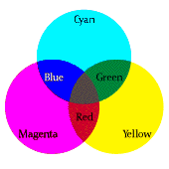
Hardcopies
All hardcopy prints require the page to be set up using CMYK.
C -
M -
Y -
K -
Cyan
Magenta
Yellow
Black Key colour
CMY overlapped in order to produce the other colours. This is called “subtractive colouring.”
When all 3 are overlapped they create a dark colour close to black but not it exactly this is why Black is still required.

Slide 5
Hardcopies
Pantone is an innovative system for identifying, matching and communicating colors to solve the problems associated with producing accurate color matches in the graphic arts community. His insight that the spectrum is seen and interpreted differently by each individual led to the innovation of the PANTONE® MATCHING SYSTEM®, a book of standardized color in fan format.

Slide 6
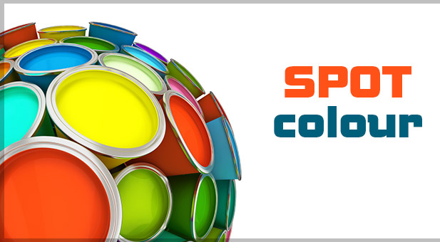
Hardcopies
In printing, a spot colour is an ink that is premixed to the colour required and printed from a dedicated plate, rather than being simulated by overprinting dots of ink from the cyan, magenta, yellow and black plates (4 colour CMYK process).
It may be a colour which cannot be achieved in CMYK, such as metallic or neon.

Slide 7
Hardcopies
When to use a Spot Colour or Pantone…
In one/two/three colour printing, e.g. you might print in orange and black alone, or red, black and silver. Can be significantly cheaper than four colour printing.
in five or more colour printing, in addition to cyan, maganta, yellow and black. e.g. as well as having a full colour image on the page, you may want to have gold elements, or print the client's logo in their signature red for best appearance.
To reinforce the company brand and ensure conformity for worldwide printing and advertising.

Slide 8
Hardcopies
Hardware that can produce Hardcopies:
Laser
Ink-Jet
Wide Format
Screen Printing
Offset Lithography
Solid Ink Systems
Flexography

Slide 9
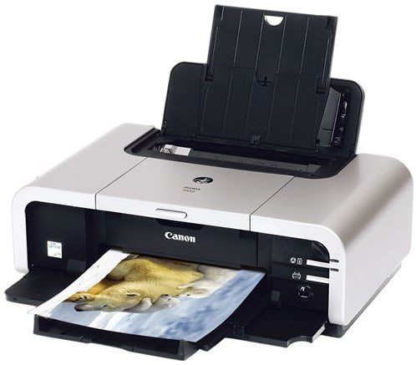
Producing a hardcopy
Inkjet – Most common printer found at home, schools and offices.
Pros and Cons
Inexpensive
Photographic quality
Print on different papers
Quick for short runs
Ink is expensive
Time to dry
Limited paper size

Slide 10
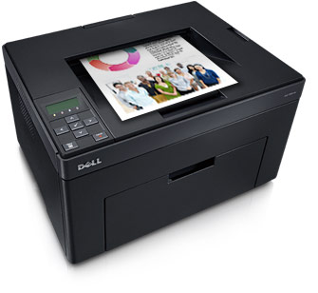
Producing a hardcopy
Colour Laser – work with toner and use a laser to fuse the toner dust to the paper.
Pros and Cons
Fairly Inexpensive
Good quality
but not photographic
Very quick for short
to medium runs
toner is expensive
Parts are expensive
Limited paper size

Slide 11
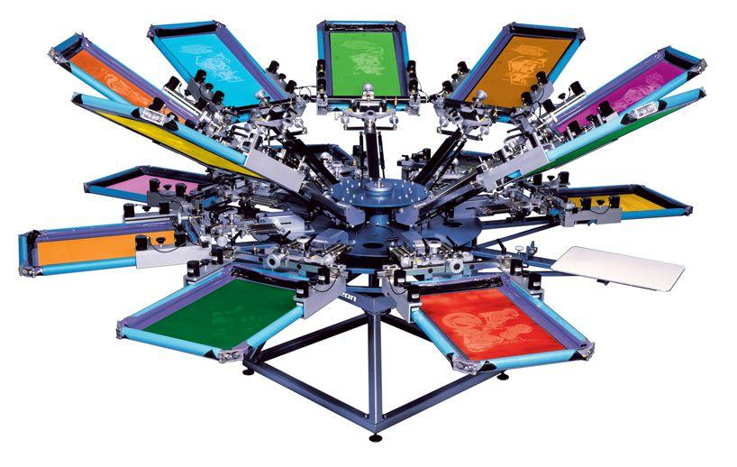
Producing a hardcopy
Screen Printing – Old fashioned but great for making t-shirts, posters or bags.
Pros and Cons
Low cost for mid volume
Bright vibrant colours
Can print on different
materials
Slow and messy
Expensive to set up
Cannot do high resolution
ink drying time

Slide 12
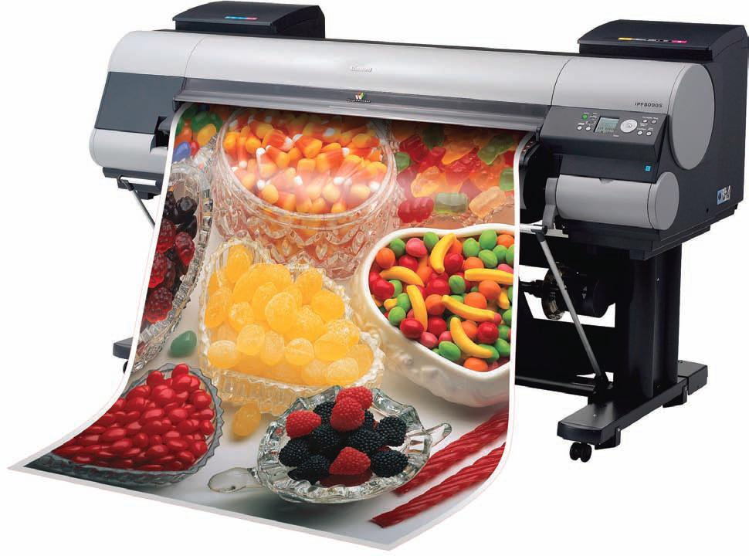
Producing a hardcopy
Wide Format Banner – Used for large banners or vehicles. Similar to an Ink Jet printer.
Pros and Cons
Can print in huge sizes
Photographic quality
Different papers
Quick for short runs of posters
Drying Time
Ink is extremely expensive
Bad for the environment

Slide 13
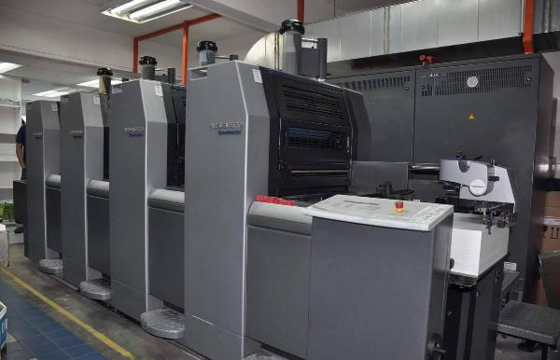
Producing a hardcopy
Offset Lithography– Great for high volume leaflets or brochures.
Pros and Cons
Cost efficient and quick
Photographic quality
Print on different paper sizes
Expensive set up
Time consuming set up
Specialist Training required

Slide 14
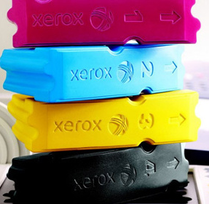
Producing a hardcopy
Solid Ink Systems
Pros and Cons

Slide 15
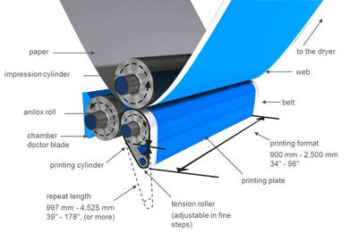
Producing a hardcopy
Flexography
Pros and Cons

