Slide 1
The 3P’s
The P’s we use to design

Slide 2
What are the 3P’s?
Production
Promotional
Preliminary

Slide 3
What order do they come?
Production
Promotional
Preliminary
Preliminary
Production
Promotional

Slide 4
Preliminary - Orthographics
Sketches
Freehand
Good proportion
Visual quality
Range of detail
Dimensioned
Line types
Annotation
Purpose: Quick sketches to provide dimensions and understanding before making a 3D model or Production Drawings.

Slide 5
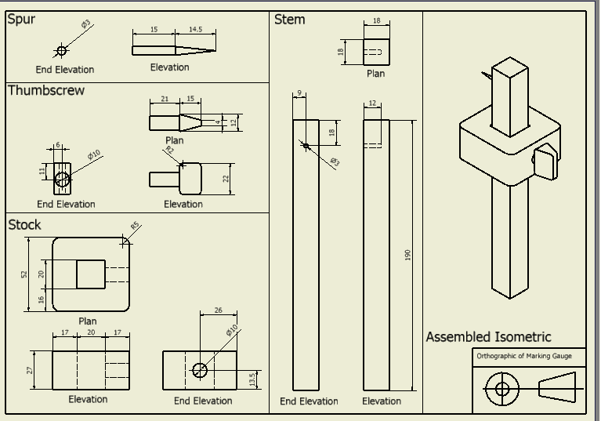
Production: CAD
An Orthographic
A Pictorial
Dimensions
Technical Detail
Parts List
Purpose: Detailed drawings that provide the manufacturer information on how to create each part and how to assemble the product.

Slide 6
Promotional: CAG
Background
Lighting
Shadow
Reflection
Gradient
Assembled
Texture
Purpose: An item that is used to promote the company/product. Can be a range of items form Posters to Business Cards.

Slide 7
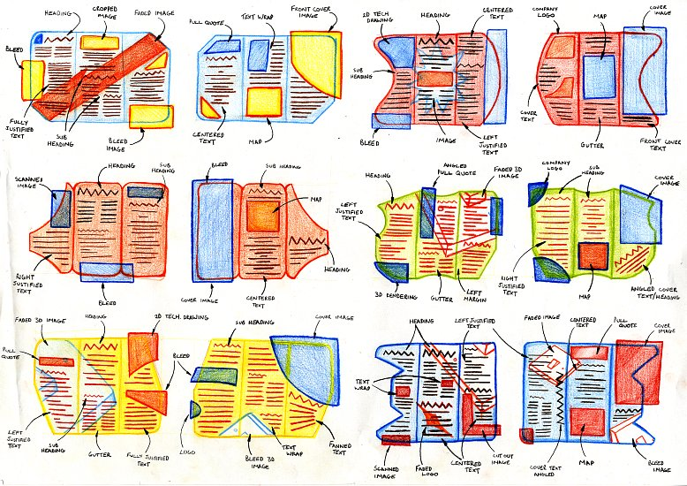
Preliminary - DTP
Thumbnail sketches
Graphic symbols
Size
Shape
Annotations
Design Principles
Design Elements
DTP Features
Purpose: Quick sketches to provide key information relating to layout, colour and shape.

Slide 8
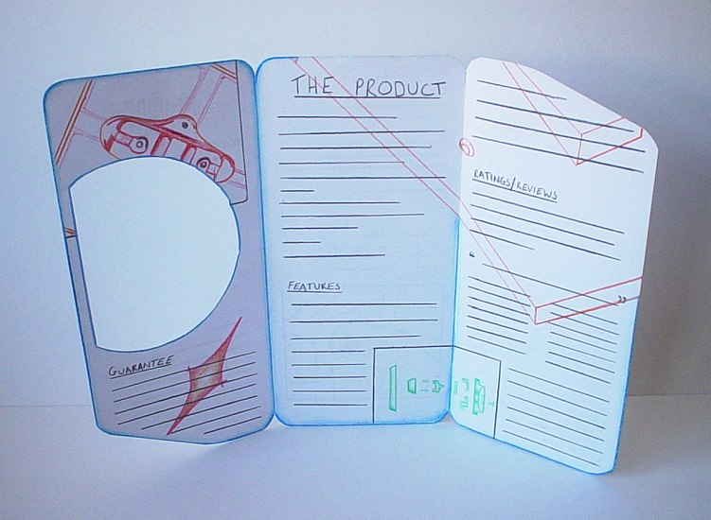
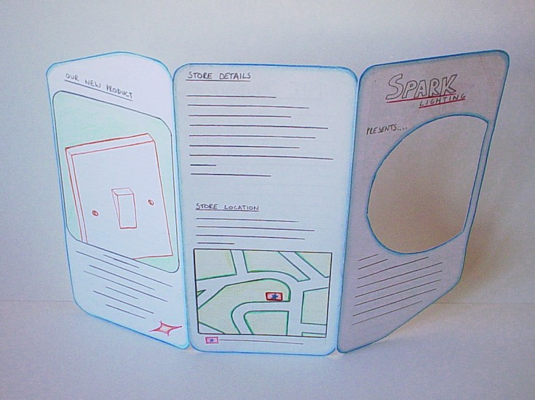
Production: Visual
Full Size
Structure
Annotation
Dimension
Font style and size
Colours
Rendered image
Purpose: A dimensioned drawings to provide essential information regarding dimensions, font type, type size and graphical images.

Slide 9
Promotional: CAG
Use your visuals
Same font throughout
Colour scheme
Consistency
Purpose: A promotional item that blends imagery and text to engage viewers.

Slide 10
Exam Question
An engineer’s office uses a range of Preliminary and Production graphics.
Explain the purpose of each type of graphic and give one example of each.
Preliminary Purpose ...................................................................................................
................................................................................................................
Example ..................................................................................................
Production Purpose ...................................................................................................
................................................................................................................
Example ..................................................................................................

Slide 11
Exam Question
State the name of 3 Promotional Graphics a Construction company may distribute.
i………………………
ii……………………..
iii…………………….
Explain the purpose of distributing Promotional Graphics.
………………………………………………………………………………………………………………………………………………………………………………………………………………

