Slide 1
National Design and Manufacture
Revision Session 2

Slide 2
Topics covered
Design Factors
Idea Generation
Marketing

Slide 3
Design Factors
Aesthetics
Ergonomics
Economics
Environment
Safety
Function

Slide 4
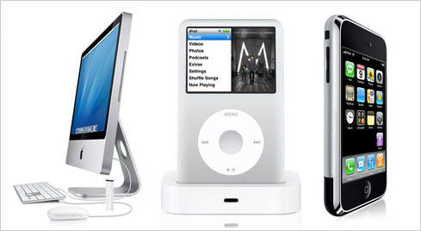
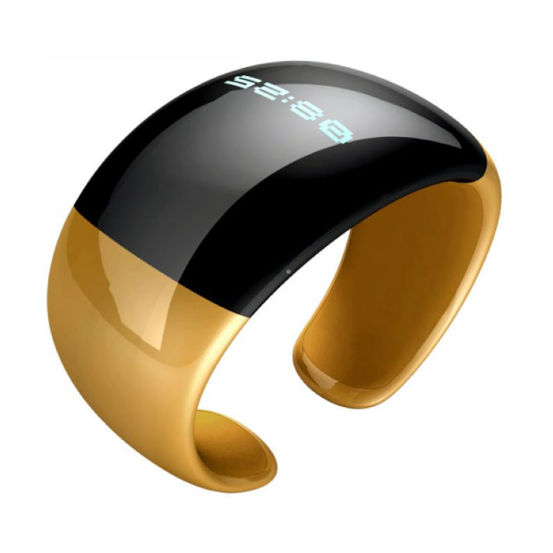
Aesthetics
Shape
Form
Line
Pattern
Texture
Harmony
Balance

Slide 5
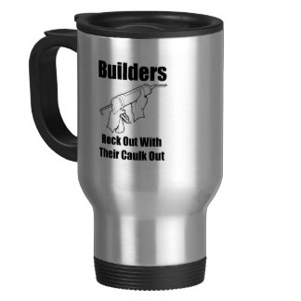
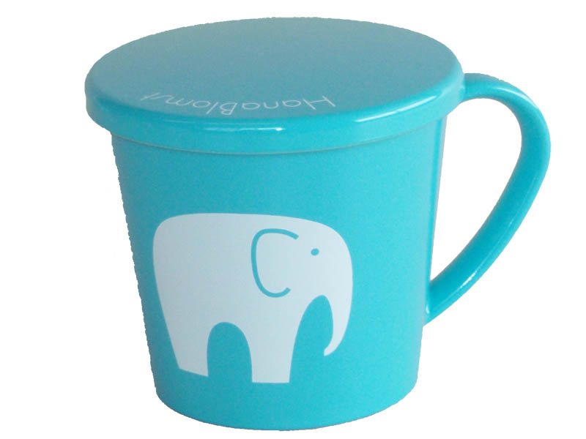
Compare the aesthetics of these two mugs (6 marks)

Slide 6
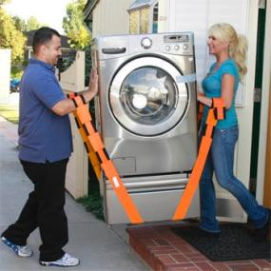
Ergonomics
Physiology
Can the person use the product comfortably

Slide 7
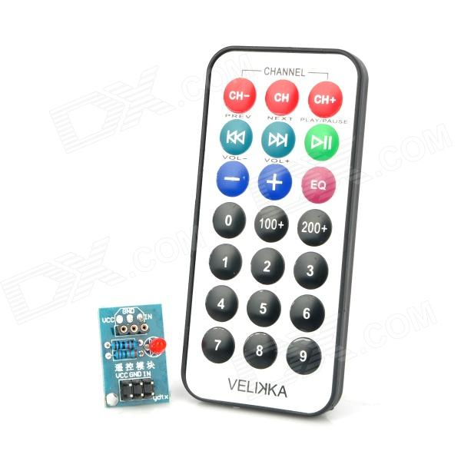
Psychology
How the user interacts with the product

Slide 8
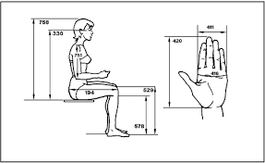
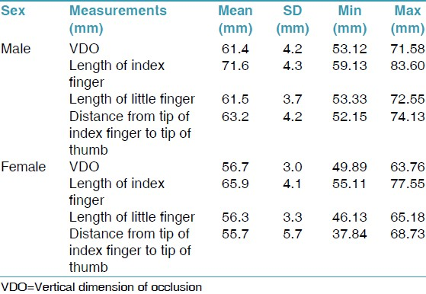
Anthropometric data
Study of human sizes
Using data to help users fit products

Slide 9
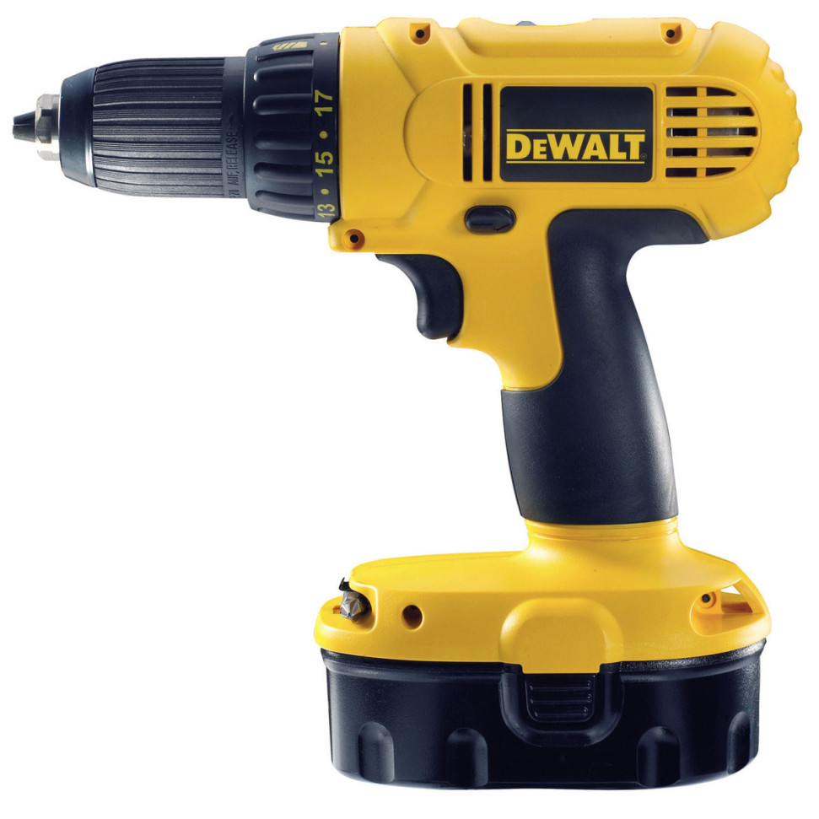
Describe three ways that ergonomics has influenced this product (6 marks)

Slide 10
Economics
Introductory cost
Cost of training staff
Cost of updating software
Cost of replenishing materials
Cost of paying staff-compared to machines
Selling cost to make profit

Slide 11
Describe the economic implications of a company introducing CAM (3 marks)

Slide 12
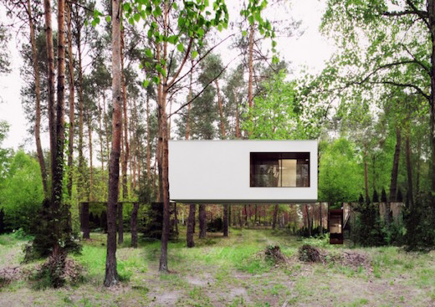
Environment
Environmentally friendly product
Reduction of material used
Reduction of waste in production process
Suitability to environment

Slide 13
Safety
Ensure safety standards met
Comply to standards for the country it will be used in
Flame retardant material
Non toxic materials

Slide 14
Describe how a product can be made more environmentally friendly (3 marks)

Slide 15
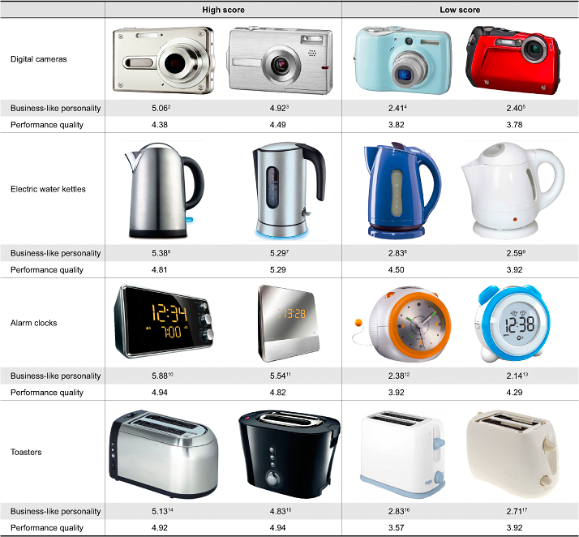
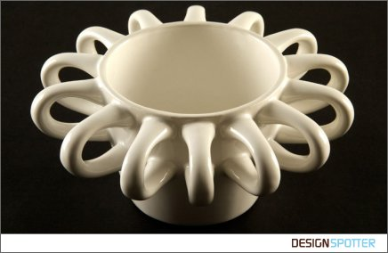
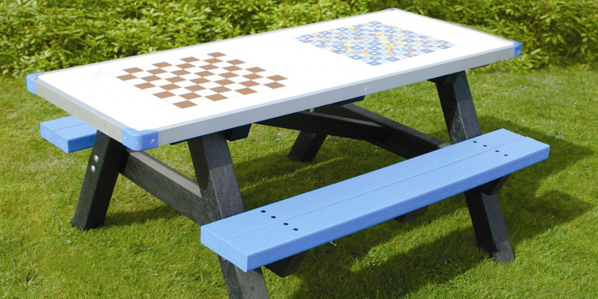
Function

Slide 16
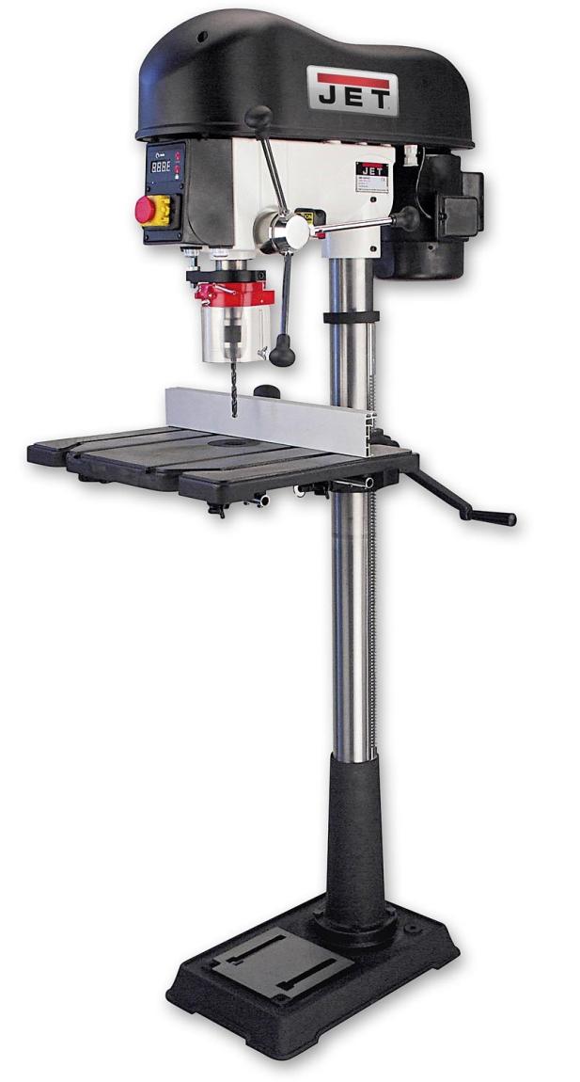
Describe two ways how function has been considered to design the pillar drill (2 marks)

Slide 17
Marketing
Market Niche- defines as the product features aimed at satisfying specific market needs, as well as the price range, production quality and the demographics that is intended to impact. It is also a small market segment.
Planned Obsolescence
Mobile Marketing
Product Placement
Viral Marketing
Mass Marketing, Brand Names
Seasonal Marketing
Celebrity Endorsement

