Slide 1
Product Design
Rapid Prototyping

Slide 2
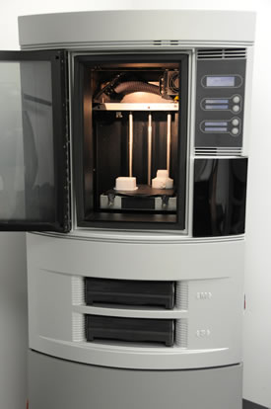
Rapid Prototyping
Rapid Prototyping is the
process of producing a 3D
model very quickly and
accurately from a 3D CAD
Model.
Complex forms can be
achieved and it is often
referred to as ‘Clean
Manufacturing’.

Slide 3
Rapid Prototyping
Generally there are three main types of rapid prototyping:
Systems which use liquid resins which are solidified by a laser such as Stereolithography and Selective Laser Sintering
Systems that melt and then fuse solid material such as Fused Deposition Modelling
Systems which use a binder to connect the primary material such as 3D Printing

Slide 4
Rapid Prototyping
Stereolithography
3D Printing
Fused Deposition Modelling (FDM)

Slide 5
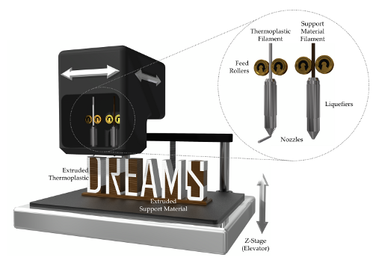
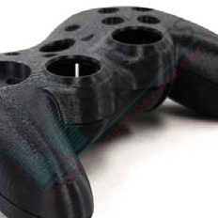
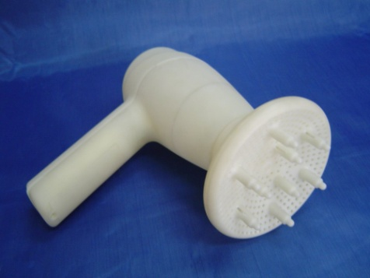
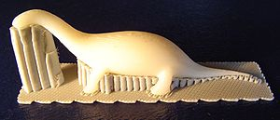
Rapid Prototyping
Fused Deposition Modelling (FDM)
ABS is fed through a heater, melted then extruded. The model is drawn one layer at a time. Each layer bonds to the layer beneath.

Slide 6
Rapid Prototyping
Advantages
Quick to produce 3D CAD model compared to traditional model making techniques.
Modifications to the design can be made easily and effectively
Complex shapes and forms can be achieved.
Prototypes can be produced using exact materials.
The designer can achieve full size and very accurate working models.

