Slide 1
Printing Terms
Commercial Printing

Slide 2
Exam Knowledge
Edge to Edge Printing
Bleed Area
Gutter
Registration Marks
Colour Calibration
Dots per Inch
Photo-reduction
Duplexing
Camera Ready Copy
Paper Weight
Paper Opacity
Use of Calendaring for glossy prints

Slide 3
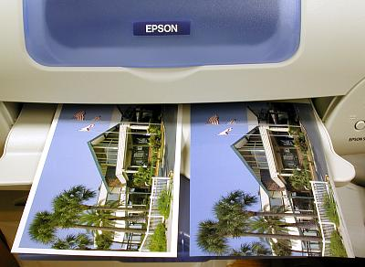
Edge to Edge Printing
Edge to edge printing is when the graphics extend to the physical edge of the paper on all edges.
Usually commercial printers will achieve an edge to edge look by cropping the paper to size after the print.
Off-set litho printing (the most common commercial method) requires printing on OS (oversized) paper which is then trimmed to size.
Modern inkjet printers now can print to the actual edge of the paper by over spraying the page.
This method however does waste ink.

Slide 4
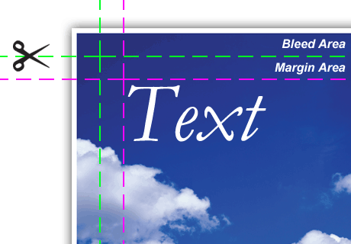
Bleed Area
If you want a graphic to reach the edge of the paper you need to extend the graphic outside the edge of the publication. This is known as a bleed.
Graphic designers usually add a bleed margin during the page set up and extend items by 3mm or 5mm to achieve a bleed.
The publication is printed on oversized (OS) paper to enable this additional bleed size. The paper is trimmed to size after printing.

Slide 5
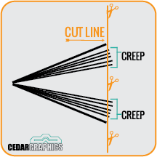
Gutter
The vertical space or alley space between columns of text is referred to as the gutter.
It also refers to the inside margins or blank space between two facing pages.
In this case the gutter space may need to be adjusted to allow for creep, the movement associated with some book binding methods.
Notes:
http://blog.mixbook.com/photo-book-layout-tip/
https://www.reddit.com/r/bookbinding/comments/45meyi/how_to_plan_for_creep_help_binding_printed_pages/

Slide 6
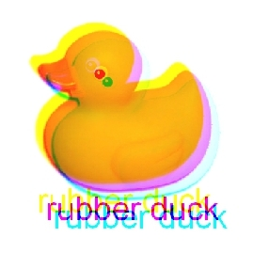
Registration Marks
When off-set litho printing with multiple plates for each individual colour (CMYK) precise alignment is needed to ensure each plate/colour is printed exactly on top of the others. This is called registration.
The registration marks are positioned in the margins of each page to help the printer operator to align the colours on the press properly.
They are trimmed off during cropping.

Slide 7
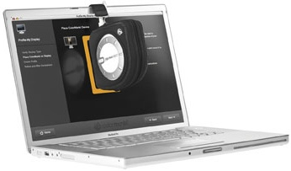
Colour Calibration
Colours will appear duller when printed than to what they look like on screen. This can cause issues for a designer who may unwittingly make his colours too bright or too warm.
In order to avoid this, the monitor should be calibrated to match the printer. A colour calibration device is set on the screen which reads the colours and brightness of the display and then adjusts the colour settings of the output to match a dataset of colour values.
Likewise it is important that a printer also bases it colours on the same dataset of colour values - so that both printer and screen match. The colour values of a printed sheet can be scanned and checked by a calibration device and then the printer colour data calibrated accordingly.
A colour data device.

Slide 8
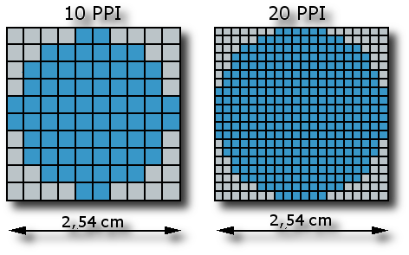
Dots per Inch (DPI)
Refers to the number of dots that can be printed within 1 inch. The higher the number of dots (resolution), the sharper and clearer the image.
For photos to appear crisp and sharp they need to have a resolution of around 300 dpi.
Many screens only output at around approx 100 pixels per inch (PPI) so images for screen can have a smaller file size.
Our school printer will print to a resolution of 300dpi.
DPI for Printing
PPI for Screens
Notes:
http://www.andrewdaceyphotography.com/articles/dpi/
http://www.fmedda.com/en/article/dpi_ppi

Slide 9
Photo Reduction
This refers to the compression of image files so that they are a smaller file size but with limited loss of quality.
This is useful for images for the web as it allows for quicker load times.
Photo editing programs reduce file size by removing meta data such as camera model, white balance and photo date and so on.
This could reduce a file from around 4MB to 1MB relatively easily.

Slide 10
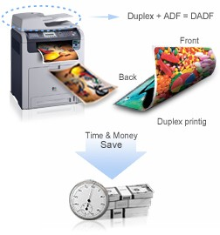
Duplexing
Put simply, it is when a printer can print on both sides of a sheet of paper. Duplexing is achieved when the printer catches the piece of paper after the first side has been printed on, then flips it, and prints again.
Environmental and Economical advantages.

Slide 11
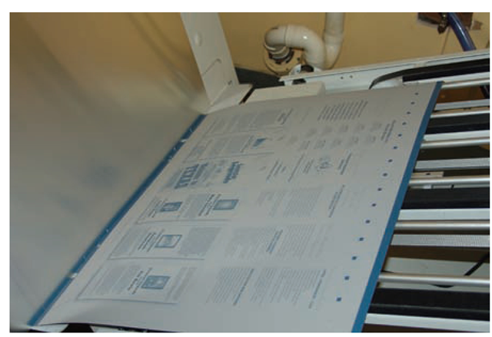
Camera Ready Copy
This is the final stage of a publication before it is printed. The document will have been exported as either a EPS file or a PDF file; it will be set for the correct colour scheme, and will be set to the correct size for printing without any need for scaling.
Fonts should be set to vector graphics, and any raster images should be at least 300 Dpi.

Slide 12
Paper
Paper weight
Paper is measured in GSM - “Grams per Square Metre”. Low quality sheets have a Low GSM value; such as the paper used in a photocopier (approx. 80 GSM). High quality paper has a higher value GSM; such as the paper used to print on Leaflets/flyers (approx. 130 GSM).

Slide 13
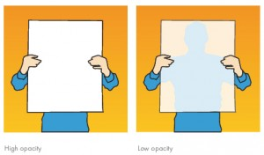
Paper
Paper opacity
Paper opacity describes how much light can pass through a piece of paper. Paper with High Opacity is good for duplex printing as not much light can pass through and you are unlikely to be able to see what’s been printed on the opposite side. Paper with Low Opacity allows light to pass through easily; for example Tracing Paper.

Slide 14
Paper
Use of calendaring for glossy print
Calendaring is the process of smoothing the surface of a piece of paper by pressing it between cylinders or rollers. This produces a very smooth, uniform surface on the paper, which then makes it suitable to have a gloss coating applied. The gloss coating requires a very smooth, flat surface rather than a rough, bumpy one.
Notes:
https://www.researchgate.net/publication/35171854_Coating_and_calendering_means_of_improving_surface_of_coated_paper_for_printing

