Slide 1
Manufacturing Processes
Rotational Moulding
Compression Moulding
Turning
Blow Moulding
Die Casting
Injection Moulding
Forging
Vacuum Forming
Press Forming
Extrusion
Laminating
Sand Casting

Slide 2
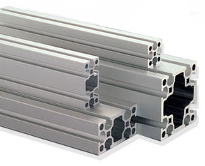
Process
Materials
Extrusion
Metal aluminium, copper brass or ThermoPlastic polythene, PVC

Slide 3
Process
Material
Compression Moulding
Thermosetting Plastic: melamine-formaldehyde

Slide 4
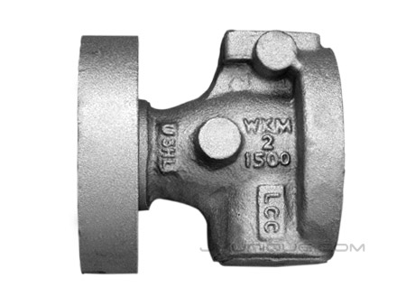
Process
Material
Sand Casting
Metals: Iron, aluminium.

Slide 5
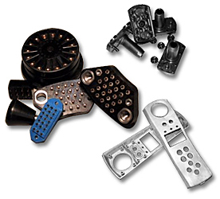
Process
Material
Injection Moulding
Thermoplastics: Polyprpelene, ABS

Slide 6
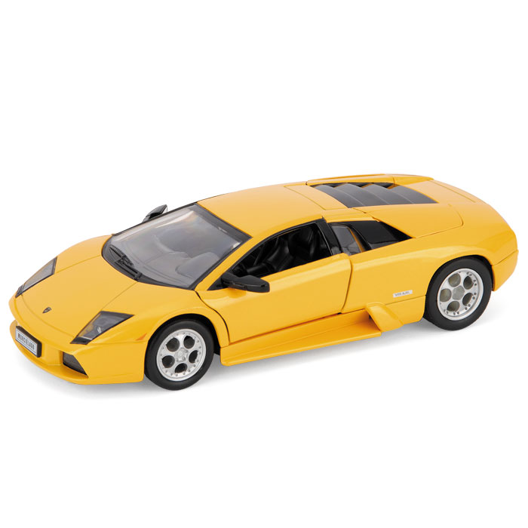
Process
Material
Die Casting
Metals: low melting temperatures, alloys, aluminum, zinc, brass.

Slide 7
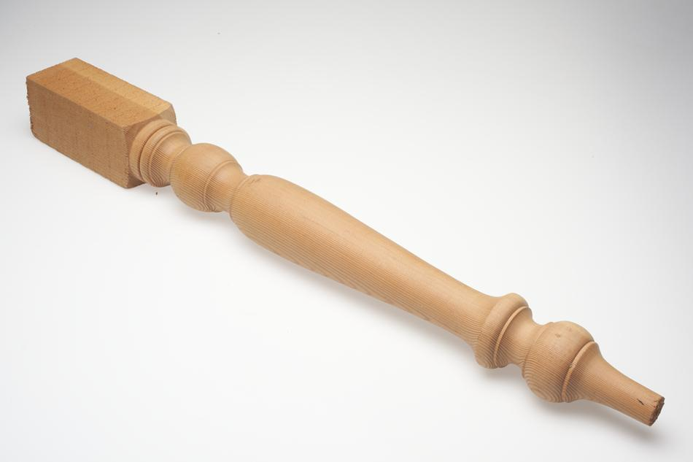
Process
Material
Turning
Wood or Metal

Slide 8
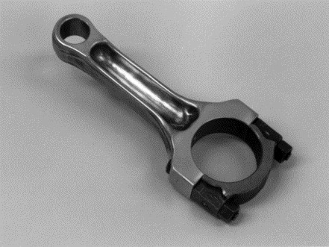
Process
Material
Drop Forging
Metal: Alloy Steels and copper alloys.

Slide 9
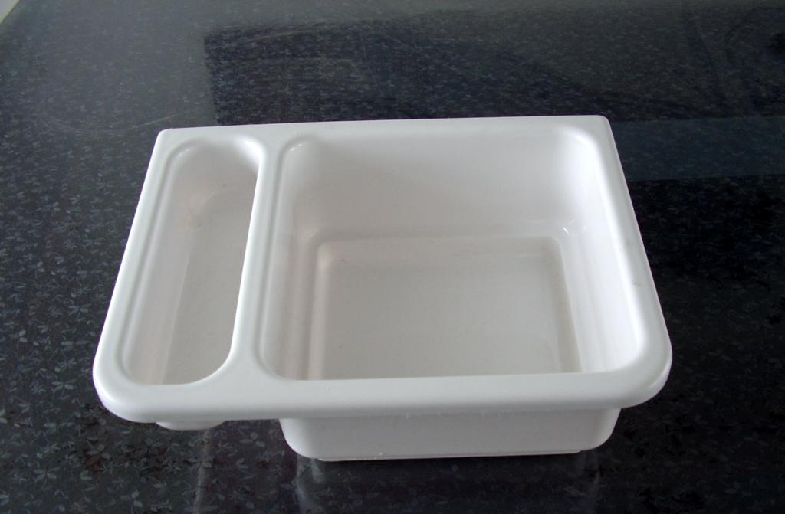
Process
Material
Vacuum Forming
ThermoPlastics: polythene, PVC, ABS, Acrylic

Slide 10
Process
Material
Rotational Moulding
ThermoPlastics: PVC, Polypropylene

Slide 11
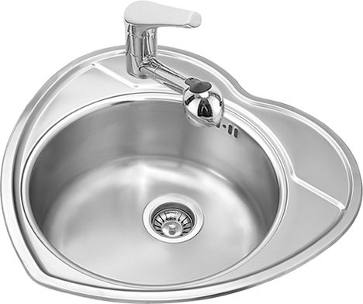
Process
Material
Press Forming
Sheet metal: steels, brass, copper, aluminium

