Slide 1
FEA

Slide 2
What is FEA?
FEA is determining how a solid body will respond to various forces
Finite Element Analysis (FEA) is a method of testing the strength and mechanical properties of a 3D CAD model.
It is the digital testing of products used to test all sorts of mechanical components from pipelines to controlled car crashes. It is also to referred to as Digital Prototyping and allows conceptual designs (new designs) the ability to be virtually tested before it’s built. Industrial designers, manufacturers, and engineers use Digital Prototyping to design, test, optimize, validate and visualise their products digitally throughout the product development process.

Slide 3
How does it work?
The computer is able to analyse and calculate areas of a structure and determine how strong or weak each area is. It then adds all these areas together to give an all over strength/weakness for a given component.
You Tube: Filter Press Stress Test: Finitie Element Analysis
M.W Watermark, LLC

Slide 4
Where is it used?
FEA is particularly suitable for:
• Structural/mechanical engineering design
• Product development
• Manufacturing processes
• Improving the efficiency of existing designs
• Failure analysis investigations.

Slide 5
What benefits does it provide?
It is possible to generate a simulation of any design concept and to determine its real world behaviour under almost any imaginable environments, therefore allowing the concept to be refined prior to the creation of drawings, when few dollars have been committed and changes are inexpensive.
Once a model has been developed the analysis helps in evaluating the feasibility of the new design as well as trouble shooting failed designs already in the market and finding solutions without the need to prototype and waste time and money.

Slide 6
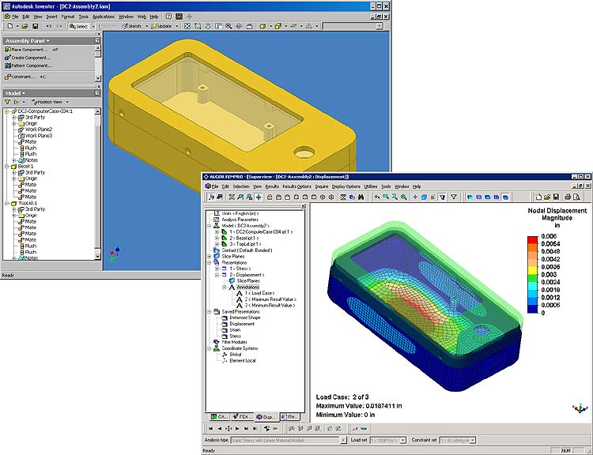

Slide 7
Digital Prototyping
Instead of needing to build multiple physical prototypes and then testing them to see if they’ll work, companies can conduct testing digitally throughout the process by using Digital Prototyping, reducing the number of physical prototypes needed to validate the design.
Using Digital Prototyping to catch design problems up front, manufacturers experience fewer changes downstream. Companies can also perform simulations in early stages of the product development cycle, so they avoid failure during testing or manufacturing phases.

