Slide 1
Electronic Components

Slide 2
Input Transducers
Input transducers are devices that convert a change in physical conditions (for example a thermistor, LDR, or variable resistor) into a change in resistance and/or voltage. This is then processed by a voltage divider circuit.
LDR

Slide 3
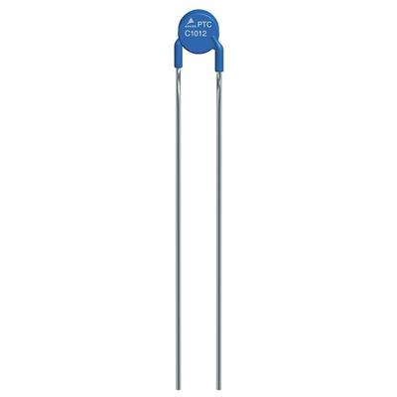
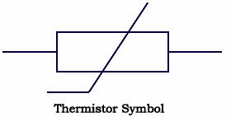
Thermistor
Measures temperature
Can measure heat or cold

Slide 4
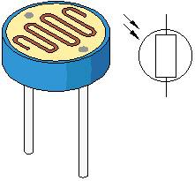
LDR
Measures light (photons)

Slide 5
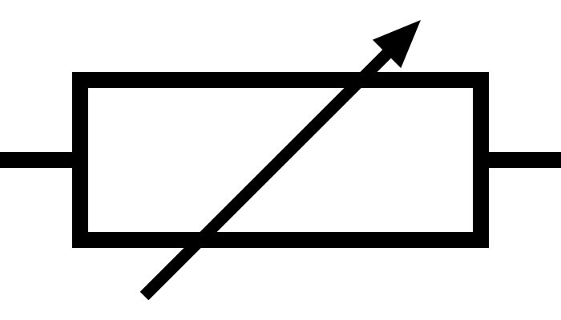
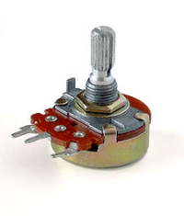
Variable resistor
Can change resistance (up to the maximum setting on the resistor)

Slide 6
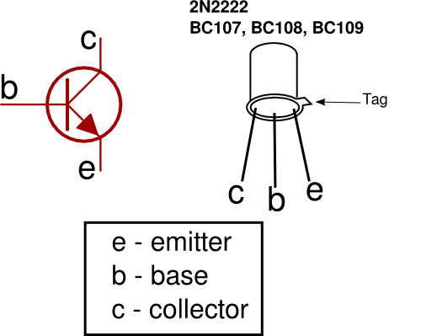
Transistor
Works as a switch or amplifier
Converts analogue
Signal at 0.7V to
ON FULLY

