Slide 1
Exam Revision
Lesson 1 - DTP

Slide 2
DTP Exam Knowledge
You must be able to identify the various DTP features within a magazine.
You must be able to give reason for colour choice.
You must be able to justify the page layout i.e Balance, Alignment, Contrast.
Be aware of the advantages and disadvantages of the use of DTP
The environmental effects of DTP

Slide 3
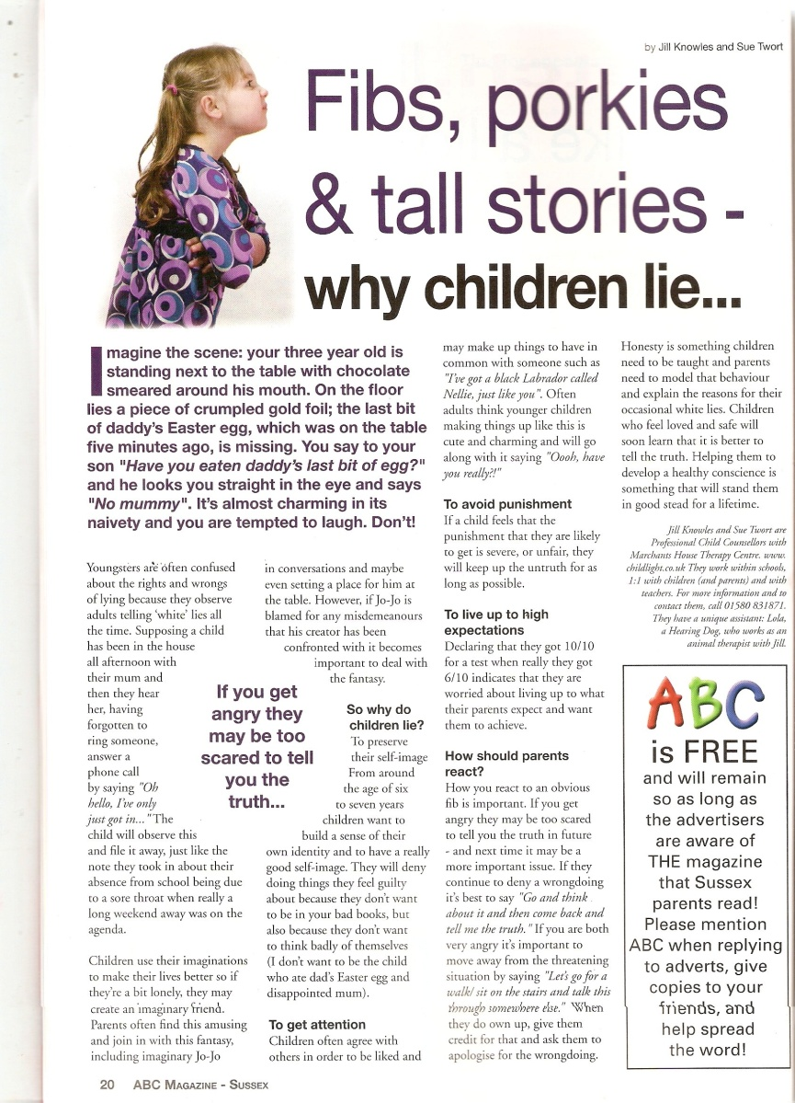
DTP Features

Slide 4
DTP Features
Header
Footer
Drop Cap
Text Wrap
Pull QUOTE
Image
Sub-Heading
Gutter
Margin
Folio

Slide 5
DTP Features
Orientation
Grid Sturcture

Slide 6
DTP-Use of Colour
Why is there a lack of colour on the page?
What is the purpose of adding colour to ABC?

Slide 7
DTP-Use of Colour
Why is there a lack of colour on the page?
Serious article, it is informative, not to detract from the information at hand.
What is the purpose of adding colour to ABC?
To identify a different topic. Childish colours have been used as it is about children. To make that area stand out.

Slide 8
DTP- Principles
Balance
Alignment
Contrast

