Slide 1
CNC/ CAM
Computer Numeric Control/
Computer Aided Manufacture

Slide 2
CNC/CAM
Often in industry products will be made with the use of computers.
In order to understand how a product is made you need to know about the processes used to make them.

Slide 3
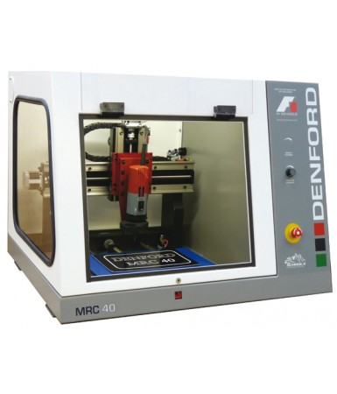
CNC/CAM
CNC (Computer Numeric Control) uses a CAD package design to cut away material from a block of wood.
This is very different to Rapid Prototyping.

Slide 4
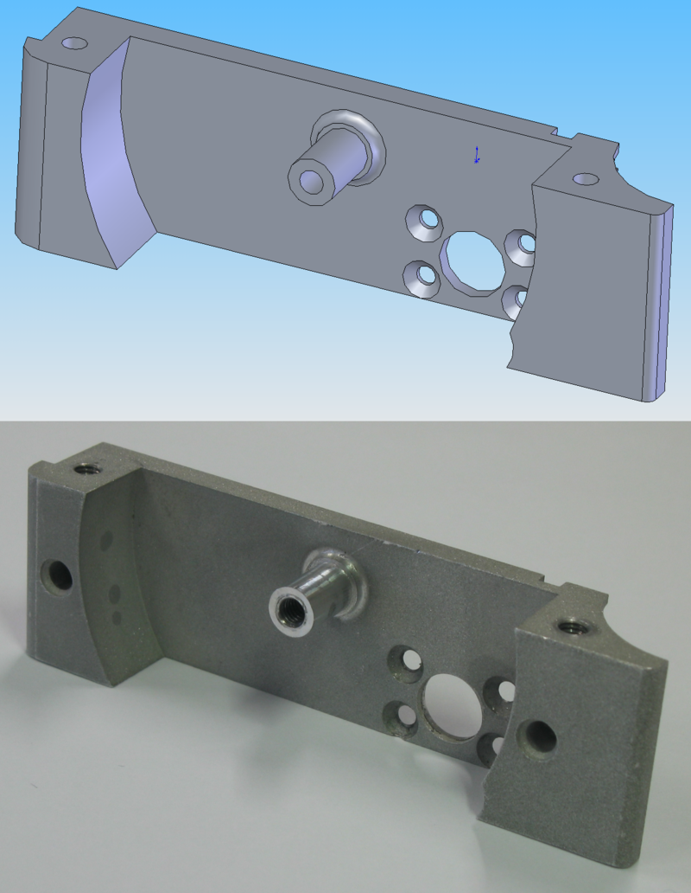
CNC/CAM
CAM or Computer Aided Manufacture describes how a computer can be used to aid the making of a product.
On the right you can see a CAD drawing then a CNC machined part below.

Slide 5
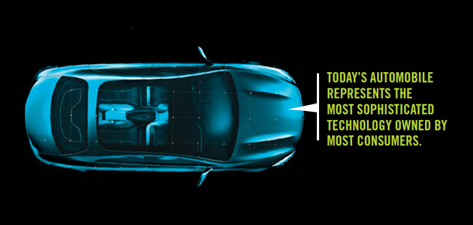
Computer Integrated Manufacture
CIM implies that there are at least two computers exchanging information, e.g. the controller of an arm robot and a micro-controller of a CNC machine.

Slide 6
CIM
Some factors involved when considering a CIM implementation are the production volume, the experience of the company or personnel to make the integration, the level of the integration into the product itself and the integration of the production processes. CIM is most useful where a high level of ICT is used in the company or facility, such as CAD/CAM systems, the availability of process planning and its data.

Slide 7
Cobots- Collaborative Robots

Slide 8
Advantages to CNC/CAM
Timescale massively reduced once the computers/robots are up and running (cars produced in hours instead of days/months).
Cost reduced on labour of manual workers.
Easy modifications made on CAD modelling before mass production.

Slide 9
Disadvantages to CNC/CAM
Initial set up cost-machines are expensive to buy.
Initial cost of buying land to set up machinery.
Initial cost of training staff to be skilled in the use of the equipment.
Cost of maintenance of machines.
Cost of updating software.

Slide 10
CNC/CAD
In order to make a CNC model first you need to use a CAD program to create a CAD model.
Depending on the type of CNC available will determine the type of model required to be produced (and vice versa).
Most engineering companies use a CAD package similar to Inventor.

Slide 11
Inventor Modelling
You are going to create a basic block Inventor with a two dimensional design similar to the one shown then will convert it to the CNC machine to cut out on a piece of MDF.
Work in pairs to create a model like the one shown to send.

Slide 12
Inventor Model
Create a two point rectangle (L)330 x (W)78)
Extrude it 18mm
Sketch on the top surface
Click on the T for Text and write your name or saying.
Finish the sketch and then extrude and cut it out.
Save the file
Open a dwg file
Use the Base button to insert your picture.
Save a copy as a DXF file
You are now ready to use the CNC.

