Slide 1
Animation

Slide 2
Types of Animation
For the exam you must have knowledge and understanding of:
The creation of animated graphics making use of:
Motion Capture
Stop frame (Stop Motion)
Motion Tweening
You must be able to discuss the advantages/Disadvantages of each of these types of Animation and make a decision as why to choose each one.

Slide 3
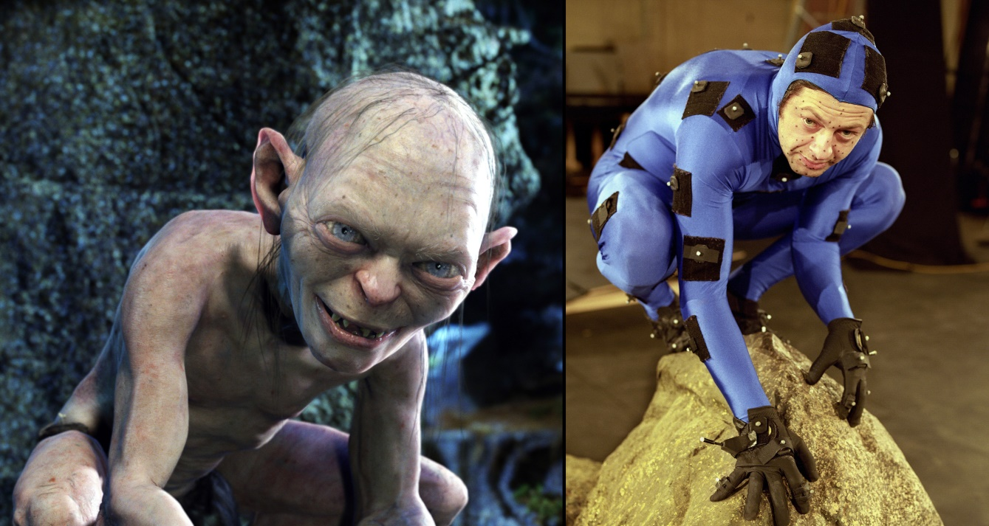
Motion Capture
Motion capture (Mo-cap for short) is the process of recording the movement of objects or people. It is used in military, entertainment, sports, medical applications, and for validation of computer vision and robotics.

Slide 4
Motion Capture
Complex and expensive process that requires specialist software and equipment. Video
Can only recreate human abilities (restricted)
Huge amount of data created that needs to be processed
very realistic

Slide 5
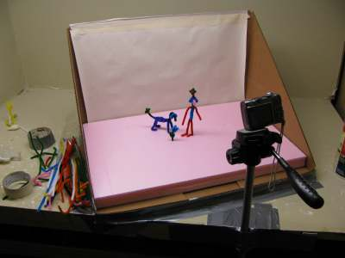
Stop Frame
Stop Frame (also known as stop motion) is an animation technique to make a physically manipulated object or persona appear to move on its own. The object is moved in small increments between individually photographed frames, creating the illusion of movement when the series of frames is played as a continuous sequence.

Slide 6
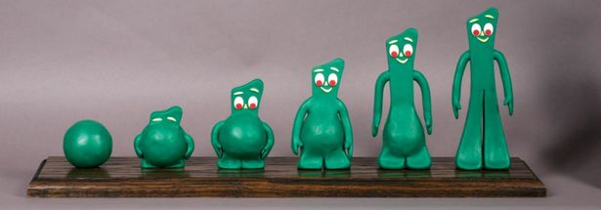
Stop Frame
simple process, achievable by everyone.
Video 1
Video 2
widely available, easy-to-use software
low cost of hardware
very time consuming for longer animations
limited by quality of model and accuracy of movement

Slide 7
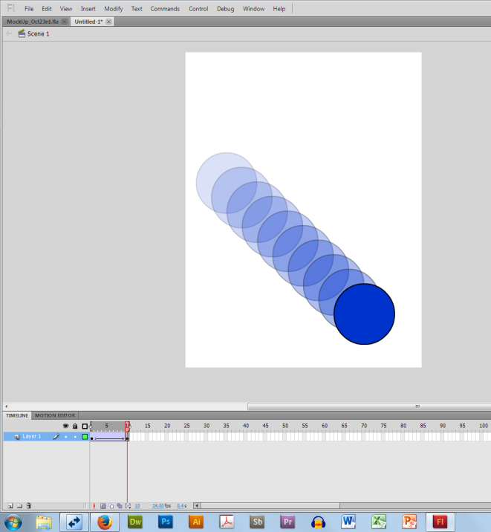
Motion Tweening
Motion tweens are a very common way to create movement with Flash because Flash does most of the work, making things easy for you. Motion tweens can also help minimize file size, particularly over frame-by-frame animation, since you have fewer assets in your documents.

Slide 8
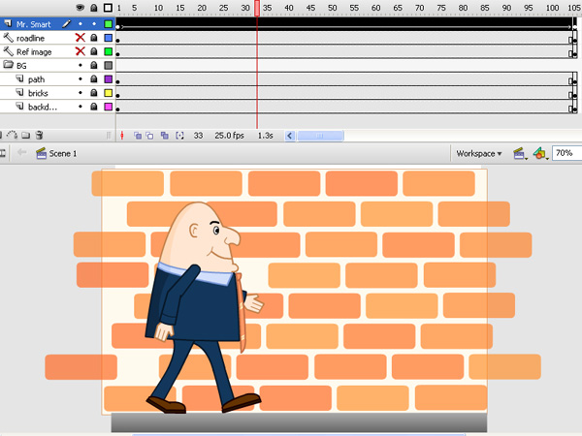
Motion Tweening
expense of software Video
complex plotting path of movement
can animate a number of frames very quickly

Slide 9
Exam
“We need to generate character movements for the new Street Fighter game. Each controlled character movement such as jump, punch, kick and character special move will have a 1-5 seconds animation. We want these movements to be as realistic as possible and expense will not be an issue.”
Identify which type of animation would best suit this situation. Make reference to the other types of animation you are aware of and justify why that type of animation is not suited for this situation.
10 Marks

